Slide 1
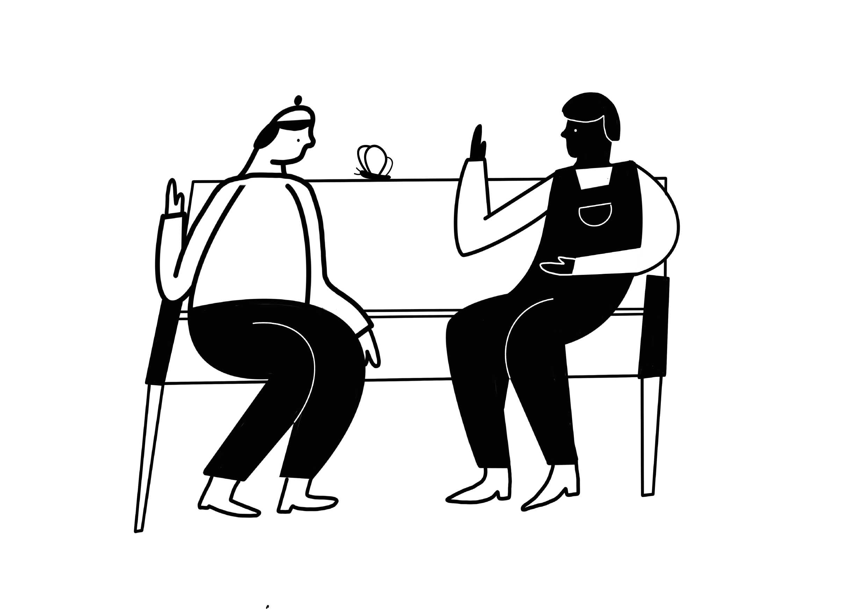
Tackling gender based violence globally by creating
intersectional & open survivor-led resources
on the web.
CHAYN
chayn.co
Guides
Platforms
Digital services
Notes:
Hello! Thank you for the kind introduction – and also for inviting me to speak on tech-based trauma and mental health support for survivors of abuse.
As you heard, I’m Alyson, and I’m Chayn’s Programme Lead for our Bloom project. Our CEO and Founder Hera is also here to speak during the discussion portion of our panel, and I’m sure she will likely expand on just what Chayn is about. But, as a quick introduction to what we do, Chayn is a survivor-centred organisation and global volunteer network that started in 2013. Chayn aims to tackle gender-based violence and abuse by creating intersectional and survivor-led resources online. We our innovative, as we meet with our survivors and communities where they’re at, rather than putting the burden on them to match us. Our focus is to be accessible in our language, practices, service, outreach, and care.

Slide 2
“I wish I had read it ten years ago. It has better advice in it than I have been ever given by any solicitor or the police about collecting evidence.”
“I feel like someone is really speaking to me… every single line is making me feel better.”
“This is the first time anyone's been able to shed any light at all on this (online safety) - usual authorities seem to be clueless…”

Slide 3
survivors of abuse
Empowering women and non-binary people with actionable guides and digital services that allow women, in abusive relationships, to take back control of their lives.
community
cash-stripped front-line services
Produce information & tech tools that help front-line services to work more effectively and support more people facing abuse.

Slide 4
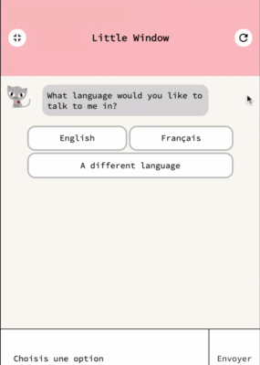
CHAYN
Guides
Bloom: remote trauma support
Digital services
How to build your own domestic violence case without a lawyer
Do It Yourself Online Safety And more!
Soul Medicine: micro-course delivered safely
Little Window:
A resource search
chatbot
YSM: curated resources for survivors of sexual assault

Slide 5
impact
400 000
2013-2020
people reached across the globe
1.2 million
page views of our content
United Kingdom
United States
India
Pakistan
Italy
Canada
Australia
Spain
UAE
Brazil
Portugal
Afghanistan
Iran
Egypt
Iraq
Syria
France
Russia
Germany
Netherlands
Chile

Slide 6
DESIGN FOR
Agency
Hope
Empathy
Solidarity
Trust

Slide 7
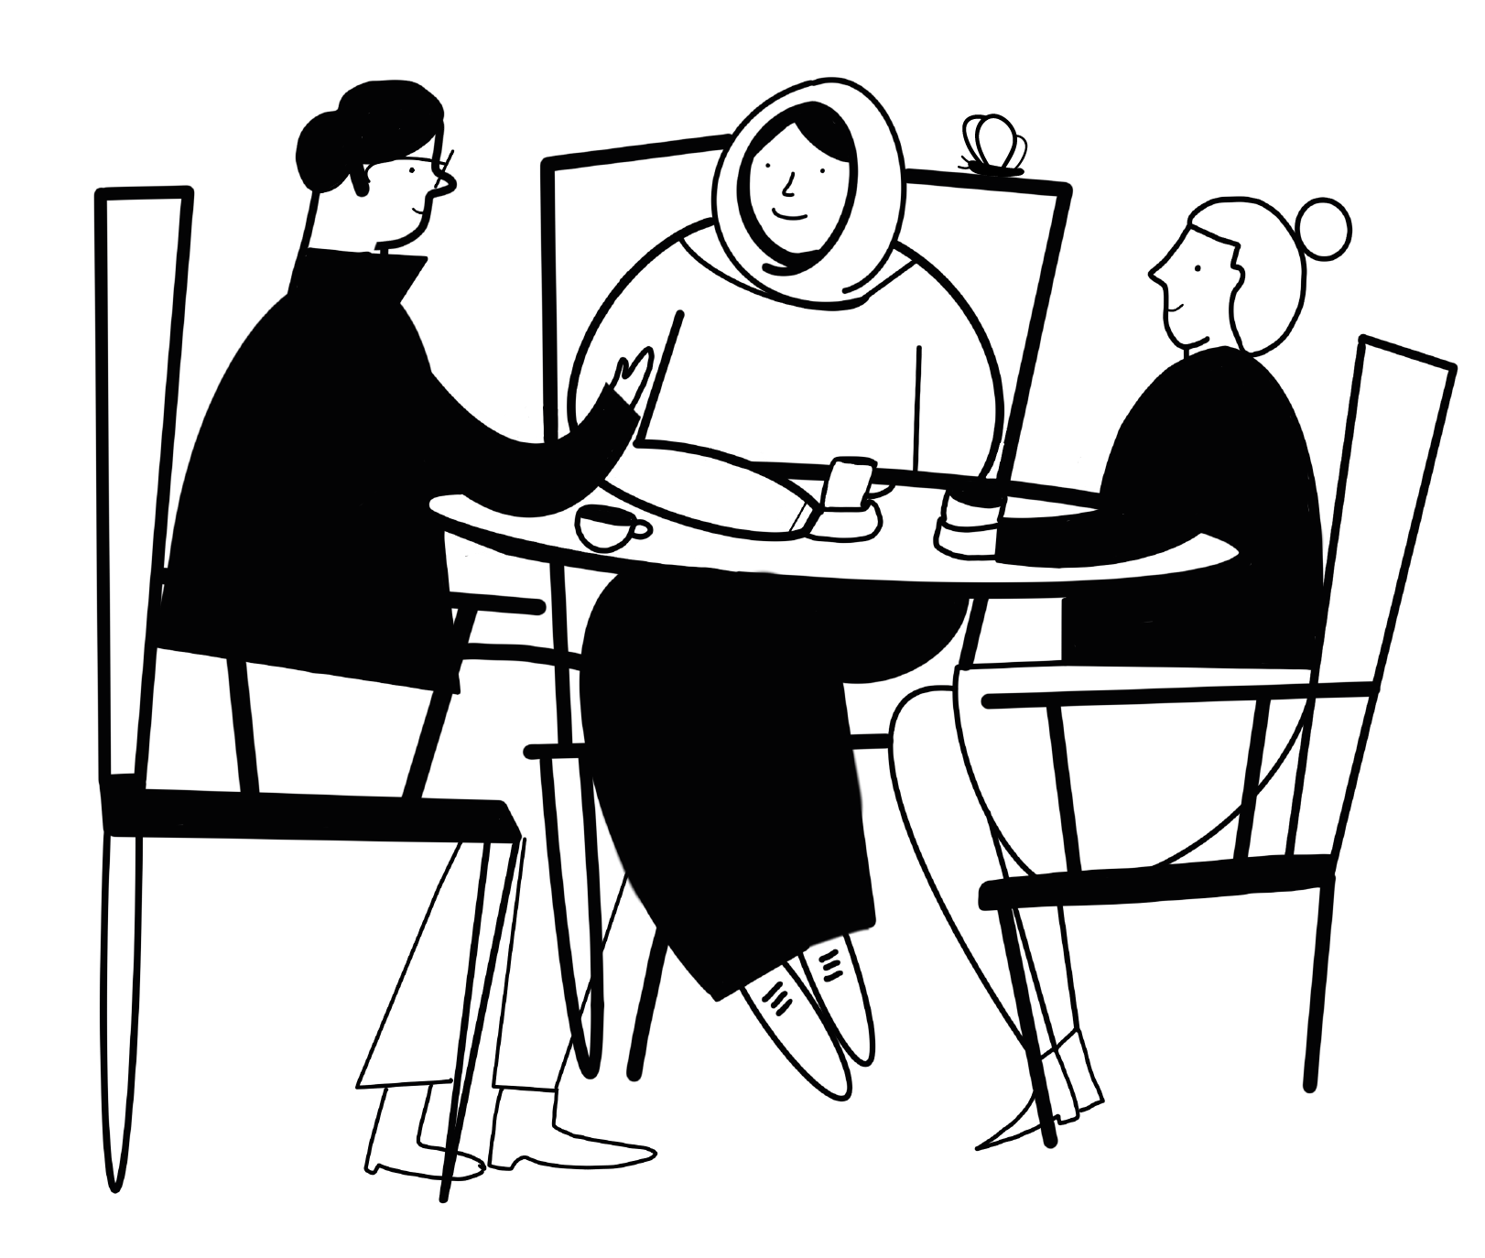
SURVIVOR-LED DESIGN
Embeds diverse views, values and experiences at each stage of the project
Builds leadership skills that volunteers and survivors can use in the long-term
Empowers survivors in the process of creation

Slide 8
guides
“I wish I had read it ten years ago. It has better advice in it than I have been ever given by any solicitor or the police about collecting evidence.”
How to build your own domestic violence case
without a lawyer
Do It Yourself Online Safety
Spotting abuse & manipulation in relationships
How to be a good friend
Getting better & moving on - mental wellbeing
Notes:
Heading changed

Slide 9
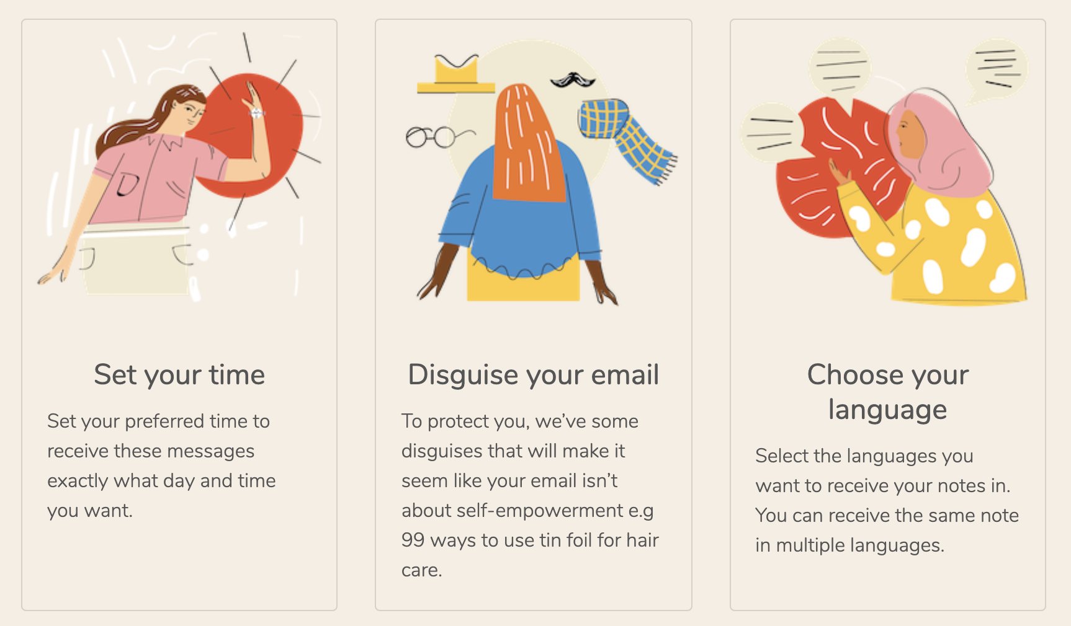
Soul Medicine
soulmedicine.io
A platform provides micro-courses on key topics that help survivors on the path to recovery. Funded by Comic Relief.

Slide 10
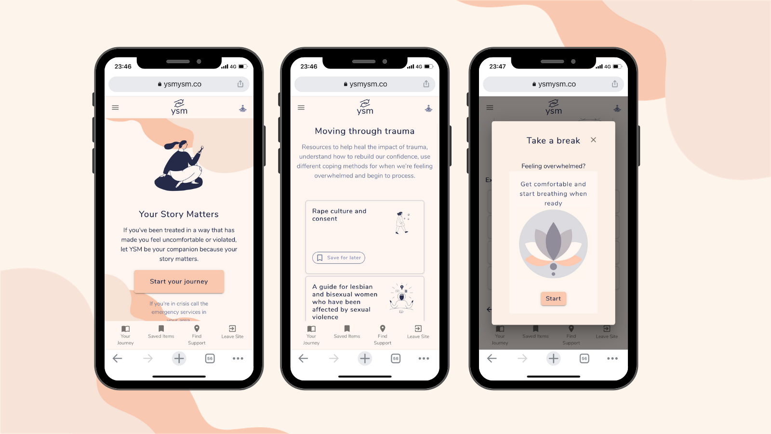
YSM

Slide 11
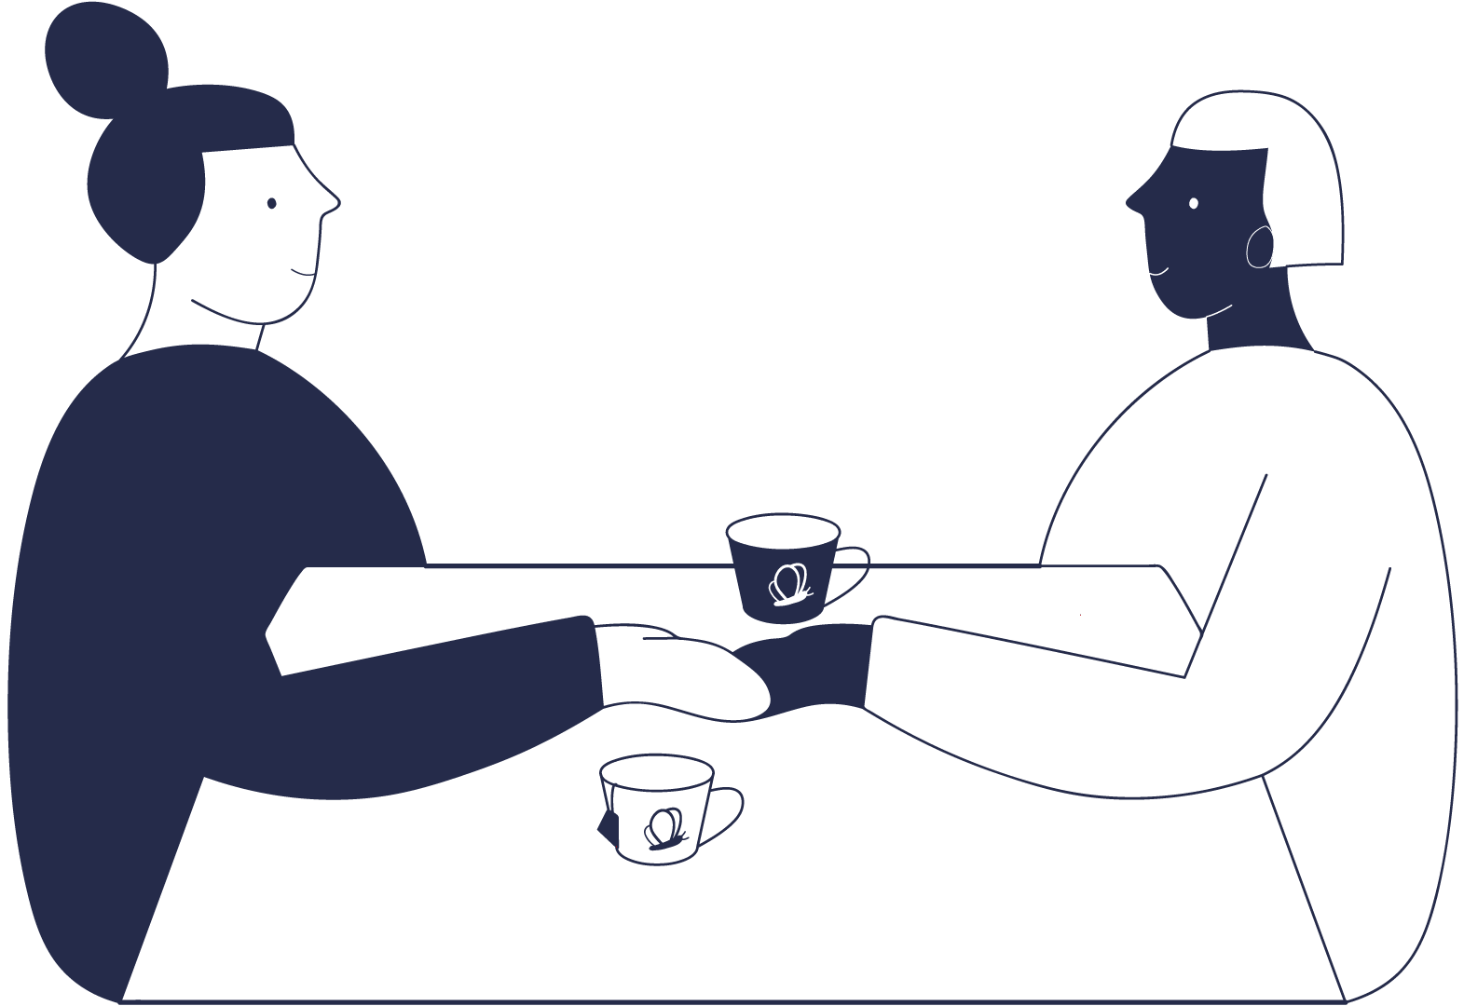
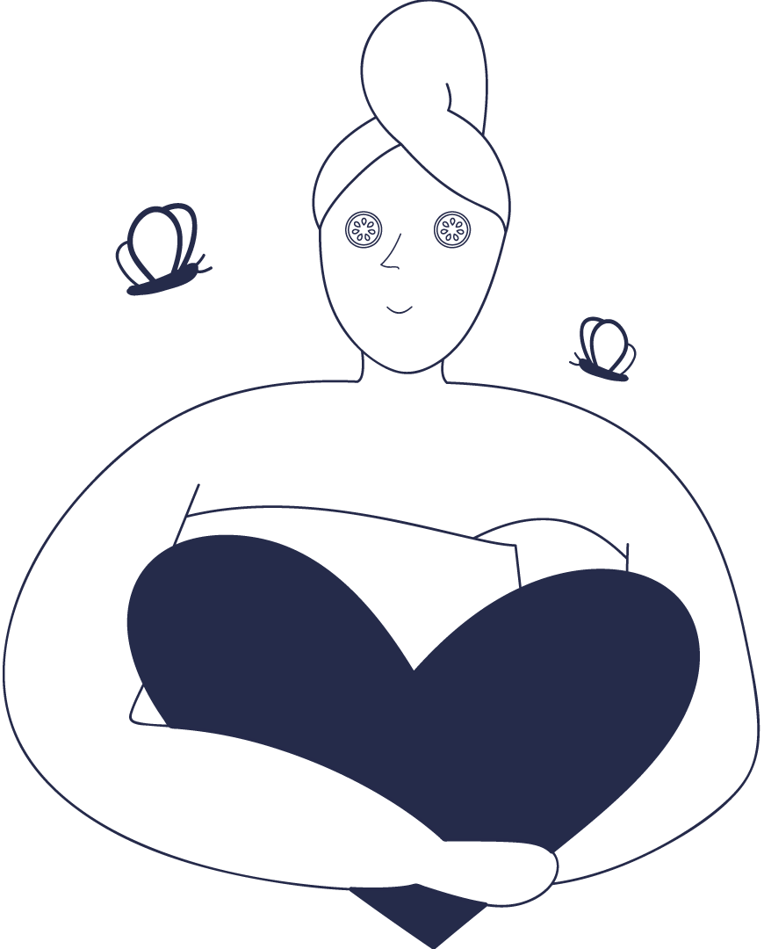
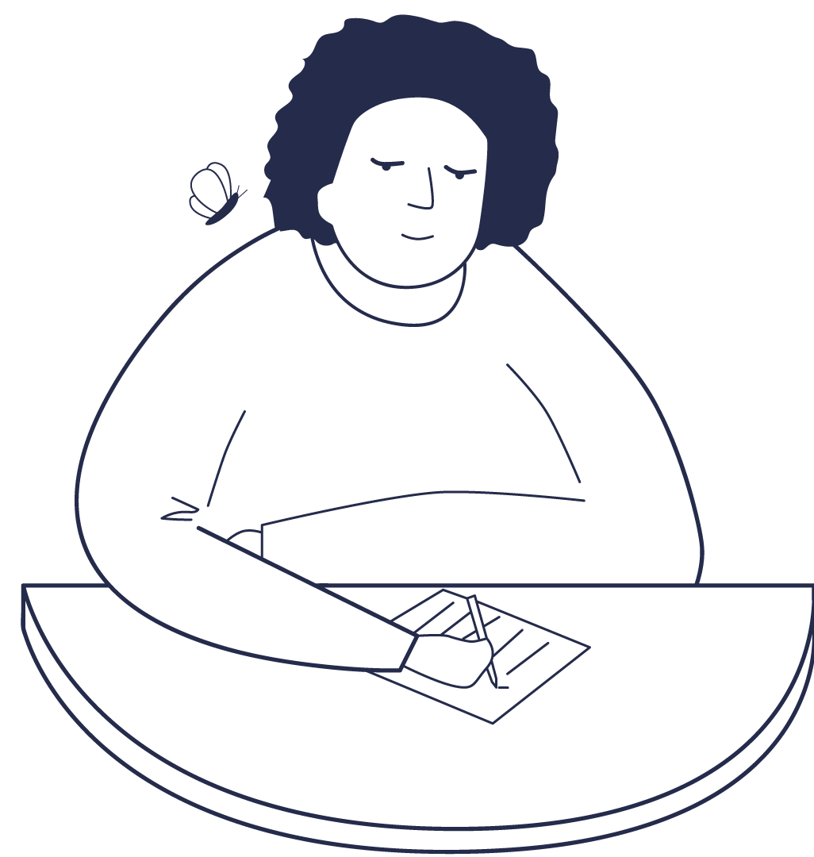
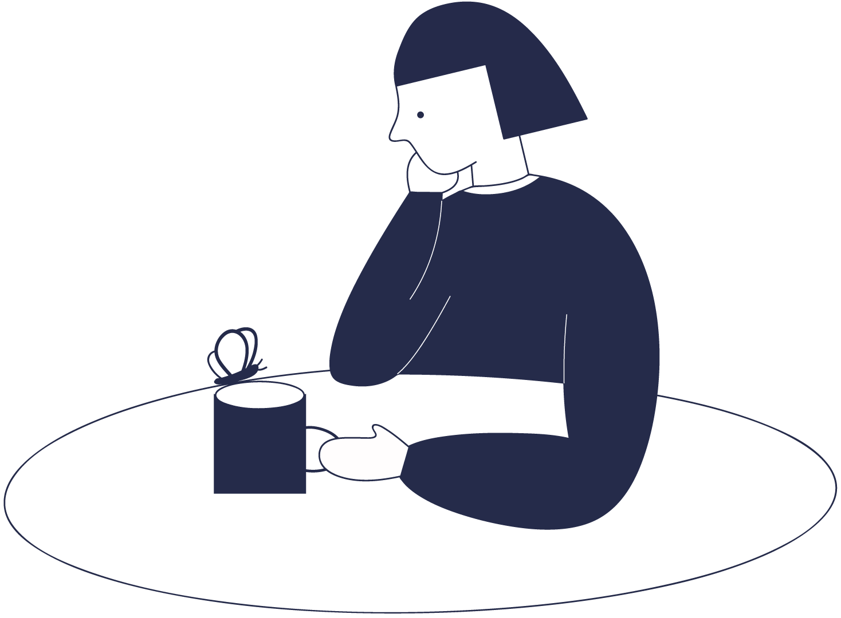
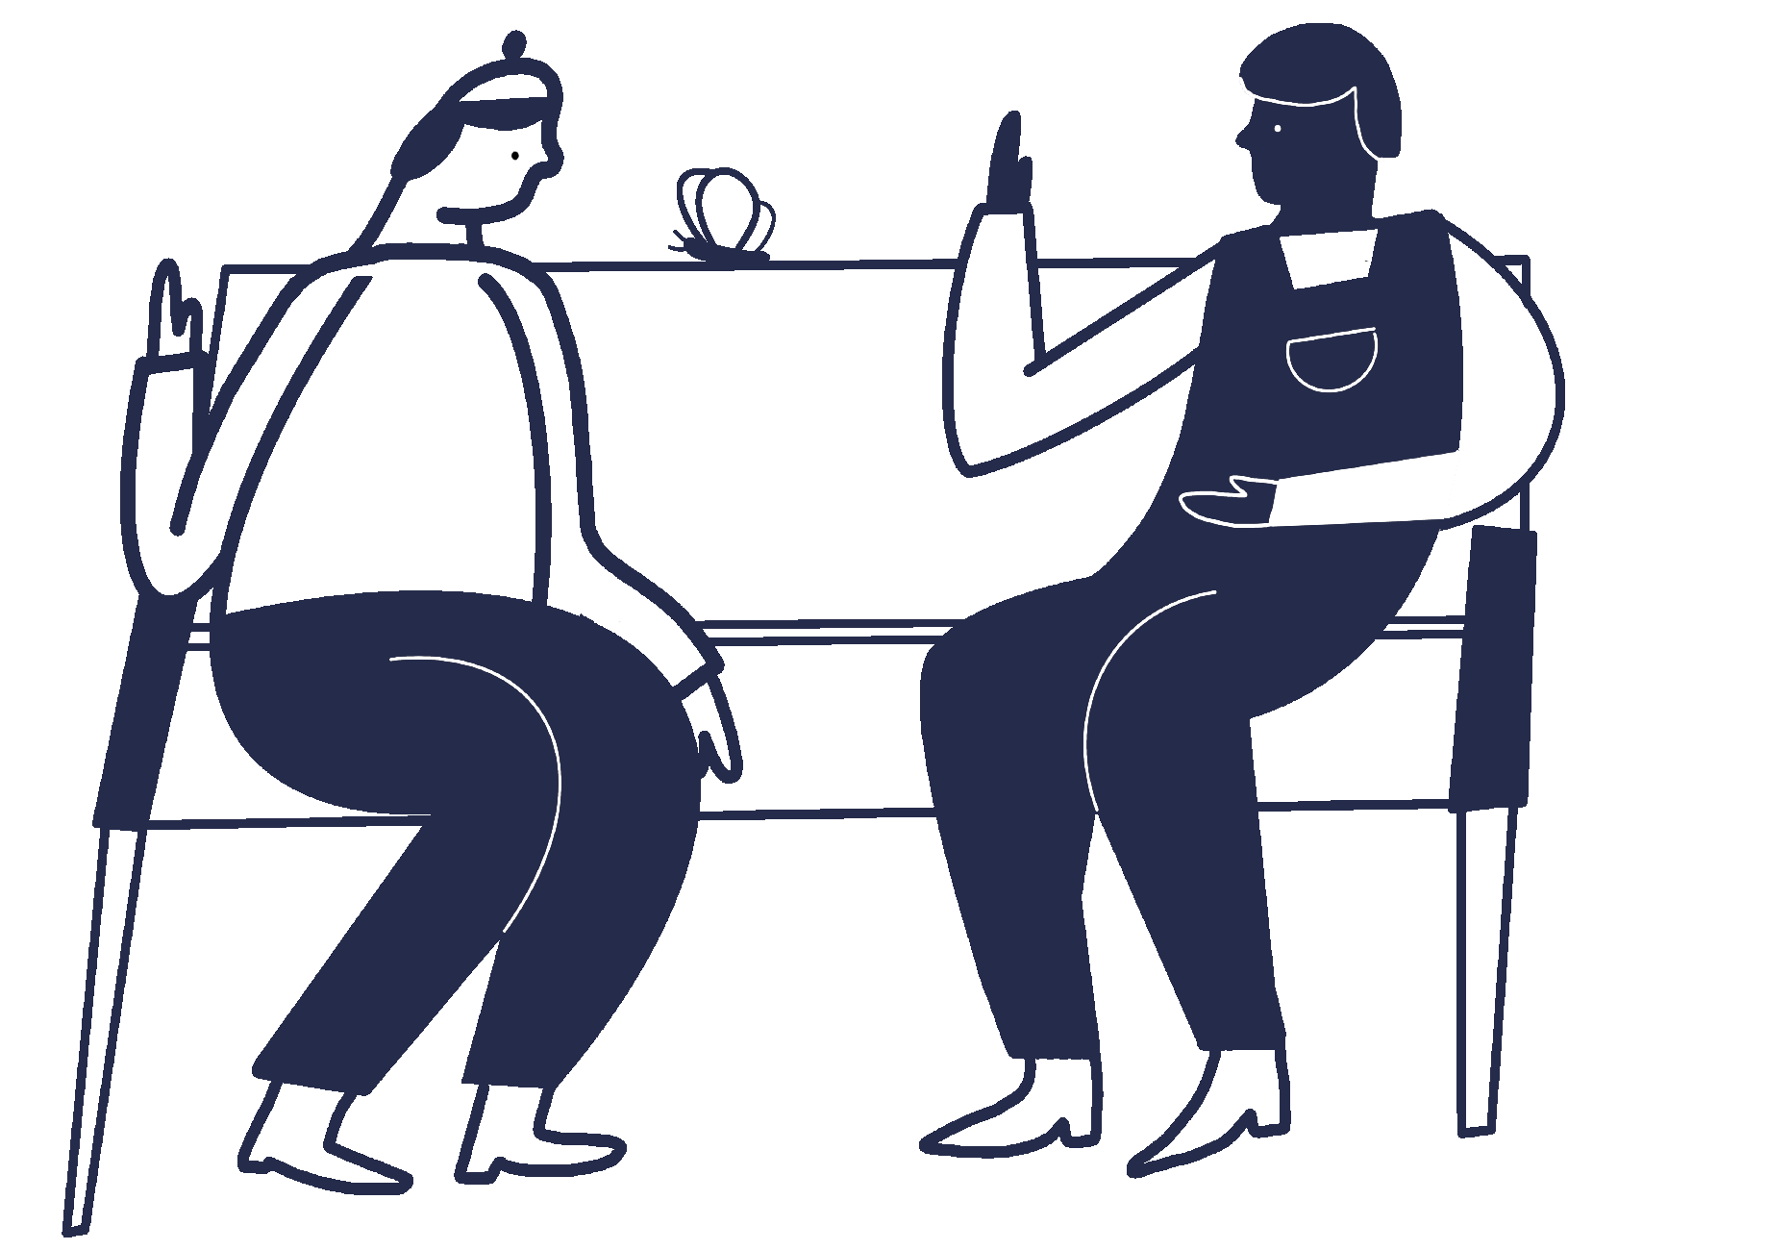
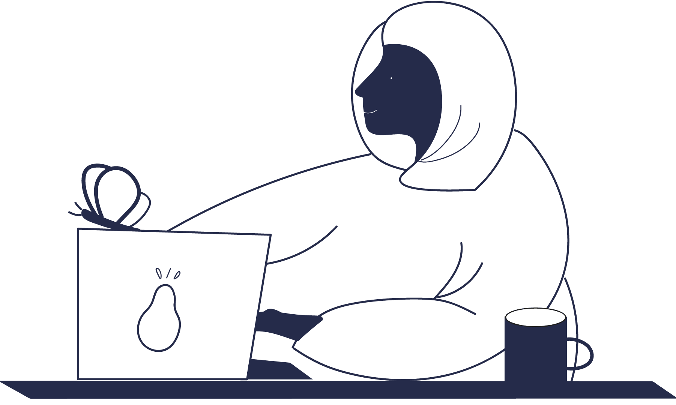
How can YSM help on our journey to recovery?
Telling someone about what happened
Taking care of your body after assault
Building your own timeline
Deciding to report or not
Rape culture & consent
Bloom

Slide 12
In 2020
Course delivered via Telegram and WhatsApp
Target audience: 300 survivors
600 participants
1400 bookings
Courses
Creating Boundaries
Healing from Sexual Trauma
Managing Anxiety
Recovering from Toxic and Abusive Relationships
Reclaiming Resilience in Your
Trauma Story
bloom.chayn.co
Notes:
Background here: I want to talk a bit about the initial process and story of how this project came together – then I will be moving on to our timeline, methodology, data collection, and distribution of tools.
Bloom originally began as Chayn’s Trauma Resilience Group - or ‘Notes From Chayn’ - as we adapted a therapy group our organisation planned to run in-person to into online medium at the start of COVID-19 lockdowns.
With social-distancing, quarantines, and border closings, life can feel frightening and uncertain. This was especially true for anyone living in an abusive household or working on recovering from trauma. Being forced to stay home with an abuser for long amounts of time can be a harrowing, as survivors well know. And stress of any kind can act as a trigger for violence and coercion, putting survivors at an even greater risk when trapped inside with abusive people.
People still healing from abuse or sexual trauma were also often not be able to go to their trauma-group or therapy right now. We wanted to provide them with coping mechanisms for that first shutdown.
Team of 4. This pilot ran from March to June 2020. 10 Weeks. At the time, we [ ] served 100 people from around the world… [etc. more on the story of the programme.] But we had to cover ALL possible issues. Bloom allowed us to funnel, etc. Focus.
Funding - What are the funding type(s)?, What is the approximate duration of grants?
Summer pilot - donations from passionate individuals
→ Bloom: The National Lottery Community Fund - 35k for 6 months

Slide 13
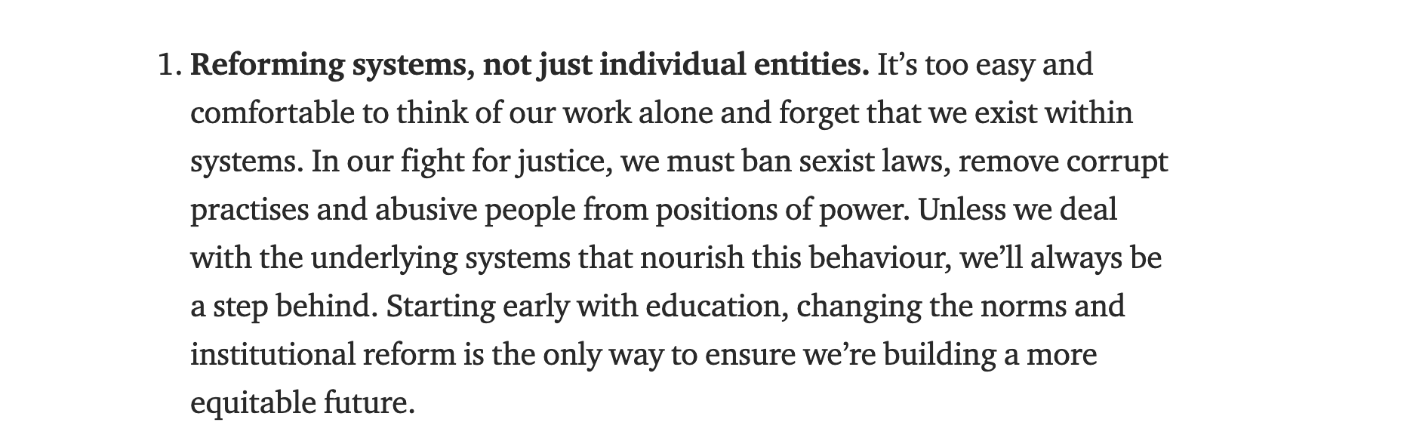
Fighting GBV together
Creating better ecosystems

Slide 14
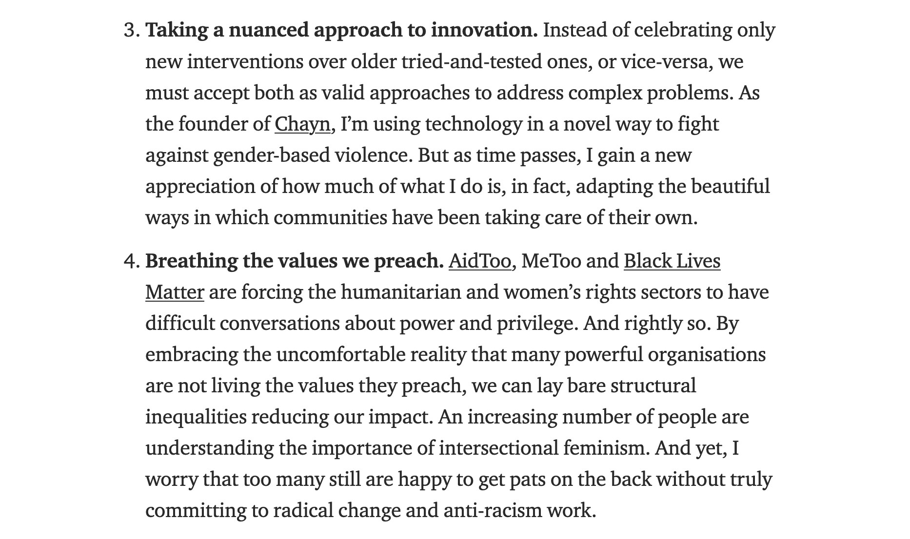
Working in the open creates accountability and innovation

Slide 15
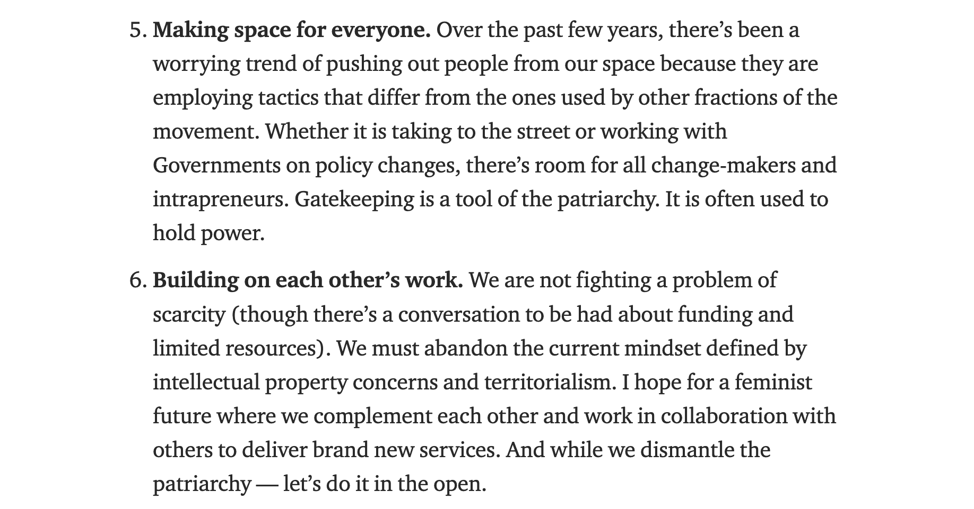
Working in the open creates accountability and innovation

Slide 16
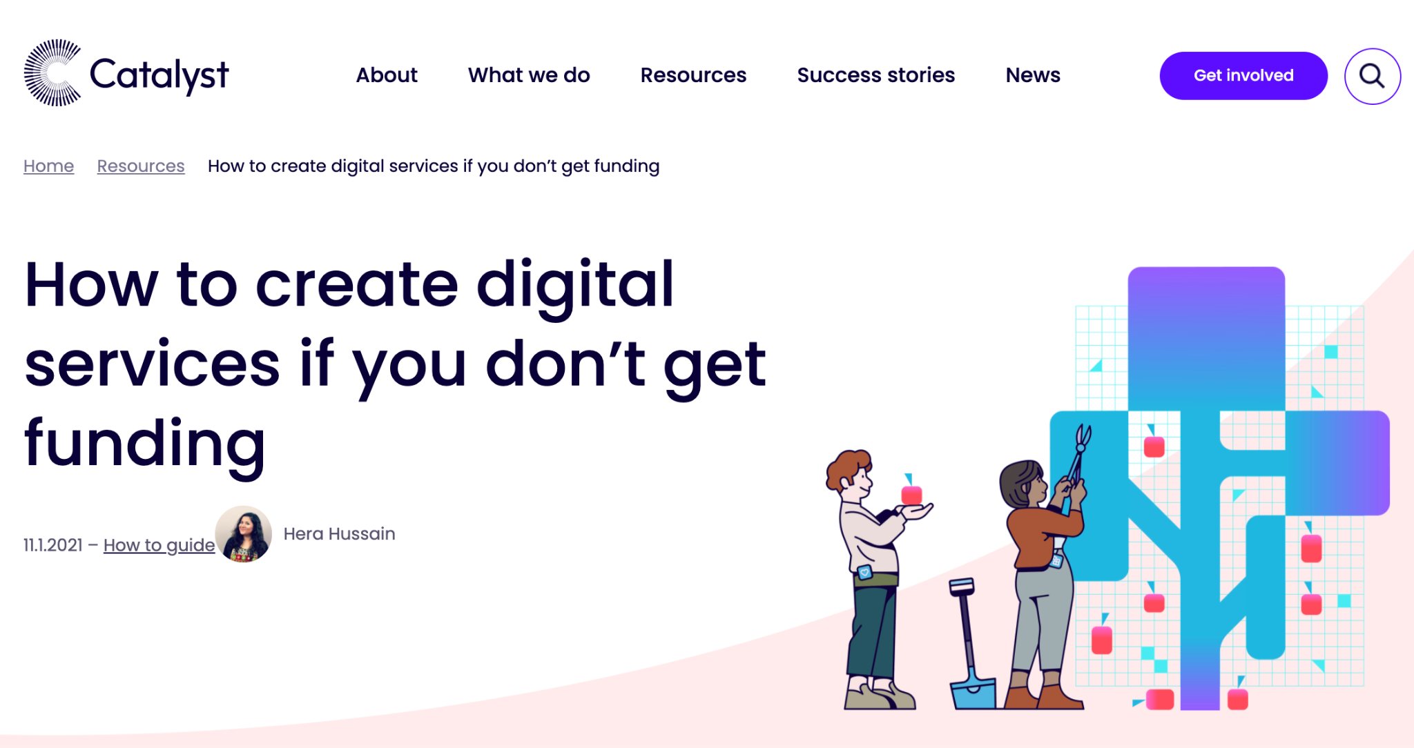

Slide 17
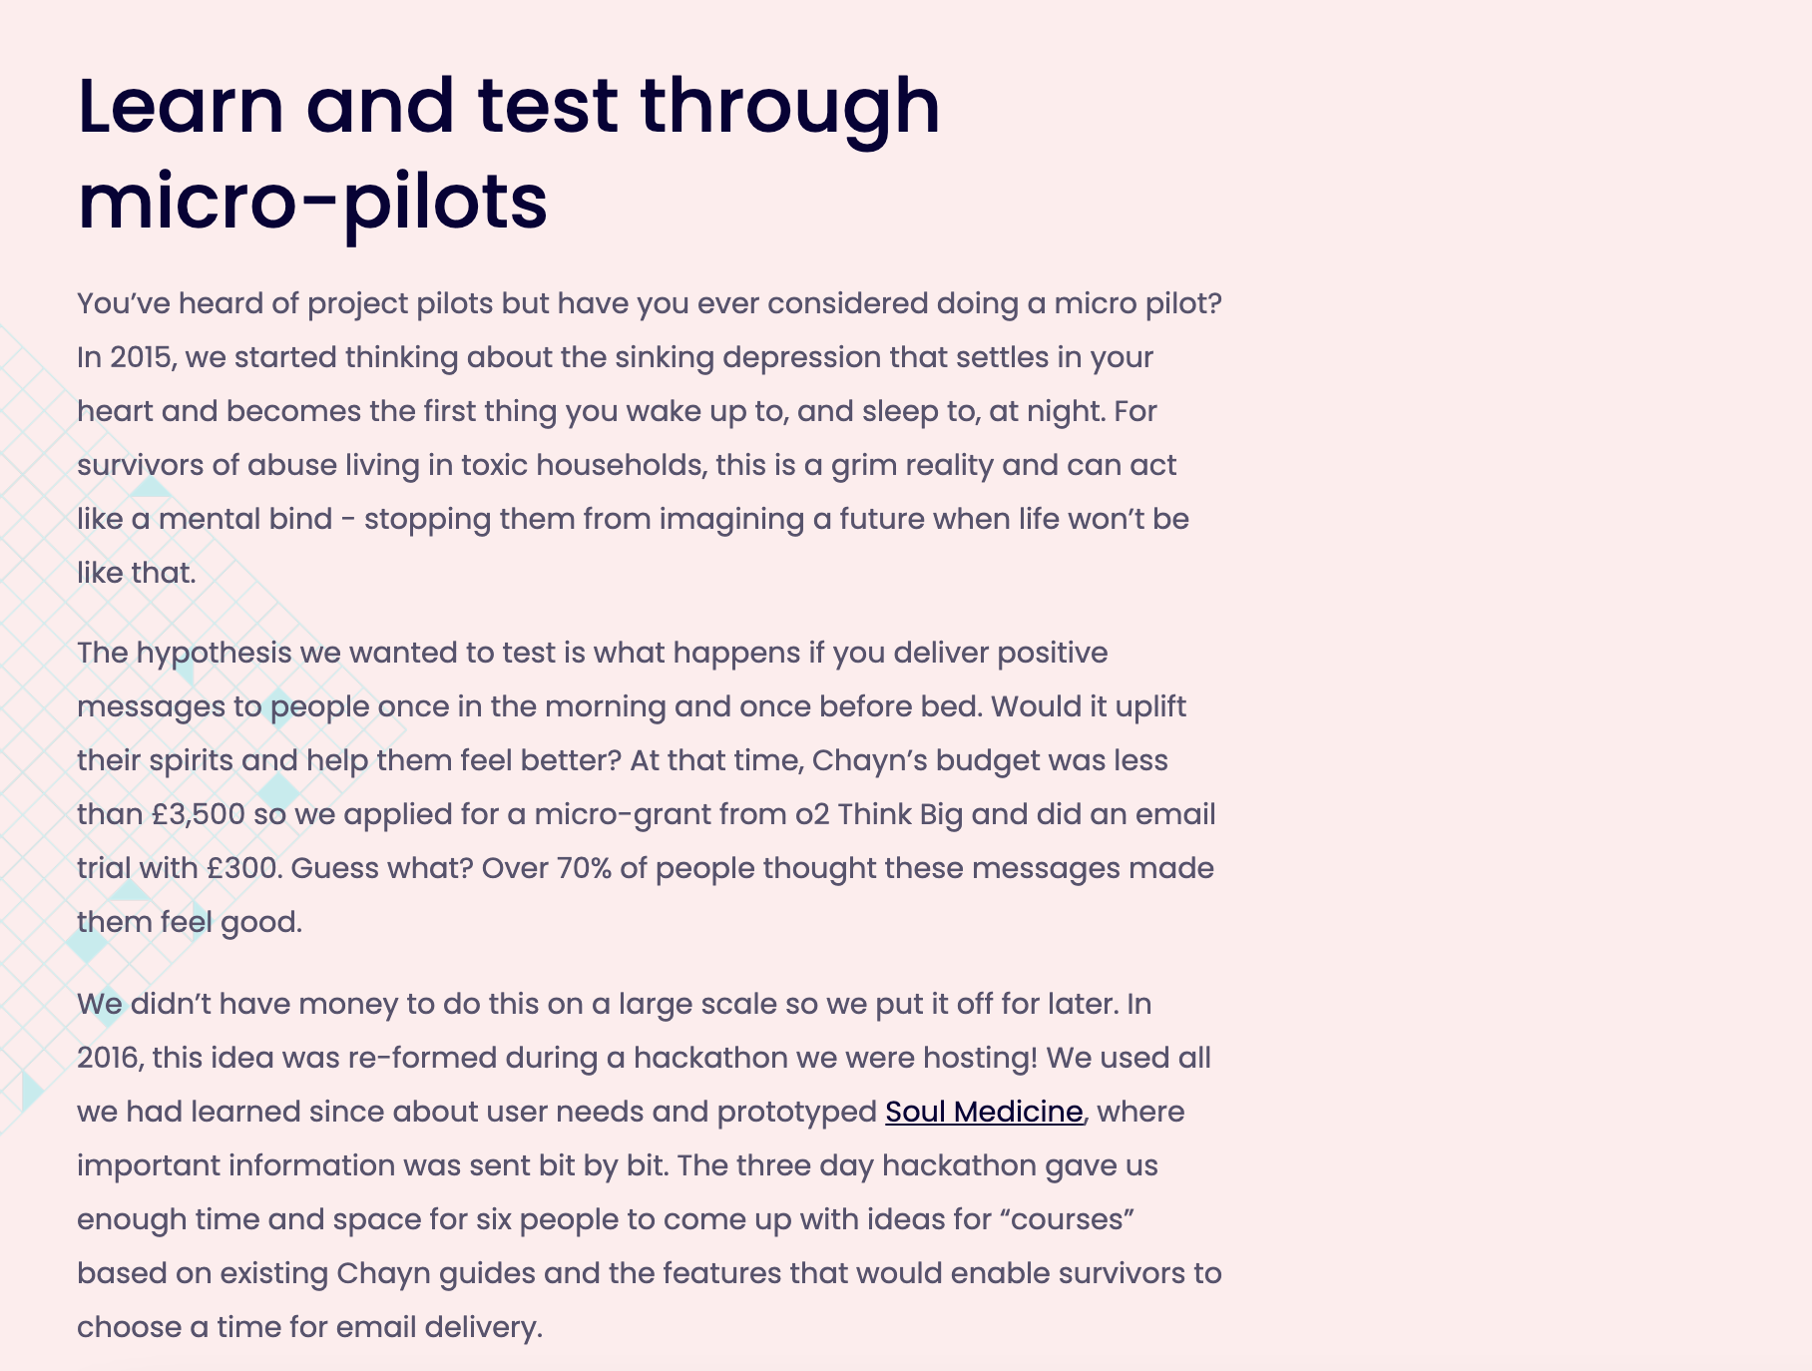
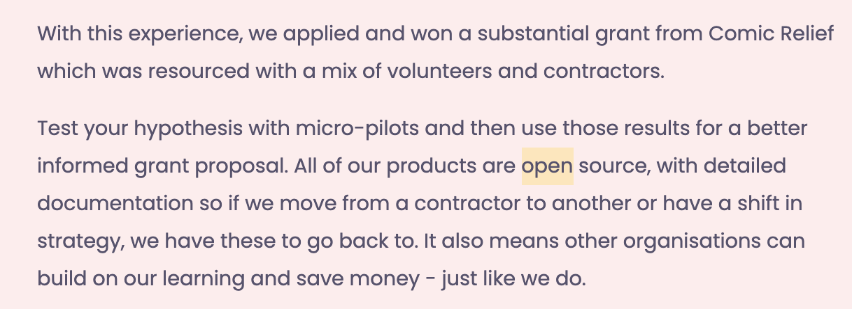
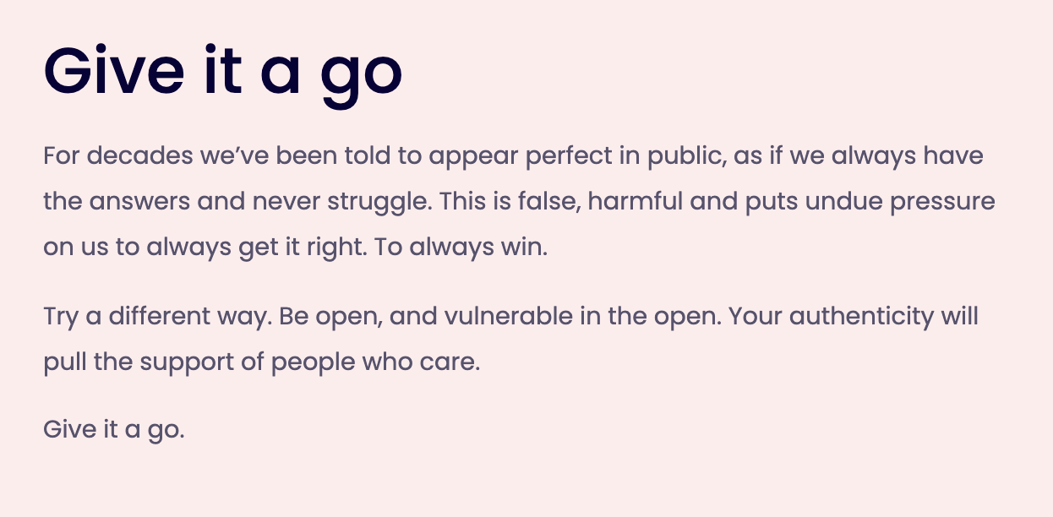

Slide 18
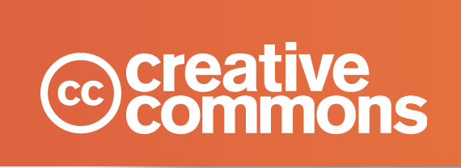
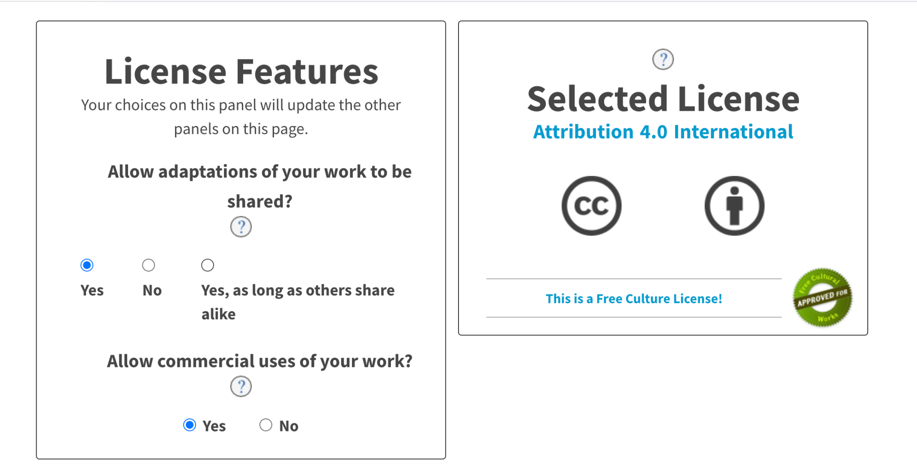

Slide 19
