Slide 1
Engaging with policy-makers: Personal reflections and the role of the Mental Health Policy Research Unit
VAMHN Webinar 17th March 2021
Brynmor Lloyd-Evans
Associate Professor, Division of Psychiatry UCL
Deputy Director, NIHR Mental Health Policy Research Unit

Slide 2
Challenges to research influence on policy and practice
Many negative research findings in mental health – scientifically important but not so interesting to practice and policy.
Research interventions end when trials do, few mechanisms for going on straight on to rapid scale-up
Civil servants change quickly, access to politicians limited
Exciting research findings may not fit current policy programmes
Policy and innovations sometimes based on not quite accurate reading of research (Hui et al. 2019)

Slide 3
Achieving evidence–informed policy: what helps?
Oliver et al. 2014: challenge assumptions that research-policy gaps are mainly due to inadequate “take-up” of relevant, available research by policy-makers. https://health-policy-systems.biomedcentral.com/articles/10.1186/1478-4505-12-34
Their summary of 3 systematic reviews identifies needs for:
Improved relationships and personal contact between policy makers and researchers
Research which is timely and relevant to policy
Easily accessible (open-access, clearly written)
With specific recommendations for policy
These are all things researchers can do more to achieve

Slide 4
Engaging with policy makers: 2 examples
Be persistent: UCL crisis care research
Be responsive: The MHPRU & the MHA Review

Slide 5
Example 1: 20 years of mental health crisis care research @UCLPsychiatry
A natural experiment and RCT establishing effectiveness & cost-effectiveness of high fidelity crisis teams as hospital alternative (2000-2006)
Three naturalistic studies of crisis houses, establishing high user satisfaction, viability as hospital alternative for some (1999-2011)
The CORE study - two RCTs in crisis teams: a service improvement programme; and post-discharge peer-support self-management (2011-17: CI Sonia Johnson)
Mixed methods investigation of acute day units (2015-2019 CI: David Osborn)
A nationwide investigation of crisis care systems at catchment area level and of innovative models (2019-2022 NIHR Mental Health Policy Research Unit)

Slide 6
Potential impacts of our crisis research programme
Inclusion of crisis team model in successive policy guidance, recommendations in NICE guidelines
Growth in crisis houses: greater confidence of their suitability to support people with severe mental health problems
Adoption of crisis team fidelity scale in NHS England crisis care policy + to inform national audit KPIs
Use of CORE crisis team trial findings to support successful case for additional funding for crisis teams in CSR
Adoption of crisis team model in Germany, Switzerland, Netherlands, including in national and regional policies
Peer supported self-management retained in some form at 5 of 6 CORE programme study sites

Slide 7
What helps researcher-led studies influence policy and practice (as far as we have)?
Patience (can take years to see impacts)
Opportunism, rather than any systematic or theory-driven approach
A proactive approach to contacting key policy staff (NHSE, DHSC) about findings: helpfulness and forming relationships
Tolerance of uncertainty whether you are having an influence/ of the many other pressures to which policy makers respond (politicians, professional bodies, the public etc.)
Engaging with key local service managers
Hanging around on Twitter
Participation in guideline/policy development
Can be reassuring to ask policy makers if you influenced them

Slide 8
A formal interface for policy and research: NIHR Mental Health Policy Research Unit
First Mental Health PRU, commissioned for 2017-22
Short-medium term delivery of evidence to inform policy, including a rapid response function.
Programme agreed with Department of Health and Social Care, NHS England, PHE, other government and arms length bodies.
Core research staff at UCL, wide network of collaborators, active lived experience working group.
Generally not resourced for substantial primary data collection – reviews, economic modelling, analysing national data sets or existing epidemiological cohorts, some qualitative data collection

Slide 9
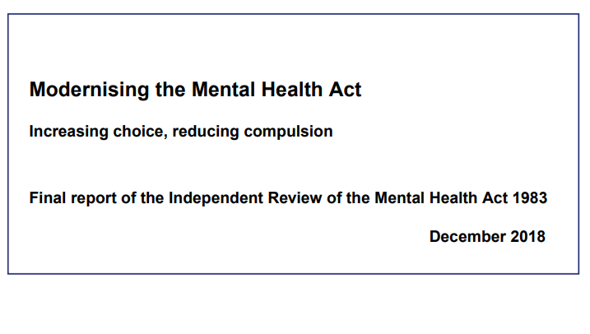
Example 2: the MHPRU providing evidence to inform the independent review of the MHA
Evidence from the PRU (completed over 9 months; generated 9 publications):
Three systematic reviews with meta-analyses
One rapid evidence synthesis
Two qualitative meta-syntheses
One analysis of UK routine data
One paper analysing international variations in legal systems and detention rates
One narrative review examining hypotheses for the rise in detentions

Slide 10
Some key PRU research findings informing Independent Review
UK detention rate is mid-range internationally, but rising faster than elsewhere. The rise may be more associated with new cases than repeat detentions.
Compulsory community treatment does not appear to prevent compulsory readmissions
Advance crisis plans show evidence of preventing compulsory admissions, but can be hard to implement
Service users and carers value good quality explanations of processes, respectful listening even when compulsory admissions ensue
Risk factors for detention: from Black ethnic groups, with psychosis, history of previous compulsory admission, on benefits
Relationship not found between legal systems and national rates of compulsory admission
Plus identified research gaps and limits of knowledge

Slide 11
Impacts of the MHPRU’s MHA work
40-page research summary included in the main MHA review Modernising the Mental Health Act – final report from the independent review - GOV.UK (www.gov.uk)
White Paper published Jan 2021 Reforming the Mental Health Act: summary - GOV.UK (www.gov.uk)
NIHR PRP themed call for MHA research 2020 (call highlights evidence gaps highlighted by our research): 4 projects funded New research to improve experiences of people with serious mental health problems (nihr.ac.uk)

Slide 12
What helps collaboration with policy makers: MHPRU structures
Time scales for research – months not years
Facilitated contact with civil servants & officials in ALB through DHSC Science, Research and Evidence Directorate
Ceding control: work programme developed in collaboration with and ultimately approved by DHSC
Research capacity on tap (MHPRU budget includes large contingency fund)
Programme can be changed to meet pressing demands for evidence (e.g. Covid response)
Facilitated access to existing evidence/sources of data

Slide 13
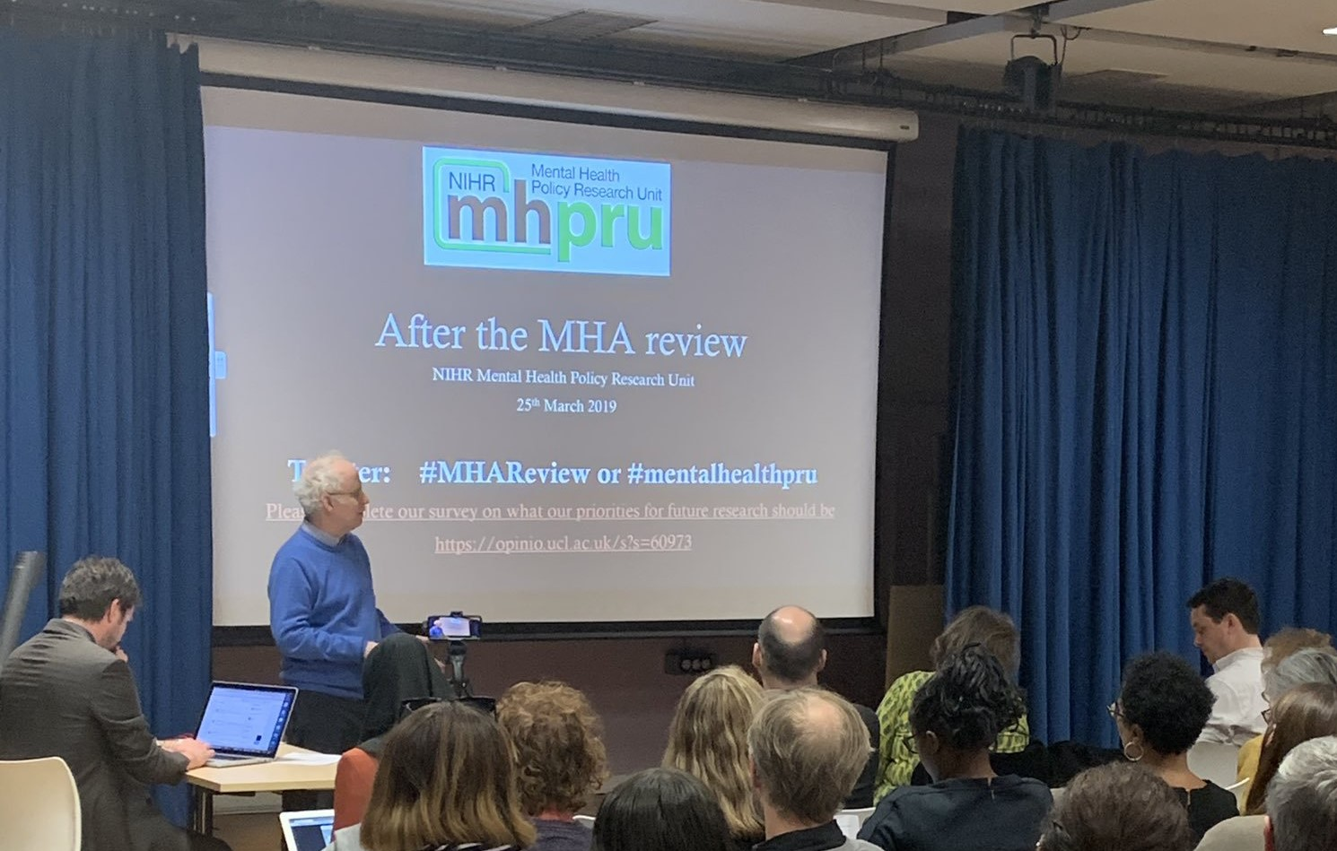
What helps collaboration with policy makers: MHPRU activities
Stakeholder events with policy focus
Get to know the influencers e.g. voluntary sector (Centre for Mental Health), social media ( Mental Elf)
Clear, succinct, but not over-simplified briefings
Policy makers value stakeholder input to all work and papers – all our papers have Lived Experience Commentaries
Don’t exclusively focus on high IF journal publications; use preprint
Keeping on hanging around on Twitter
Facilitate connections between policy makers and collaborators: a conduit for the research community

Slide 14
Thank you for listening
@MentalhealthPRU

