Slide 1
Technology for mental health
Dr. Josefien Breedvelt

Slide 2
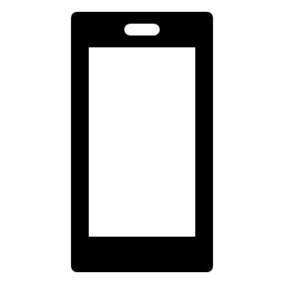
Technology for mental health
“Digital technologies to deliver, support, or enhance mental health services (WPA, 2017)”
Increased access
Personalisation
Innovation in delivery
https://imh.org.rs/wp-content/uploads/2017/07/1FINAL-WPA-Positionstatement-on-eMental-Health-10072017.pdf

Slide 3
Effective?
For preventing onset of depression (Buntrock et al., 2016; N = 406)
Online internet based CBT vs psychoeducation for people with subclinical symptoms of depression. 41% RR - NNT = 5.9
However, not online guided rumination focussed CBT in young adults vs TAU (Cook et al., 2019; N = 159)
For treatment
iCBT > WL and TAU conditions (Karyotaki et al., 2021)
As effective as face to face to treat depression (Carlbring 2018 – N = 4!)
Some components may be more helpful than others (Furukawa et al., 2021)

Slide 4
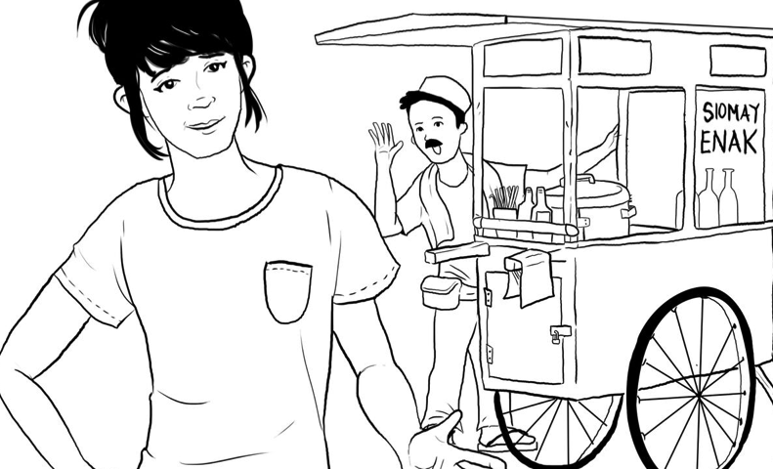
Low and Middle income countries
Guided Act and Feel - Internet based Behavioural Activation guidance by lay counsellors in Indonesia (Arjadi et al., 2020)
50% higher chance of remission at 10 weeks
Effects sustained over 6 months
Also for low SES
Recent meta-analysis online psychological intervention vs TAU HR = 0·54 [0·35–0·73]).
(Fu et al., 2021)
Depression (14), addiction (7), anxiety (4), PTSD (3)
14/22 with guidance
From China to Iran to Colombia

Slide 5
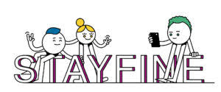
For relapse prevention
NOT Internet/mobile CT Relapse prevention (Kok et al., 2015; Klein et al., 2018)
N = 276 remitted patients - TAU + M-PCT vs TAU
Significant effects in people in partial remission from depression Hollandare (2013)
STAYFINE study now underway!
www.stayfine.nl

Slide 6
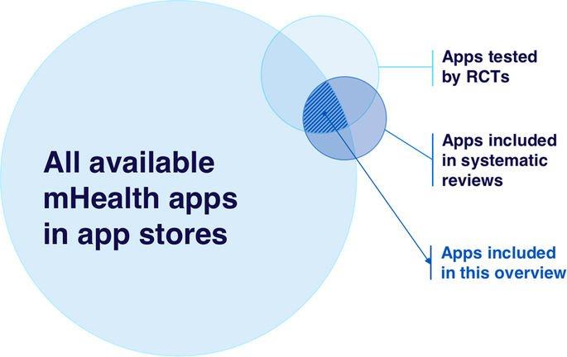
Implementation
Byambasuren O, Sanders S, Beller E, Glasziou P. Prescribable mHealth apps identified from an overview of systematic reviews. npj Digit Med. 2018;1:12. doi:10.1038/s41746-018-0021-9.

Slide 7
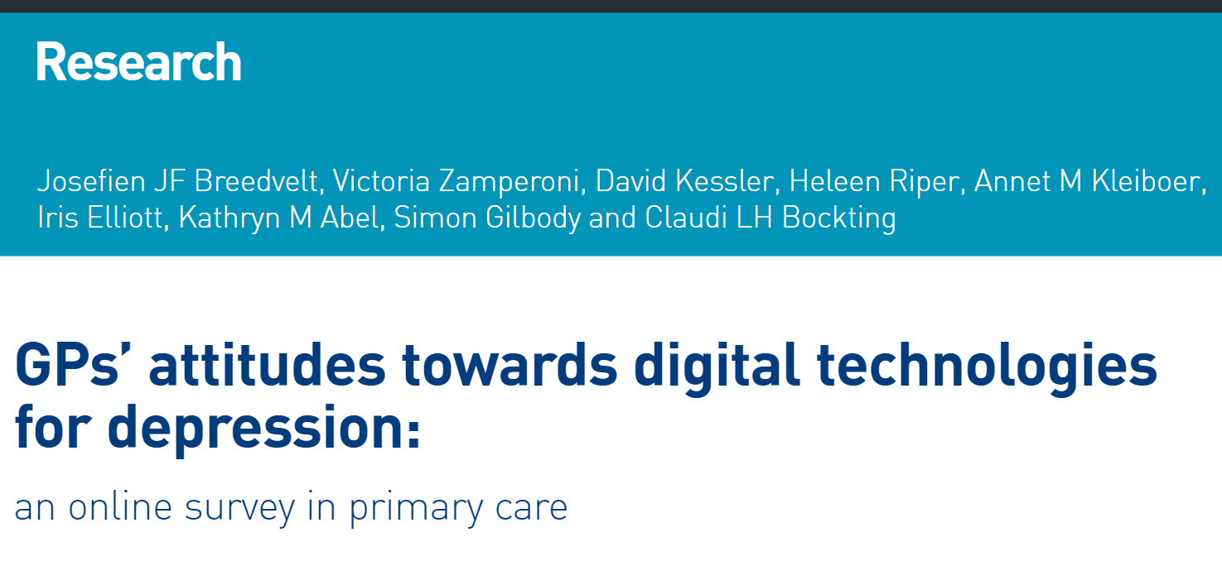
Primary care implementation
GP attitudes and use (N = 1044)
2 in 3 used digital mental health interventions for treating depression – most cCBT – most unguided
2 in 3 optimistic use will increase
Breedvelt et al., 2018

Slide 8
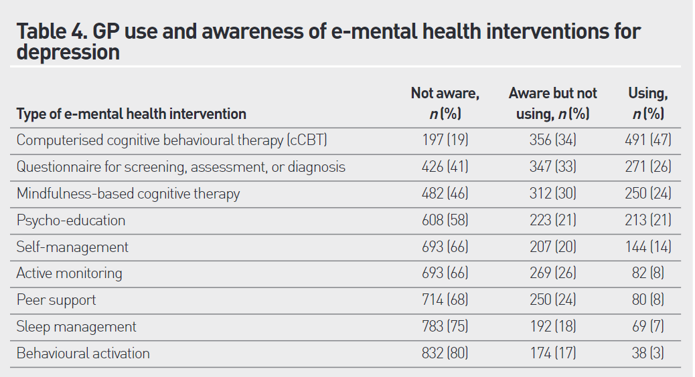
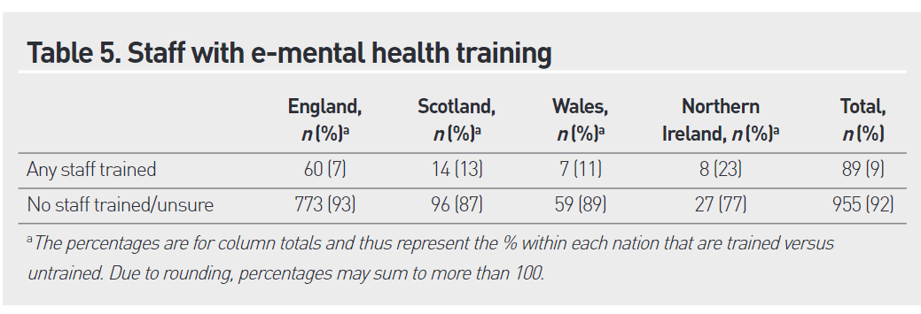
Awareness, use & training
Most commonly used
cCBT (47% use 19% not aware)
Online behavioural activation (3% use 80% not aware)
92% (N = 955) not received training for themselves or staff

Slide 9
Final points
Technology for good?
Covid-19
Personalisation, minimal intervention, implementation & access

Slide 10
Thank you
Josefien.Breedvelt@natcen.ac.uk

