Slide 1
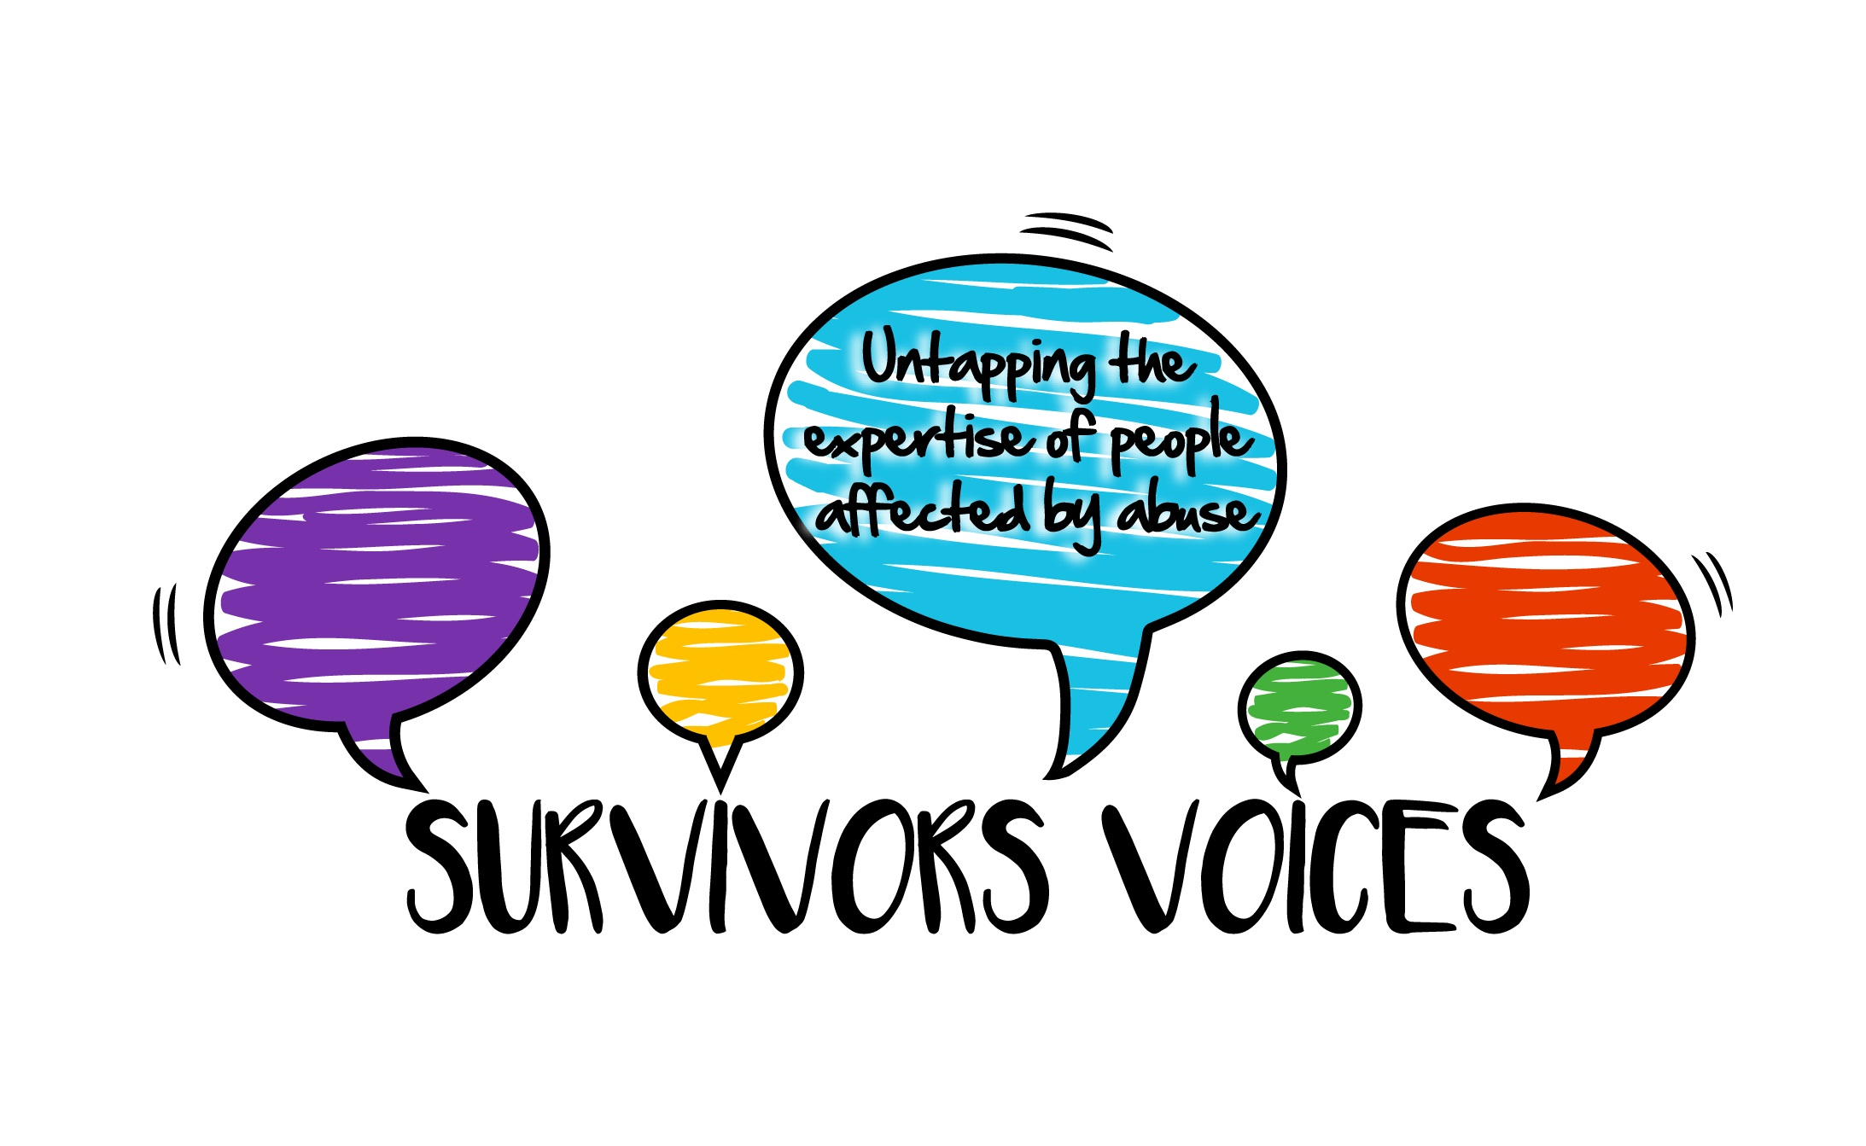
SAFE
SEEN
SUPPORTED
How to reach and help children and young people experiencing abuse in their households
JANE CHEVOUS
LAURA E. FISCHER
CONCETTA PERÔT
ANGELA SWEENEY

Slide 2
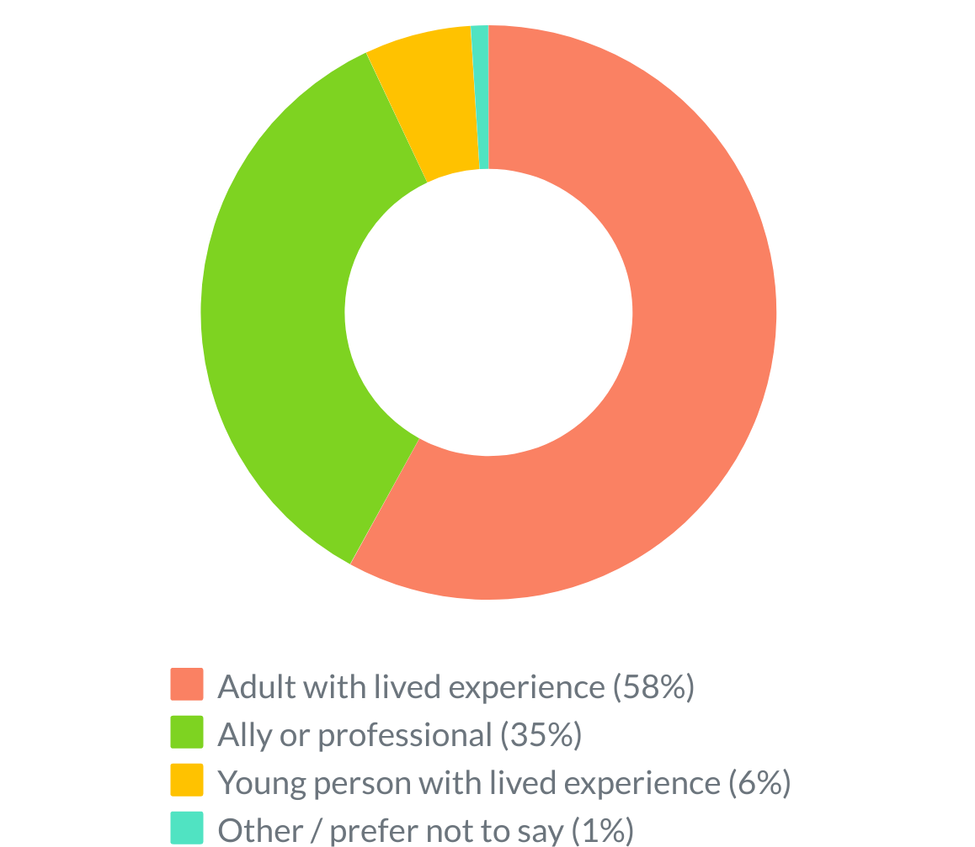
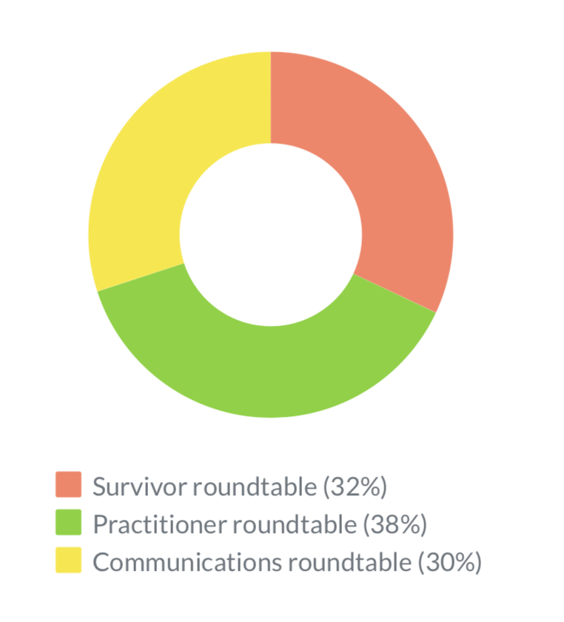
71 people
took our survey
37 people
attended our roundtables

Slide 3
FINDINGS
Summary
It is extremely hard for CYP experiencing abuse to reach out for help
CYP experiencing violence/abuse at home are hidden in plain sight
We need a global conversation so that everyone knows how to recognise and respond to abuse
We need to create safe spaces: internal, relational physical/virtual
We need to listen and know how to listen well
We need to trust, empower, and support CYP to lead the way
Healing is within reach and all survivors deserve this
PROTECTING CHILDREN AND YOUNG PEOPLE IS EVERYONE’S RESPONSIBILITY

Slide 4
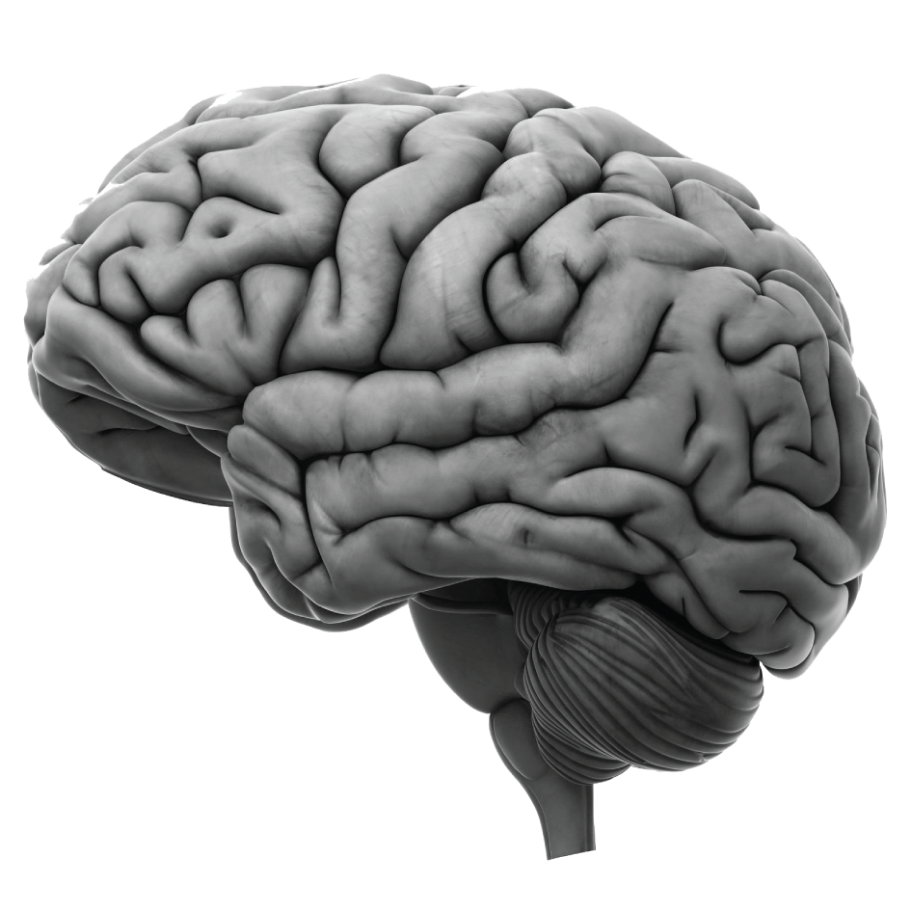
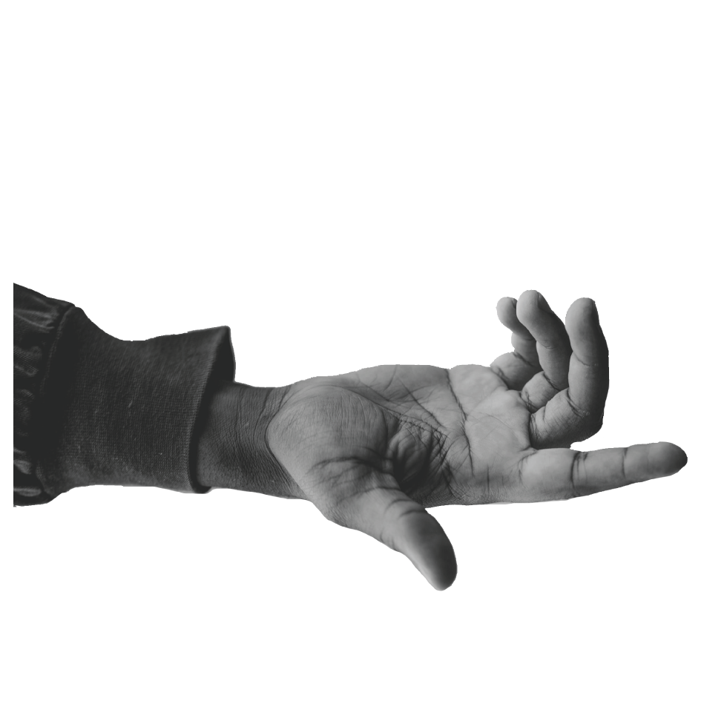
FINDINGS
Key themes
Our data analysis from the survey and roundtables highlighted four strong themes:
1. The importance of awareness and education
2. The need for safe places and trust
3. The significance of children and young people being heard, in control, and supported
4. The barriers to disclosure

Slide 5
02
Key theme
01
Key theme
Education + awareness
A better understanding of abuse – how to recognise it, how to talk about it, and what to do about it – is critical, both for children and young people and the wider community.
It is important that community members and professionals are taught how to recognise signs abuse
CYP often know no other reality than the one they live in and do not recognise their experiences as abuse: they must be taught what abuse looks like and feels like
Education helps both with practical information and with reassuring CYP that what is happening is not their fault, that nothing is wrong with them, and that their struggle is valid
A wide range of language must be used as CYP do not identify with words such as ‘abuse’ or ‘trauma’
Awareness of survivors’ stories is important for insight and hope
Overall, training, education, and awareness-building are urgently needed

Slide 6
02
Key theme
01
Key theme
Education + awareness
“We need to make sure that every single adult knows what child abuse is and what the signs are so that if you need to, you can disclose to your neighbour or your local shop keeper and they would know what to do.”
"If there had been any education around this at school, it would have helped. I was aware of things like Childline being available for kids, but as the abuse I was suffering was normalised at home, I didn't identify with the kids in the advert at all or see myself at risk."
“One thing that would help is if at all these levels there was an awareness and understanding of the large scale nature of childhood violence/abuse at home and it's immediate and lasting impacts.”

Slide 7
03
Key theme
02
Key theme
Safe Places + Trust
Safe places and relationships of trust are key.
All 3 types of safety – internal, relational, physical/virtual – must be nurtured.
For physical safety, CYP need access to safe places away from harm
For relational safety, CYP need access to trustworthy people
With physical and relational safety, CYP can experience internal safety
Individuals with a good rapport with CYP should regularly check-in with them as CYP are most likely to disclose to people they trust
If CYP make a disclosure, interventions must be carefully considered: it is critical not to further disempower CYP

Slide 8
02
Key theme
02
Key theme
Safe Places + Trust
“Surround the community with a positive set of invisible proactive people.”
"Provide more community base drop in centres for children to access a safe place which is known for a 'hang out' place but also offers lots of advice/support resources of different topics; domestic abuse being one of them."
"LISTEN LISTEN LISTEN!!!
I was in so much pain, I need someone to listen to me, one human talking to another.”
- Bobbie Galvin

Slide 9
04
Key theme
03
Key theme
Heard, in control, supported
It is vital that children and young people are heard, in control, and supported.
To ensure they are heard, we must;
Be present and accessible, create a safe relational space where disclosures could happen
Ensure openness and non-judgemental support
Ensure that CYP are listened to and disclosures believed
See the child / young person as a whole entity and validate their experience
Confirm that what is happening to them is not right

Slide 10
04
Key theme
03
Key theme
Heard, in control, supported
It is vital that children and young people are heard, in control, and supported.
To ensure they are in control, we must;
Offer reassurance and clear information on options and what can/will happen with disclosure
Offer choices and entrust CYP with decisions regarding their abuse
Co-develop any safety plans
Offer appropriate educational resources and information on services
Reinforce the power and rights of CYP

Slide 11
04
Key theme
03
Key theme
Heard, in control, supported
It is vital that children and young people are heard, in control, and supported.
To ensure they are supported, we must;
Ensure all CYP are in regular contact with a person they trust who listens to them
When CYP disclose, reassure that what is happening is not their fault, they are not in trouble, they are not alone, and there are people who care and can help
Provide practical help and information on their options, choices, rights
Support CYP with referral to services and ensure they have access to children’s advocates
Encourage and help CYP to engage in creative activities to help express their feelings and support their wellbeing

Slide 12
04
Key theme
03
Heard, in control, supported
"You have to let the child lead things. You have to trust and empower them."
"Ask what they want and how they want to be helped. Some may not be ready to be removed from the abusive situation, simply educated on it. Victims with trauma bonds are loyal to their perpetrators and initially the bonds needs to be respected by the professionals before any work can be done."
"Someone really seeing you as a person and a human being, and validating your experience, is the most powerful thing that services, organisations and communities can do to help off-radar children experiencing abuse, whether that leads to disclosure or not."
"Lack of control is one of the most frightening things about being abused - then if the only option for getting help is to have other people make all the decisions the moment you start talking about what is happening, then this will prevent children from opening up, as well as causing damage when they do so."

Slide 13
Key theme
04
Barriers to disclosure
It is extremely hard for many abused CYP to reach out for help and tell what is happening to them.
Difficulty recognising that what is experienced is not right and is indeed abuse
Conflicting emotional attachment and sense of loyalty to the abuser to them being a family member
Due to age and vulnerability, the most common response to abuse in CYP is freeze
Internalised messages of shame, secrecy, and threat
Fear of what will happen after disclosing
Mistrust of adults; CYP are more likely to disclose to their peers
Prior attempts that were dismissed or poorly responded to
Trauma behavior mislabeled ‘difficult child’ or hidden under ‘model child’
Lack of resources and understaffing

Slide 14
01
Key theme
04
Key theme
Barriers to disclosure
"Some children are still so trauma bonded to the individual committing the abuse that they are unable to identify and associate with words such as "violence and abuse"
"The dismissal of disclosures lead me to not trust the systems that were there to protect me.”
"Many professionals though no fault of their own, often do not have time to create close and trusting connections with the young people in their care however without these relationships, children will not make disclosures to you willingly. Teachers are very well placed to create these bonds with their students, however they are under too much pressure to get children through exams and rarely have the time or capacity at this point to have important discussions with even the more obviously troubled children in their classrooms, let alone the polite and steady seeming student sat at the back of the classroom."

Slide 15
FINDINGS
Practical tips
Survivors and allies provided some useful practical information on:
1. How to communicate with children and young people
2. How to use social media and phone-based resources
3. How schools can provide support

Slide 16
02
Practical Tip
01
Key theme
How to communicate with CYP
Talk to children and young people directly (i.e. not mediated through adults)
Take the time to build trust
Be honest and transparent
Use language that is age appropriate, understandable, and relatable
Ask the right questions (e.g. open-ended questions about wellbeing and feeling safe)
Develop and provide safe words or signals that can be used to alert abuse and/or feeling unsafe
Offer and respect anonymity and confidentiality (to the greatest extent possible within safeguarding responsibilities)

Slide 17
02
Practical Tip
02
Key theme
How to use social media / phone-based resources
Teach CYP how to use social media, online and phone-based tools safely
Make use of social media platforms that CYP use to communicate important information to them about abuse and seeking safety
Make support available on social media and other online and phone-based platforms
Offer virtual and/or phone-based counselling
Create apps for CYP to access information and support about abuse and seeking safety
Support digital inclusion by helping CYP access devices, offering emergency credit top-ups, and making phone-based services free

Slide 18
02
Practical Tip
03
Key theme
How schools can help
Provide education on violence and abuse as part of standard timetabling (PSHE)
Intentionally create safe spaces, regularly check-in on children and young people, and offer regular pastoral support
Be proactive: All school staff (teachers, assistants, librarians, etc.) should seek to identify signs of abuse (clues may be found in the staff’s interaction with children and young people or in observing children and young people’s behaviour; their interactions with their parents; or their interactions with their peers)
Provide contact numbers for emotional/psychological support on school material (e.g. on online education home screens)
Help children and young people access services; signpost, support, help them use school computers to contact services

Slide 19
FINDINGS
Messages of hope
There was agreement among survivors and allies about the key messages of hope to give children and young people experiencing violence and abuse:
What’s happening to you is not okay
It's not your fault and you are not in trouble
You matter and you have a right to be safe and unharmed
You are not alone
We believe you
Tell someone what is happening so they can help
There is support for you
Things can and will get better
Don’t give up, believe in yourself, you are strong
Your abuse doesn’t define who you are
Notes:
These messages are important in addition to practical help and support because bringing children and young people to safety takes time and we need to help them survive and cope with the impact of abuse until they can be free from it. Additionally, not all children and young people at risk will be identified, but messages may still reach them and help them.

Slide 20
Reflection
01
01
Reflection
Do we have a shared understanding of what we mean by abuse?
The professional language around child abuse and safeguarding is not adequate
When CYP experience violence and abuse as normal family life, they won’t describe it in the language of safeguarding
Education on what healthy family life looks like, using the language of feelings (e.g. feeling safe or scared) is easier for CYP to recognise their experiences of abuse and communicate these
Notes:
Reflections on findings + our own lived experiences

Slide 21
Reflection
02
02
Reflection
Do CYP experiencing abuse want to be found and helped?
Is disclosure always a good thing?
People clearly want abusive behaviour to stop
Yet, there are concerns that traditional child protection processes don’t always lead to the best outcomes: the care system isn’t always caring, the justice system isn’t always just
Additionally, some people only want for their families to be supported to do better so that further abuse is prevented
Ultimately, each child is different and what matters most is to find out what is right for them

Slide 22
Reflection
03
03
Reflection
Do current child protection process work?
Can we keep children and young people safe?
Our legal and care systems are not able to provide the best outcomes for all CYP at risk: as well as systemic reform, we need alternative solutions
There are ways we can ensure CYP are safe or safer
Healing and recovery is possible with the right support and resources
First and foremost we need to create safe spaces, build relationships of trust, and listen to what CYP are telling/showing us
We must take things slowly and follow the child / young person’s lead
Notes:
NB: I clustered reflections 3, 4, 5, 6 together

Slide 23
Reflection
04
04
Reflection
Why is it important to listen, give control, and empower CYP?
It is important because being abused means having no voice, no control, no power: we cannot help CYP by replicating these dynamics
We must actively reinforce their voice, control, power: that is the only way out of abuse and toward safety and recovery
Notes:
NB: I clustered reflections 3, 4, 5, 6 together

Slide 24
Reflection
05
05
Reflection
Why don’t children and young people disclose?
What happens is ‘normal’ in their family so they don’t know that things can be different
They don’t often have the language to explain what is happening
They might try to tell or show but people don’t want to hear or see, or can’t understand
They may be afraid of being ‘disloyal’ or tearing the family apart
They may be ashamed
They may not trust adults: they are more likely to tell their peers
Notes:
NB: I clustered reflections 3, 4, 5, 6 together

Slide 25
Action
02
01
Key theme
Learning
Abuse is often hidden: it is difficult to recognise, but it is imperative that we all know how to.
Recommendations
We need to help people recognise abuse – both in their own and in others’ experiences
We need a language to describe what abuse versus healthy relational dynamics look like so that everyone can understand
We need to train teachers, youth workers, health workers and other frontline staff to understand how to recognise abuse, what to do about it, and how to do handle it well
We need a wide social conversation to raise awareness and understanding of abuse; how to recognise it and how to respond

Slide 26
Action
02
02
Key theme
Learning
Reaching out to help is key, yet it must be done sensitively.
Recommendations
We need safe physical and online spaces where CYP can go to find refuge, help, support, and information
We need to build good relationships and make ourselves available so that CYP are able to reach out
We need to proactively reach out to CYP and not place all responsibility on them to ask for help; there are many reasons why this may be difficult for them
We need nuanced conversations that grapple with the complexities. For example, barriers that prevent children and young people from asking for help may also be protective barriers that keep them safe

Slide 27
Action
02
03
Key theme
Learning
We must act to protect CYP from abuse and our actions must be led by them.
Recommendations
We need to understand that protecting CYP is everyone’s responsibility
We need to support people to notice and deal with abuse, not turn a blind eye or blame victims
We need to do more so that everyone knows how to recognise and respond to abuse
We need to be better at listening to CYP and acting on their wishes and feelings
We need to consider options carefully
We need more accessible trauma-informed support
We need coordinated efforts across agencies and sectors
We need to invest resources appropriately
We need to communicate hope
We need to recognise the strength of CYP
We need survivors involved in all initiatives and services

Slide 28
02
Actions in pandemic times
Key theme
Top 3 actions
For families and communities
Train people whose role involves visiting houses (e.g., community volunteers, postal workers, delivery workers) to recognise signs of abuse (or code words/signals promoted through public information campaigns)
Educate communities on how to spot signs of household violence and abuse, and how to sensitively ask children and young people if they are safe and OK.
Educate communities on simple and clear actions of what to do if you suspect possible abuse.

Slide 29
02
Actions in pandemic times
Key theme
Top 3 actions
For schools, nurseries, childcare settings
Educate children and young people about abuse. This includes providing age-appropriate information and resources on supporting at-risk friends.
Allocate regular check-ins with a child or young person to teachers who have a good rapport with them to maximise the chances of disclosures.
Train teachers and provide them with guidance on how to identify the signs of household violence/abuse, and sensitively ask questions and respond to disclosures.

Slide 30
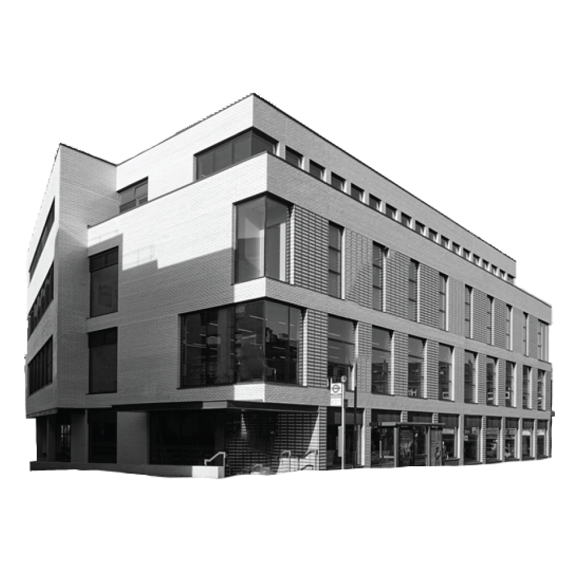
02
Actions in pandemic times
Key theme
Top 3 actions
For statutory services, charities, youth organisations
Ensure services and organisations are allocated sufficient and ongoing resources to respond to demand.
Designate a worker/volunteer to check in with all the young people they work with, particularly those known or suspected to be vulnerable (especially while pandemic-related social restrictions measures are in place)
Ensure children and young people can be referred to, or continue to access, workers, services and counselling (by phone or online if it is not possible in person).

Slide 31
02
Actions in pandemic times
Key theme
Top 3 actions
For government and inter-agency bodies
Develop apps/helplines/websites/social media links for children and young people to access freely. These should be easily hidden (from abuser or non-protective parent).
Provide refuges (both short-term and long-term) to children and young people who need to find a place of safety away from harm.
Run a public information campaign to raise awareness of household violence/abuse during and post-pandemic, to help children, young people, adults, and professionals recognise abuse, and to advertise resources and sources of help.

Slide 32
Protecting children and young people from abuse is everyone’s responsibility.

Slide 33
Thank you
www.survivorsvoices.org
www.laurafischer-trauma.co.uk
www.vamhn.co.uk
www.mcpin.org

