Slide 1

2nd Network Meeting
7th October 2019
Institute of Mental Health, University of Nottingham
#VAMHN
Notes:
Thank participants for attending and IMH for hosting
This is the second of our network meetings, which will run every six months
Acknowledge that individuals in the room have experience of violence, abuse, and mental health problems
Let people know we have booked a separate room should anyone want to step out and take some time away from the presentations and discussions

Slide 2
Network meeting – aims
To share information about network aims and activities
To share recent findings and resources
To plan future resources
To discuss how we measure success
#VAMHN

Slide 3
Programme
1100-1120 | Welcome, aims of the day, and update on activities. | Sian Oram
1120-1200 | Survivor research priorities: findings | Concetta Perot
1200-1300 | Findings from research and practice I How Cambridgeshire try to ameliorate the pain of mental ill health following domestic abuse Connecting the dots – locating legal responsibility for psychological abuse and associated suicidality within intimate relationships | Vickie Crompton Vanessa Munro
1300-1400 | Lunch
1400-1500 | Findings from research and practice II (3) Sexual safety in mental health settings (4) Preparing healthcare professionals to ask the right questions with BME women victims of domestic violence and abuse | Julie McGarry Parveen Ali
1500-1550 | Roundtable discussions
1550-1600 | Upcoming activities and close
#VAMHN

Slide 4
Our vision is to reduce mental health problems by addressing associated violence and abuse, particularly domestic and sexual violence.
#VAMHN

Slide 5
Why an interdisciplinary network?
We believe that progress will require:
A shared language and approach to measurement
A better understanding of pathways to domestic and sexual violence and their relationship to mental health problems
Improved experiences of health and social care
More effective interventions
#VAMHN

Slide 6
Network themes
Measurement of domestic and sexual violence and related outcomes in relation to mental health
Understanding pathways to domestic and sexual violence and their relationship to mental health problems
Interventions and services to prevent, reduce, and address domestic and sexual violence in people with mental health problems or at risk of problems.
#VAMHN

Slide 7
Ensuring lived experience involvement
Development of our lived experience involvement strategy
We are recruiting for a Lived Experience Involvement Coordinator
  Contribute to the development and delivery of the Network's survivor and service user involvement strategy
  Advise the Network on involvement issues
  Organise and coordinate a Lived Experience Advisory Panel for the Network
30% FTE until 31/10/2022
Closing date 30/10/2019
Job pack at https://tinyurl.com/y2cknlrs
“The successful candidate will have experience of coordinating or facilitating survivor and service user involvement in a violence, abuse, or mental health context. As the post-holder will be coordinating the involvement of people with experiences of violence, abuse, and mental health problems, we are seeking to recruit someone who has these lived experiences. However, at no time will the post-holder be asked about personal experiences.”
#VAMHN

Slide 8
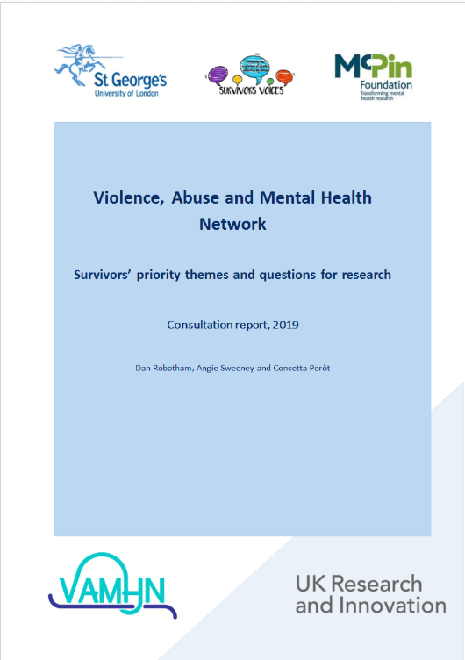
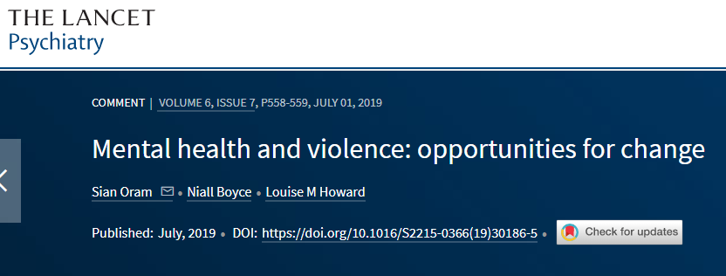
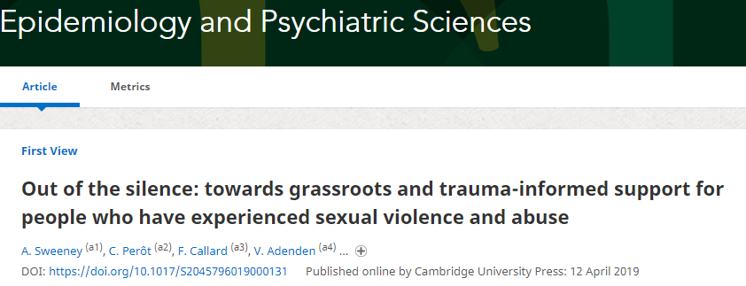
Setting a research agenda for violence, abuse, and mental health
#VAMHN

Slide 9
Supporting research, nurturing researchers
Our year 1 funding call focused on measurement and was open June to September 2019
  Maximum value £25,000 and duration 12 months
  Grants can be used to deliver a targeted piece of research or to pump-prime larger projects
  Assessment criteria included cross-disciplinarity and effectiveness of plans for involving and disseminating findings to survivors and service users.
  Applicants will be notified of outcomes by 1st November 2019
Our first early career researcher bursaries were awarded in June 2019 – and applications for our next round is now open!
  Awards of up to £250 to support training courses or conference fees, or for travel and accommodation to support attendance.
  Funding is for PhD students, early career researchers based at universities, independent researcher, and people who have been working in charity or public sector organisations in roles that include a significant research component for up to 8 years.
  Activities should be relevant to domestic/sexual violence and mental health and to future interdisciplinary practice.
#VAMHN

Slide 10
Developing new resources
We are seeking to develop an online data directory bringing together information about datasets that include both violence and mental health.
In the roundtable session, we would like to ask you:
If you have previously used online data directories, what did you find helpful or unhelpful about them?
If you have not previously used online data directories, what might encourage you to access one?
What datasets (including administrative and research datasets) are you aware of that we should include in the directory?
#VAMHN

Slide 11
Setting goals and measuring success.
We want to set ourselves clear targets for success and have shared our draft with you.
In the roundtable session, we’d like to ask you:
What do you think of our short, medium, and long-term goals – is there anything you think we have missed or that should not be there?
What do you think about how we plan to measure our success (outcomes and evidence) – is there anything you think we have missed or that should not be there?
Some of the goals we have identified as important are lacking outcome measures and sources of evidence – what would you like to see us include here?
#VAMHN

Slide 12
Notes:
Thank participants for attending
This is the first of our network meetings, which will run every six months
Acknowledge that individuals in the room have experience of violence, abuse, and mental health problems
Let people know we have booked a separate room should anyone want to step out and take some time away from the presentations and discussions

Slide 13


Consultation on Survivors’ Priority Themes & Questions for Research
Violence, Abuse & Mental Health Network
7th October 2019

Slide 14
About me
Independent consultant & researcher, Associate King’s College London and University of Bristol
Psychotherapist and social worker (MBACP, DiPSW)
Co-founder, Survivor’s Voices
Survivor of abuse

Slide 15
Aims & Methods
Who? McPin commissioned by VAMH to conduct consultation with survivors in partnership with St. George’s University & Survivors’ Voices
Why? To develop a list of priority research topics and questions on violence, abuse and mental health from the perspective of survivors
What – online survey (n 89 of which 59 identified as having experienced violence / abuse) two focus groups with 15 people, all with experience of violence /abuse
How? Thematic analysis of survey open questions; themes discussed, expanded and refined by focus groups and research questions elicited. Final version then sent to participants for additional comment

Slide 16
Format of findings
  Theme
  Defining the problem – what survivors described
  Key questions
  Sub-questions

Slide 17
Themes
  Defining and measuring
  Conceptualising abuse
  Measuring prevalence
  Understanding
  Recognising abuse for oneself
  Understanding impacts on survivors
  Recognising abuse in others
  Understanding perpetrators
  Interconnected systems
  Intervention and providing support
  Seeking support for the first time
  Unhelpful support
  Helpful support
  Support for professionals
  Capacity in the survivor-led sector

Slide 18
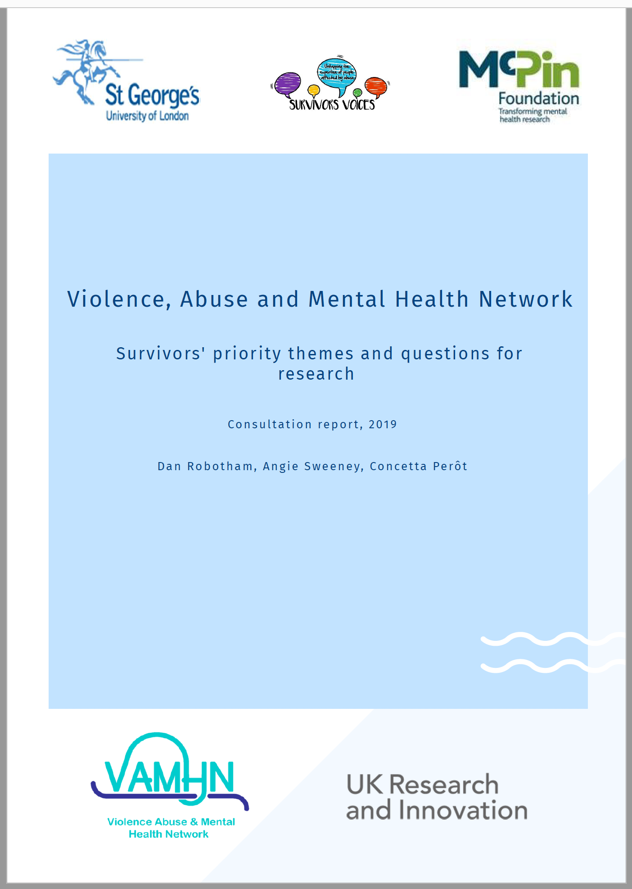
The Consultation Report
Launched today!
Available at https://www.vamhn.co.uk/resources.html

Slide 19
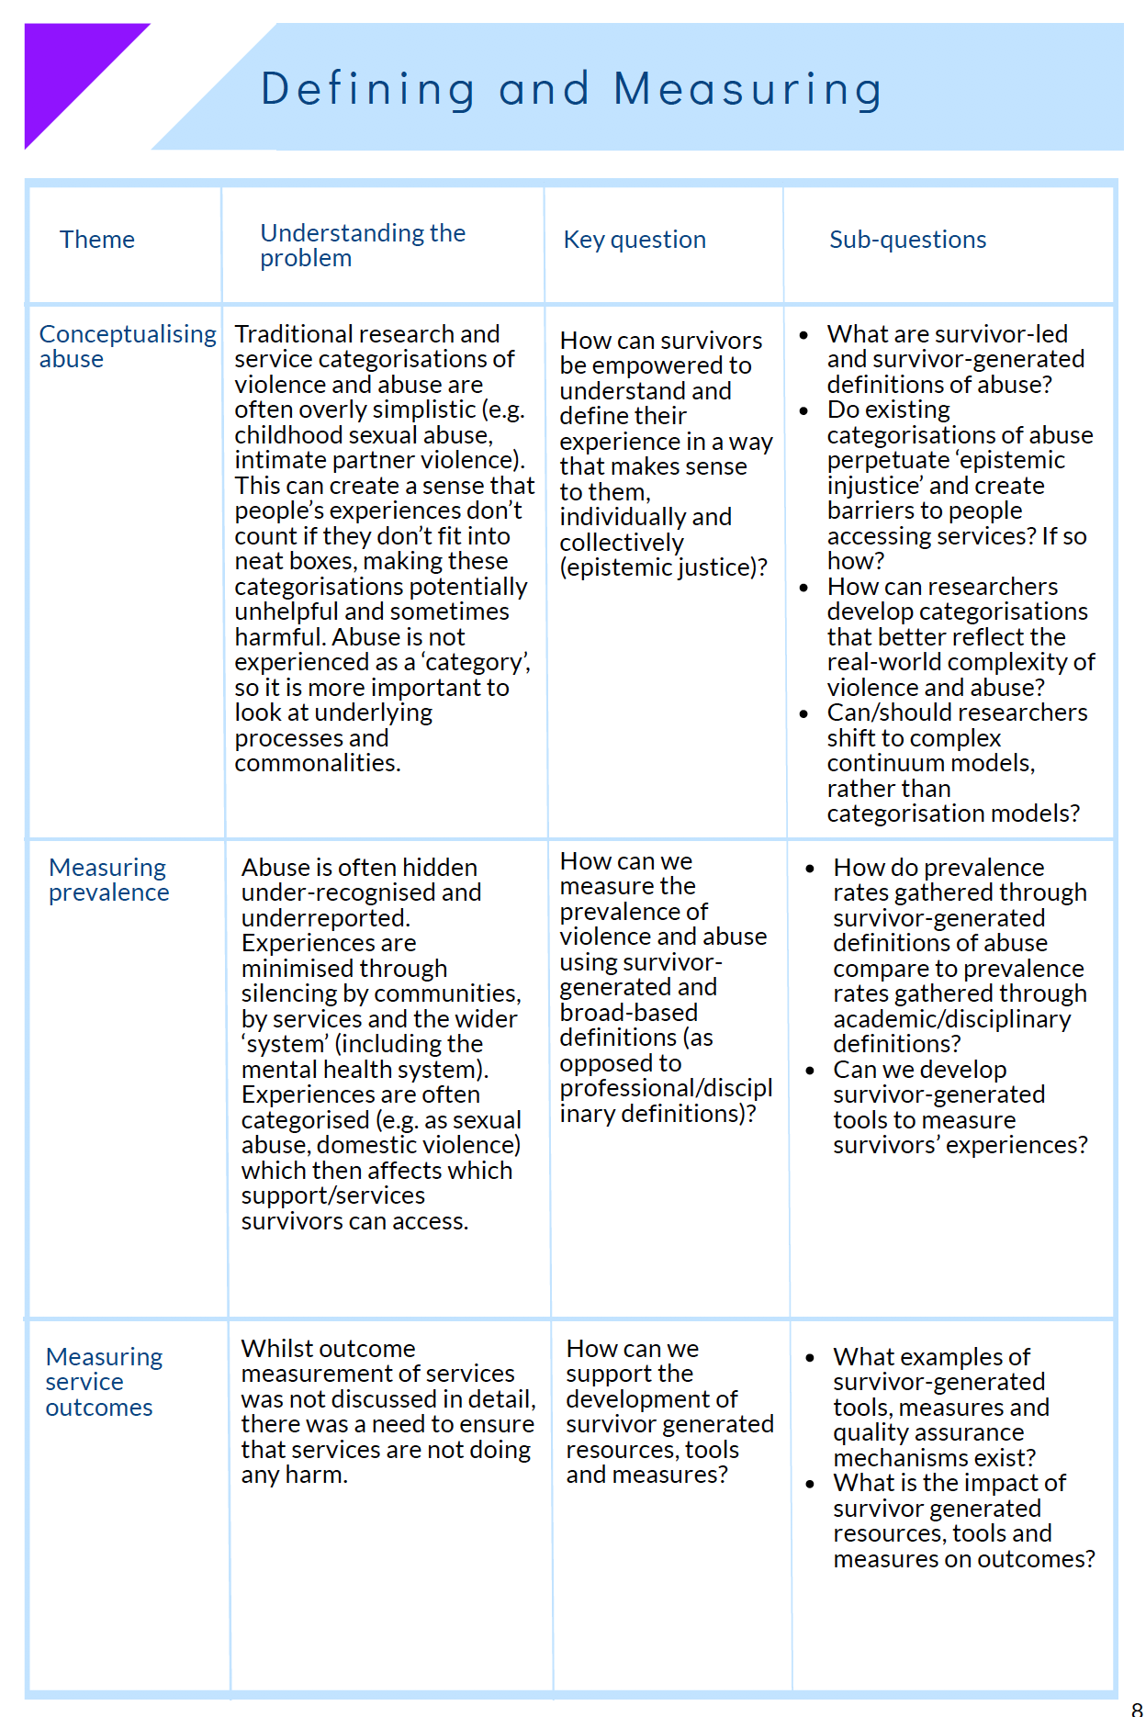
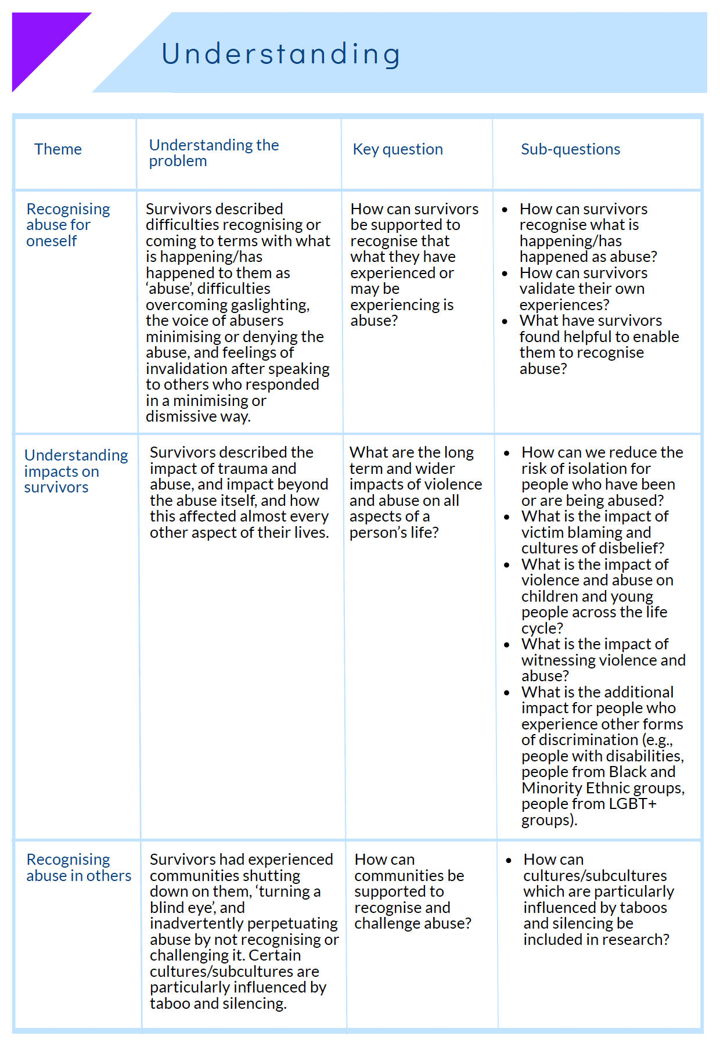
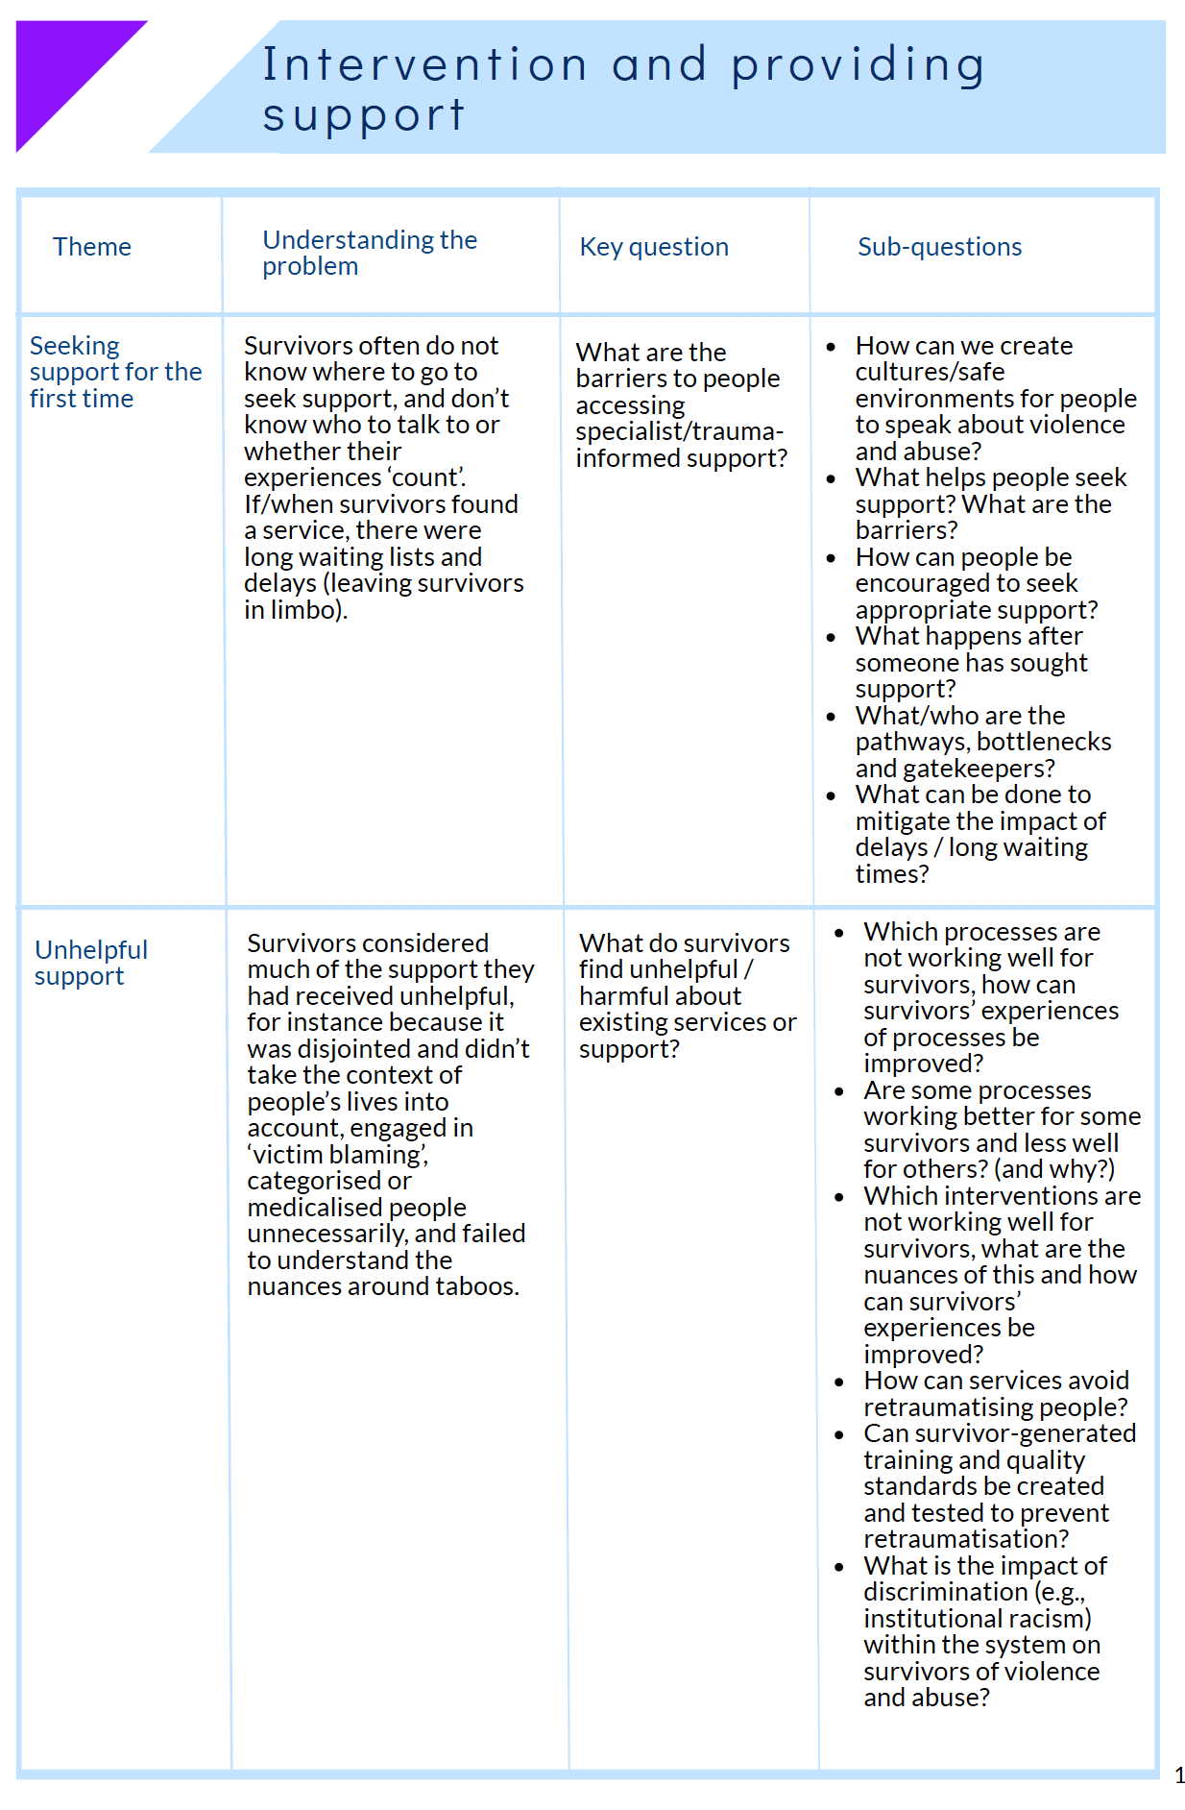

Slide 20
Survivor research questions
  How can survivors be empowered to understand and define their experiences in a way that makes sense to them, individually and collectively (epistemic justice)?
  How can survivors be supported in recognising that what they have or are experiencing is abuse?

Slide 21
Survivor research questions
  How can we measure prevalence of violence and abuse using survivor-generated, broad based definitions?
  Can/should researchers shift to continuum rather than categorisation models?

Slide 22
Survivor research questions
Do existing categorizations of abuse perpetuate epistemic injustice and create barriers to accessing services? If so how?
What are the barriers to people accessing specialist, trauma-informed support? How can we create cultures / safe environments for people to speak about violence and abuse?”

Slide 23
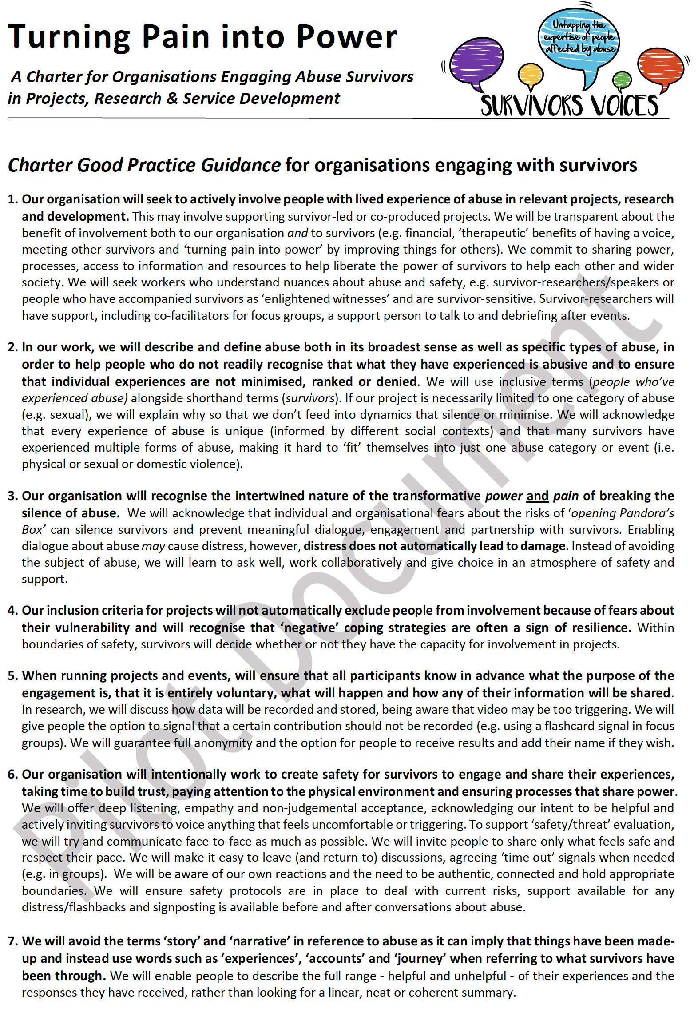
“…describe and define abuse both in its broadest sense as well as specific types of abuse, in order to help people who do not readily recognise that what they have experienced is abusive and to ensure that individual experiences are not minimised, ranked or denied”.
Turning Pain into Power
A Charter for Organisations Engaging Abuse Survivors
Perôt & Chevous, 2018

Slide 24
The Importance of evolving our understanding…
“Incest is extremely rare, and does not occur in more than 1 out of 1.1 million people. Such incestuous activity diminishes the subject’s chances of psychosis and allows for a better adjustment to the external world…the vast majority of them were none the worse for the experience.”
Comprehensive Textbook of Psychiatry, Freedman, Kaplan & Sadock 1975, quoted in The Body Keeps the Score by Bessel van der Kolk

Slide 25
Survivor research questions
How can communities be supported to recognize and challenge abuse, particularly within cultures/sub-cultures strongly influence by taboos and silencing?”
How can survivors, communities and professionals recognise the traits, tactics and characteristics of perpetrators?”

Slide 26
Survivor research questions
What are the long term and wider impacts of violence and abuse, including the impact of victim blaming and cultures of disbelief, impacts of witnessing violence and intersection with other forms of discrimination?

Slide 27
Survivor research questions
How can we understand and measure the damage caused by the various interconnected systems that survivors encounter?
To what extent do current systems perpetrate and perpetuate abuse and violence?

Slide 28
Survivor research questions
How can professionals be supported to provide better support for survivors?

Slide 29
Survivor research questions
What is the scale, capacity and funding of survivor led organisations?

Slide 30
“I hold in highest esteem people who have survived abuse and make the decision to fight the silence, stigma and injustice. I mean, really – they have survived something incredibly destructive and traumatic and then they consciously choose to go back into that fire. That is beyond surviving – these people are warriors”.
Adrienne Simone

Slide 31
Contacts and downloads
  Report Authors
  Dan Robotham danrobotham@mcpin.org
  Angela Sweeney asweeney@sgul.ac.uk
  Concetta Perôt concetta.perot@kcl.ac.uk
  Downloads
  The Consultation Report https://www.vamhn.co.uk/
  The Charter for Engaging Survivors
  http://survivorsvoices.org/charter/

Slide 32
Notes:
Thank participants for attending
This is the first of our network meetings, which will run every six months
Acknowledge that individuals in the room have experience of violence, abuse, and mental health problems
Let people know we have booked a separate room should anyone want to step out and take some time away from the presentations and discussions

Slide 33
Connecting the Dots – Locating Legal Responsibility for Psychological Abuse & Associated Suicidality within Intimate Relationships
Vanessa Munro, Warwick Law School
V.Munro@warwick.ac.uk

Slide 34
Outline of Presentation
Part I: R v Dhaliwal: a missed opportunity
Part II: Suicidality in Domestic Abuse Contexts
Part III: Harm, Cause and the Law in Practice

Slide 35
R v Dhaliwal (2006)
Psychological injury did not constitute ‘bodily harm’ c.f. psychiatric injury
No need to consider whether infliction of such harm ‘caused’ suicide
Legal causation requires being a ‘substantial and operating’ cause

Slide 36
Beyond Dhaliwal?
Coercive control - Serious Crimes Act 2015
Could this ground a manslaughter charge?
Gravity of psychological and emotional harm
Ongoing ‘hurdle’ of causation

Slide 37
Refuge Project
Project Report: ‘Domestic Abuse and Suicide: Exploring the Links with Refuge’s Client Base and Work Force’
https://www.refuge.org.uk/wp-content/uploads/2018/07/domestic-abuse-suicide-refuge-warwick-july2018.pdf
‘From Hoping to Help: Identifying and Responding to Suicidality Amongst Victims of Domestic Abuse in England and Wales’ (2019) International Review of Victimology
https://journals.sagepub.com/eprint/8TfxhmvkfumSfWn2KDGB/full
‘Adding Insult to Injury? The Criminal Law’s Response to Domestic Abuse-Related Suicide in England and Wales’ (2018) Criminal Law Review 732-741

Slide 38
Refuge Dataset
3,519 Refuge client case files
All of whom were –
aged over 18
completed all items on the CORE-10 measure of psychological wellbeing, and
provided a history of abuse to their caseworker
20 semi-structured interviews with staff employed by Refuge

Slide 39
Key Findings on Suicidality
The vast majority were women (96.5%)
Overlapping forms of abuse experienced
The vast majority from male partners or ex-partners
24.2% (n=854) had experienced suicidality
18.3% (n=644) had made plans to end their lives
3.1% (n=108) had made suicide attempts in the past
Likely to underestimate the true scale of suicidality

Slide 40
Potential Predictors of Suicidality
86% above the cut off for clinical concern across the entire sample
3.5 times more likely for those who reported feeling depressed
1.87 times more likely for those without children
1.69 times more likely for those feeling despairing or hopeless
1.68 times greater for those with additional alcohol needs
1.59 times greater for those with additional drug related needs

Slide 41
Interviews with Staff
Perceived Increase with –
alcohol or substance misuse
experiences of depression
social isolation
interactions with statutory agencies (housing, immigration and CJS)
Perceived Decrease with -
having children
holding religious beliefs

Slide 42
Interviews with Staff
“counselling and psychological support in the borough is abysmal” (Refuge 15)
“Often when people have got to that point, what you’re told and what the mental health teams in the local area want you to do, is send them to A&E…and it’s like am I going to be able to tell a suicidal person sitting at home looking at boxes of pills, am I going to be able to say ‘oh just pop over to A&E’…I mean if someone’s really in crisis, I don’t think they are going to be getting the bus up to A&E to sit there to wait, not many people do.” (Refuge 16)
“Got another one here; must be a full moon or something.” (Refuge 15)

Slide 43
Where does that leave us?
Relationship not linear, but prevalence and risk of suicidality is substantial
Factors that mitigate risk include networks and hope
Findings don’t settle legal debates in Dhaliwal BUT do attest to the severity of psychological abuse

Slide 45
Next Steps: Jury Research
  Recognition of nature and severity of psychological abuse?
  Causal link between abuse and suicide?
    ‘causation is not a single, unvarying concept to be mechanically applied without regard to the context in which the question arises.’ (R v Kennedy (no 2), HoL)
    ‘the abuser does not pull the trigger or provide the rope. The victim may even see the act of suicide as a form of liberation or a final expression of rebellion or subversion against a partner’s control. But this does not mean that the actions of the abuser are not a significant cause of death’ [Munro & Shah, 2010]

Slide 46

Questions?

Slide 47
Notes:
Thank participants for attending
This is the first of our network meetings, which will run every six months
Acknowledge that individuals in the room have experience of violence, abuse, and mental health problems
Let people know we have booked a separate room should anyone want to step out and take some time away from the presentations and discussions

Slide 48



Vickie Crompton
Programme Manager, Whole Housing
Cambridgeshire & Peterborough Domestic Abuse & Sexual Violence Partnership Manager

Slide 49
“The most dangerous place for a woman in Cambridgeshire is in her own home”
Victim & Offender Needs Assessment, 2015

Slide 50
Dual Diagnosis
Mental Health Pathfinders - Offenders
Mental Health First Aid

Slide 51
DA Mental Health Pathfinders
“Professional Generosity”

Slide 52


Slide 53
Domestic Abuse & Sexual Violence
Champions Network
Quarterly, held in 5 places across the area

Slide 54




A fixed term pilot project funded by the Department of Health and Social Care and Department of Culture, Media and Sport until March 2020
A collaboration between the Pathfinder Consortium and 27 NHS Trusts in 8 sites across the UK
A shared vision to achieve best practice responses to domestic abuse in acute health, mental health and general practice settings
We will develop a model of best practice that can be easily adopted by any NHS trust and create a toolkit to support the process
To find out more:
www.PathfinderToolkit.org
m.pio@standingtogether.org.uk
Pathfinder consortium partners:

Slide 55
Up to 64% of Domestic abuse survivors are thought to have PTSD – compared to 20% of military personnel who have served in conflict zones.
Trauma and it’s impact should be expected
Be Generous
Be Kind

Slide 56
Thank you for Listening
V.Crompton@standingtogether.org.uk

Slide 57
Notes:
Thank participants for attending
This is the first of our network meetings, which will run every six months
Acknowledge that individuals in the room have experience of violence, abuse, and mental health problems
Let people know we have booked a separate room should anyone want to step out and take some time away from the presentations and discussions

Slide 58

Exploring the complexity of sexual safety within acute in-patient mental health settings
“because of our experiences, awareness can grow from that”
“It took me 48 years to be heard”
“Speaking with women who have accessed mental health services”
Julie McGarry
Associate Professor
&
Marie Davis
Trainee Forensic Psychologist
“In the wilderness as I call it”
“you could go on and on and on about sexual safety, it’s never ending!”
“keep us safe to the best they could”

Slide 59
Notes:
Thank participants for attending
This is the first of our network meetings, which will run every six months
Acknowledge that individuals in the room have experience of violence, abuse, and mental health problems
Let people know we have booked a separate room should anyone want to step out and take some time away from the presentations and discussions

Slide 60
The School
Of
Nursing and
Midwifery.
Using participatory approaches to develop tool to help primary care nurses support women victims of domestic violence from black and ethnic communities
Dr. Parveen Ali
University of Sheffield

Slide 61

Plan
Overview of Domestic Violence and Abuse
Overview of our research and findings
Questions and comments

Slide 62
Background: Policy context
Definition of DVA (Home Office, 2013)
National Institute for Health and Care Excellence DVA and latterly Quality Standards (2014, 2016)
Nursing and Midwifery Council (NMC)

Slide 63
Forms of Abuse
Physical abuse
Verbal abuse
Sexual abuse and coercion
Controlling behavior
Notes:
Behaviour within an intimate relationship that causes physical, sexual or psychological harm, including acts of:
Physical aggression
Sexual coercion,
Psychological abuse &
Controlling behaviours”
(WHO, 2010)

Slide 64
Prevalence of Domestic Violence

Slide 65
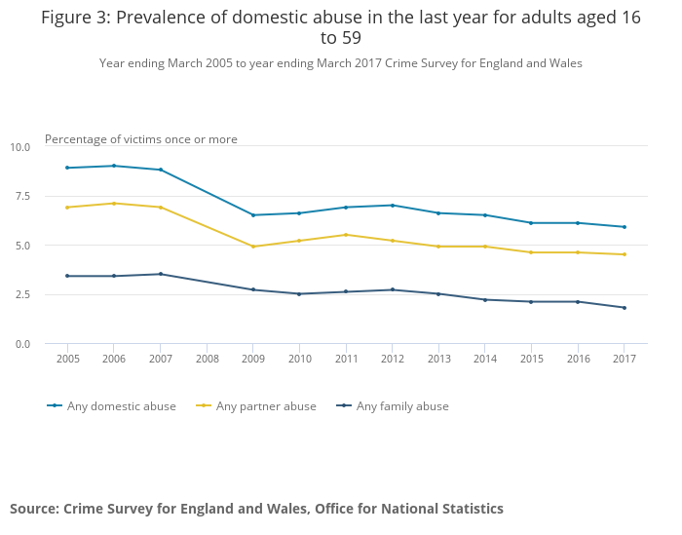
Percentage of women aged 16 to 59 who experienced intimate violence in the last year, by headline category, 2005 to 2017 CSEW

Slide 66
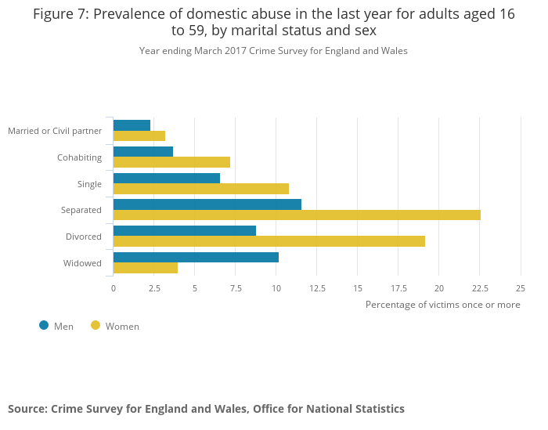
Figure one: Percentage of adults aged 16 to 59 who were victims of domestic abuse in the last year, by marital status and sex, year ending March 2017 (Crime Survey for England and Wales , 2017)

Slide 67
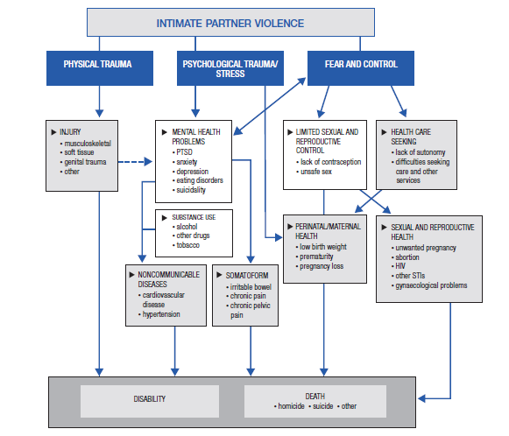

Slide 68
DVA and women from Black and Minority Ethnic Background
Experience additional barriers (gender, ethnicity and, marginalisation, institutional discrimination, lack of access to or knowledge of services, and cultural differences)
Exposed to violence from other family members
Other factors: lack of social networks; appropriate family support systems; lower personal income

Slide 69
Factors affecting Nurses and Health Care Professionals ability to assess DVA
Victims ability to disclose IPV
Practitioner ability to explore IPV
Workplace/ organisational support

Slide 70
Research Aims
Develop an educational resource to support nurses working in primary care who provide support and care to victims/ survivors of domestic violence (DV) from BME communities
  Exploring the experiences of a group of BME women
  Exploring the experiences of nurses working in primary care
  Co-producing of an educational resource based on the findings of fieldwork

Slide 71
Methods
Setting Sheffield, Rotherham
Sample BME women exposed to DVA (n=40)
Nurses working in Primary Care (n=30)
Other professionals (n=4)
Data Collection Individual Interviews (women=10; Nurses=8)
Focus Group Discussions (Women=2; Nurses= 2)
Resource Development 2 Participatory workshops (25 participants)
Data Analysis Thematic

Slide 72
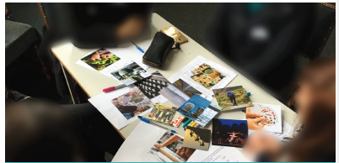
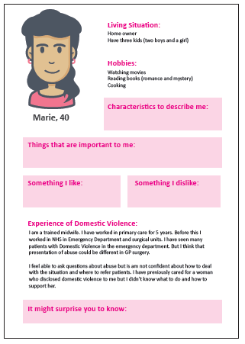
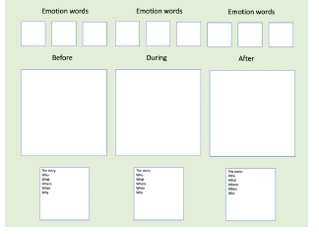
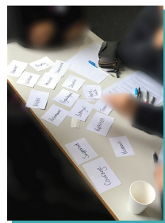
Co design workshop 1
Aim
To understand the lived experience of disclosing domestic abuse from a service user and service provider perspective

Slide 73
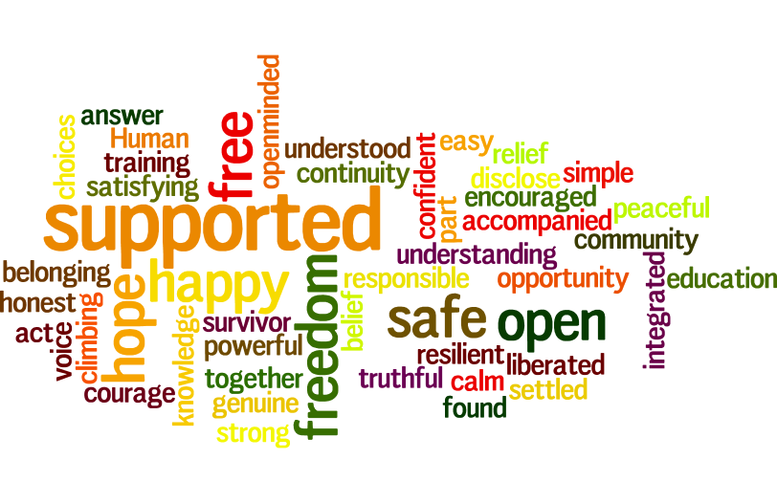
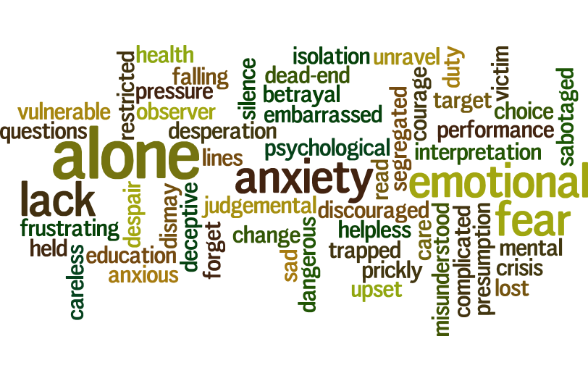
Co design workshop 1 outputs
Themes from story telling and specification statements

Slide 74
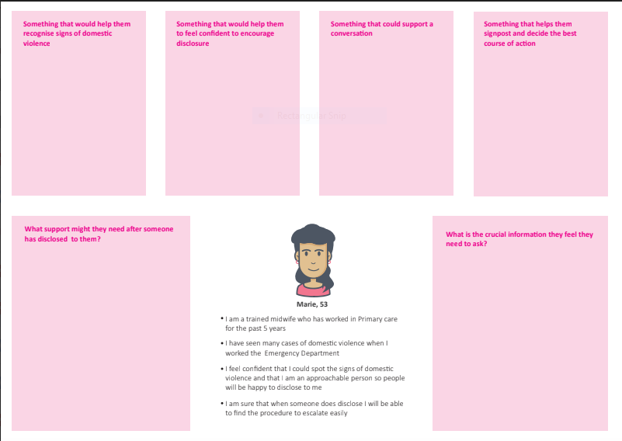
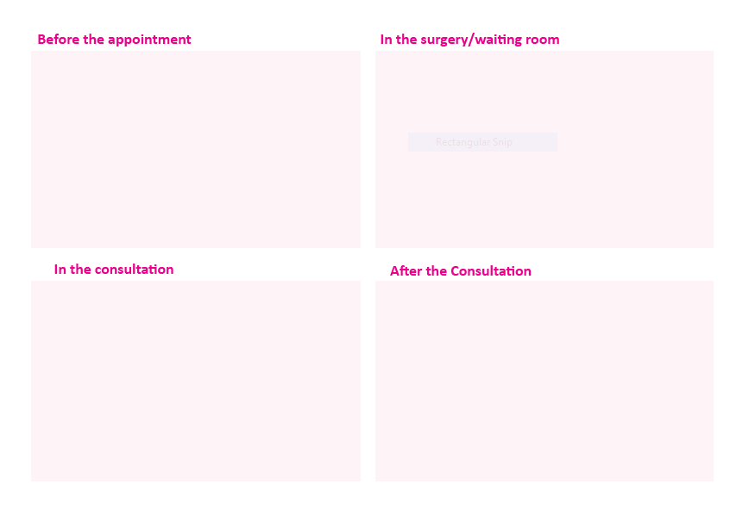
Co design workshop 2
Aim
To generate ideas for the educational resource to support domestic violence disclosure in BME communities

Slide 75
Findings
BME Women
Nurses
Role of Nurses and HCPs
Knowledge and Skills
Awareness of Available Services
Preparedness
Link with Other Services and Professionals
Training Needs

Slide 76
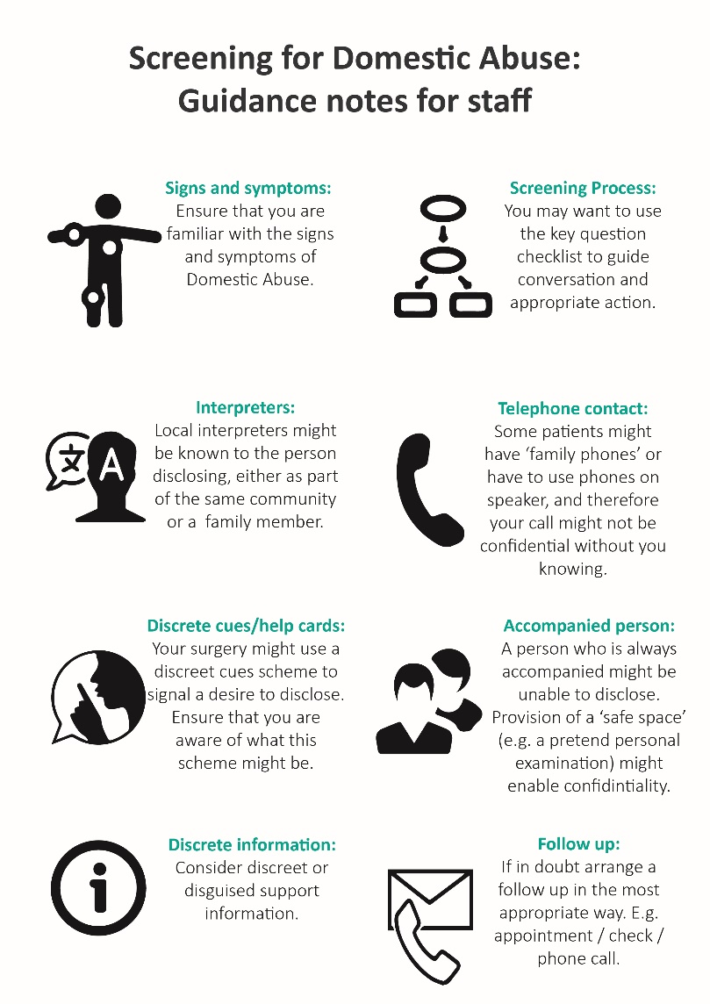
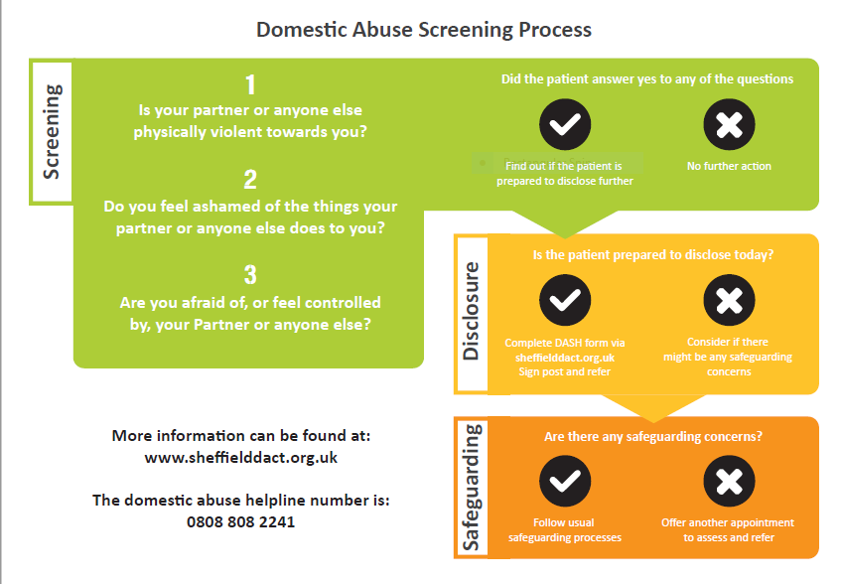
Prototype development

Slide 77
Othering and Domestic Violence
Cultural blaming
  This is acceptable in their culture
  Women from minority ethnic background are always victims of DV
  Asking question about DV will annoy the patient/ their family
Religious blaming
  The religion permits it
Gender blaming
  Men are always perpetrators of DV
Notes:
Domestic violence is a sensitive area and it is not easy for the practitioners to work with victims of abuse or perpetrators of abuse. It id an emotionally taxing issue which makes people think of ways of explaining the issue. And use of othering is one such example. There are many different examples of othering and some of these are listed here. Often there is cultural blaming or culturalisation of domestic violence which means that the culture is seen responsible for domestic violence and you would statement like’ this is acceptable in their culture’ or women from minority ethnic background are always victims of violence, when actually domestic violence persists in all cultures and societies and the rate of domestic violence are not much different in different groups.
Another example is religion blaming when people blame certain religions for violence. But if you actually look at any religion, you would similar teachings, expectations and description about women. Another example is gender blaming,. Thinking men are always perpetrators. While a larger majority of victims of violence are women, there is ample evidence that suggest that violence affects both men and women and can perpetrated by men or women in anytype of relationship.
white need to “save brown women from brown men,

Slide 78
“…its ok in their culture, and they think its normal for their husbands to be in control and the wife does as he says …think that’s the norm”
“Obviously they know physical abuse is abuse but its the other more subtle forms of abuse that they are not sure about”
Notes:
Here I have just shown a couple of example of qoutes from practitioners which demonstrate their conceptualisation of ‘other’ people.

Slide 79
Why Practitioners otherise?
Confidence
Lack of awareness
Rationalisation
Coping mechanism
Inability to deal with barriers
Notes:
So why people or practitioner otherise? Well there could be many reasons. For example, lack of confidence, lack of awareness about the culture, about the issue. It can be a result of an inability to know what need to be done and how needs of the people are met and thereofre practitioners may use othering to rationalise their behaviour. It could be their coping mechanism as many nurses, health care professionals and other practitioners do not always get appropriate support to cope with the emptional impactof dealing with such sentsitive and traumatising issues.

Slide 80
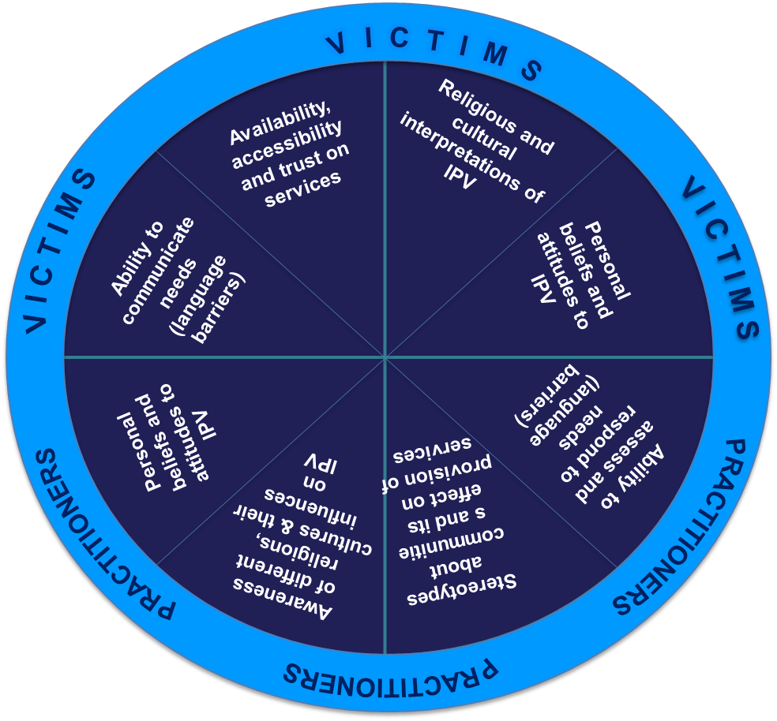
Factors affecting practitioner's ability to provide culturally sensitive services
Notes:
A couple of years back myself and colleagues conducted a study explore factors affecting DV practitioners ability to provide culturally sensitive care to patient. Fifty eight men and women, including domestic violence practitioners, interpreters, domestic violence key workers, religious leaders and IPV victims participated in the study. The data coming from practitioners clearly highlighted issues associated with practitioners awareness of culture, their personal attitude to wards violence and the stereotypes or prejudices that they had about particular community groups. These issue affected their ability to provide appropriate services. One thing was very clear that all of these issues are very much associated with othering as the practitioners saw these women different than them. They saw them as others with different issues.
While thinking of people as individuals is good and facilitates person centred care, unconscious othering can also have a negative impact when ‘othering acts as a barrier on provision of services

Slide 81
Parveen.ali@sheffield.ac.uk
@parveenazamali

Slide 82
Houry, D., Kaslow, N. J., Kemball, R. S., McNutt, L. A., Cerulli, C., Straus, H., . . . Rhodes, K. V. (2008). Does Screening in the Emergency Department Hurt or Help Victims of Intimate Partner Violence? Annals of Emergency Medicine, 51(4), 433-442.e437.
NICE. (2014). Domestic violence and abuse: how social care, health services and those they work with can identify, prevent and reduce domestic violence and abuse. Retrieved from http://www.nice.org.uk/guidance/ph50
Sundborg, E., Saleh-Stattin, N., Wandell, P., & Tornkvist, L. (2012). Nurses' preparedness to care for women exposed to Intimate Partner Violence: a quantitative study in primary health care. BMC Nursing, 11(1), 1.

Slide 83
Notes:
Thank participants for attending
This is the first of our network meetings, which will run every six months
Acknowledge that individuals in the room have experience of violence, abuse, and mental health problems
Let people know we have booked a separate room should anyone want to step out and take some time away from the presentations and discussions

Slide 84
Roundtable discussions: part I
We are seeking to develop an online data directory bringing together information about datasets that include both violence and mental health.
If you have previously used online data directories, what did you find helpful or unhelpful about them?
If you have not previously used online data directories, what might encourage you to access one?
What datasets (including administrative and research datasets) are you aware of that we should include in the directory?
#VAMHN

Slide 85
Roundtable discussions: part II
We want to set ourselves clear targets for success and have shared our draft with you.
What do you think of our short, medium, and long-term goals – is there anything you think we have missed or that should not be there?
What do you think about how we plan to measure our success (outcomes and evidence) – is there anything you think we have missed or that should not be there?
Some of the goals we have identified as important are lacking outcome measures and sources of evidence – what would you like to see us include here?
#VAMHN

Slide 86
Notes:
Thank participants for attending
This is the first of our network meetings, which will run every six months
Acknowledge that individuals in the room have experience of violence, abuse, and mental health problems
Let people know we have booked a separate room should anyone want to step out and take some time away from the presentations and discussions

Slide 87
Current and upcoming activities
Announcement of grant funding to support measurement of violence, abuse, and mental health
Events to mark 16 days of activism against gender-based violence
ECR bursary competition 2
ECR grant-writing workshops (to be announced in early 2020)
Recruitment of lived experience involvement coordinator and advisory panel
State of the art review for Social Psychiatry and Psychiatric Epidemiology

Slide 88
Next steps
We will….
With permissions, make slides and audio available online
Summarise roundtable discussions and make these available online
Follow up with individuals on specific ideas and any pressing suggestions from today
We hope you can…
Suggest resources you can bring to the network and initiatives you want to lead
Spread the word about the network among your colleagues and online
Keep talking with each other and with us
Join us again next time!
#VAMHN

