Slide 1
Reading or hearing about other people’s experience can:
Be upsetting
Be distressing
Lead to secondary trauma
Be combined with burnout and/or compassion fatigue
Notes:
What is secondary trauma? - Secondary Trauma – PTSD UK

Slide 2
Working with trauma can impact:
How you feel
Powerless
Helpless
Hopelessness
Anxious
Despair
Irritable
Sad
Overwhelmed
Grief
Anger
Unsafe
Intense emotions
Dread
How your brain works
Detachment
Nightmares and intrusive thoughts
Dissociation
Cynicism
Inability to empathise
Difficulties concentrating
Problems with memory
Doubting yourself
Judging others
Difficulties making decisions
How your body functions
Lack of energy
Restlessness
No appetite
Sleeping difficulties
Headaches/migraines
Aches and pains
Gastrointestinal complaints
Hives/rashes
Your work
Working harder/longer
Ruminating over case
Overidentification with or detachment from client
Blurred boundaries
Diminished creativity and flexibility
Impaired decision making
Impaired communication
Avoiding duties, supervision, colleagues, listening
How you behave
Avoidance
Disconnection
Self medicate
Changes in eating habits
Isolation
Changed sense of humour
Grandiosity
Neglecting own needs
Your beliefs
The world is a cruel place
There is no safe place
Helping is hopeless
People have all/no power
Scarcity mindset (I’m a victim)
There’s no hope for change
Notes:
Professional Quality of Life (ProQOl) website – ProQOL
PRoQOL measure - ProQOL Measure | ProQOL

Slide 3
Boundaries
Care for your body
Breaks
Self-compassion
Grounding
Rituals
Ta-da list
Breaks
Breathe
Take in the good
Move your body
Mix it up
Triggers
Connect
Supervision
Notes:
Grounding techniques – grounding-worksheet.pdf (winona.edu)
Ta da list - Why My Ta-Da List is More Powerful Than My To-Do List | by Linda Smith | The Startup | Medium
Boundaries (Brene Brown video) - https://youtu.be/Ck6atQ6xppc
Self compassion - Self-Compassion

Slide 4
'the solidarity of a group provides the strongest protection against terror and despair, and the strongest antidote to traumatic experience’
Judith Herman
Notes:
Judith Herman (2015) Trauma and Recovery: The Aftermath of Violence – From Domestic Abuse to Political Terror. New York: Basic Books.

Slide 5
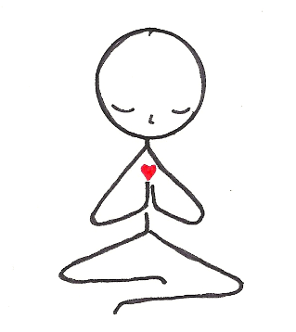
Notes:
Collection of resources: https://avaproject.org.uk/covid-19-resources/supporting-yourself-during-through-covid-19

