Slide 1
Global Strategies to Reduce Violence Against Women
PROF RACHEL JEWKES
EXECUTIVE SCIENTIST FOR RESEARCH STRATEGY AND INTRAMURAL UNITS, SOUTH AFRICAN MEDICAL RESEARCH COUNCIL
FORMER Consortium director, what works TO PREVENT VIOLENCE AGAINST WOMEN AND GIRLS? global programme

Slide 2
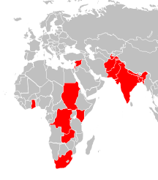

DFID flagship programme: What works to prevent violence against women and girls?
What Works has generated new knowledge on :
  prevalence and drivers of violence
  what works in prevention
  costs of violence prevention
We have undertaken research in 13 countries of Africa, Asia and the Middle East including evaluating VAWG prevention interventions

Slide 3

Content
VAW in global contexts: prevalence and drivers
What do we know about prevention of VAW?
What features of the design and implementation of interventions are associated with success?
Concluding thoughts

Slide 4
What do we mean by violence against women (and girls)?
Non-partner sexual violence incl. sexual abuse in childhood and adolescence
Intimate partner violence: physical, sexual, emotional, economic
Globally intimate partner violence and non-partner sexual violence are the most highly prevalent
Other forms of VAWG: sexual slavery/ trafficking, FGM, child marriage, ukuthwala, Swara etc

Slide 6
Prevalence of women subjected to physical and/or sexual violence in the past 12 months in the research populations of What Works?
* Only physical IPV

Slide 7
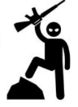
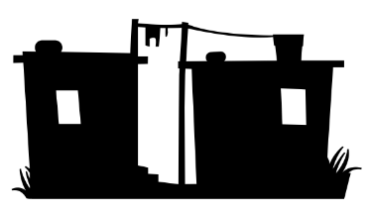
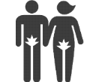
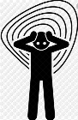

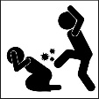


Drivers of violence against women

Slide 8
Women and girls with disabilities
2 x increased risk that women and girls with disabilities will be subject to sexual and/or physical IPV in the past 12 months
Research definition of disability included mental health related disability
Analysis based on data from 7 studies in 5 countries

Slide 9
What Works studies evaluated VAWG prevention programming on..

Slide 11
VAW prevention through gender transformation and economic empowerment programmes
Poverty & women’s financial dependence on men are very well established drivers of VAWG
There is compelling evidence that cash transfers can reduce women’s experience of IPV, particularly when combined with conditionalities
Economic interventions on their own have not been shown to reduce IPV
A gender transformative intervention with economic empowerment interventions can reduce IPV, prevent possible backlash IPV and improve economic outcomes

Slide 12
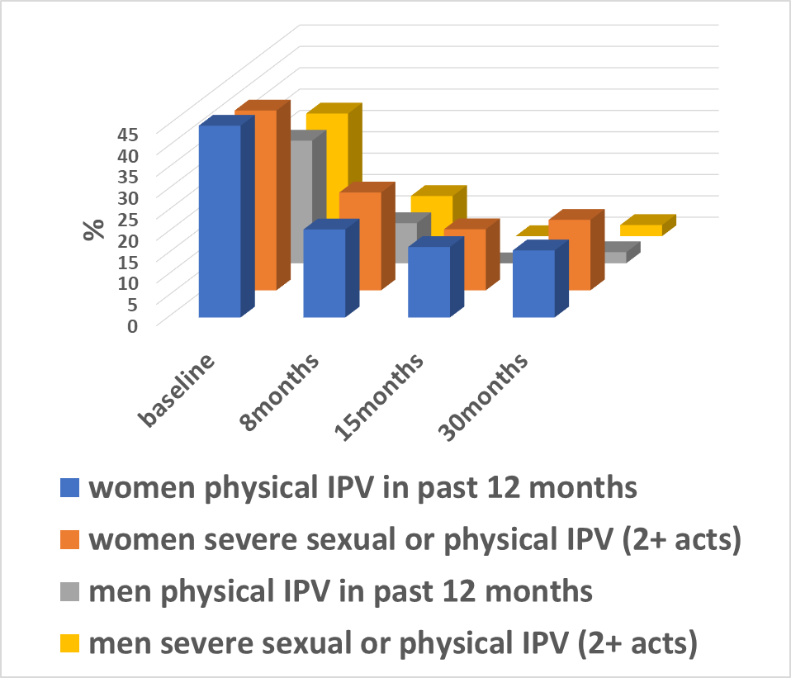
What Works’ contribution
Zindagii Shoista, Tajikistan: impact after 15 months intervention
Interventions must be built on a strong contextual understanding
Emerging evidence from What Works has pointed to the value of economic interventions with poor and marginal men and shown that they may enable engagement around gender and power that would otherwise not be possible
It has also shown the value of interventions with families
Interventions must be sufficiently intensive
Delivered by highly trained and supported staff
The quantum of economic empowerment must be meaningful

Slide 14
Interconnection between gender attitudes and roles, and social norms on gender and violence and practices of VAWG
There is good evidence that interventions using volunteer community activists can change attitudes and norms related to the use of VAWG in communities

Slide 15
Interventions to change gender attitudes and roles, and social norms on gender and violence
Well trained and supported community activists can be very effective in VAWG prevention
Awareness raising alone does not change behavior. It must be followed by meaningful interpersonal engagement and programmes addressing drivers of violence using participatory methods
Effective interventions constructively engage community leadership structures – religious and traditional – as well as engage and support the police, health and social services
Direct engagement with couples experiencing IPV and enabling access to services are key elements of more effective interventions
Interventions are successful when they are:
  Sufficiently long (2+ years)
  Based on a strong contextual understanding, theory of change, and each stage is properly prepared for, resourced etc
  All workshops and activities need to have manuals

Slide 16
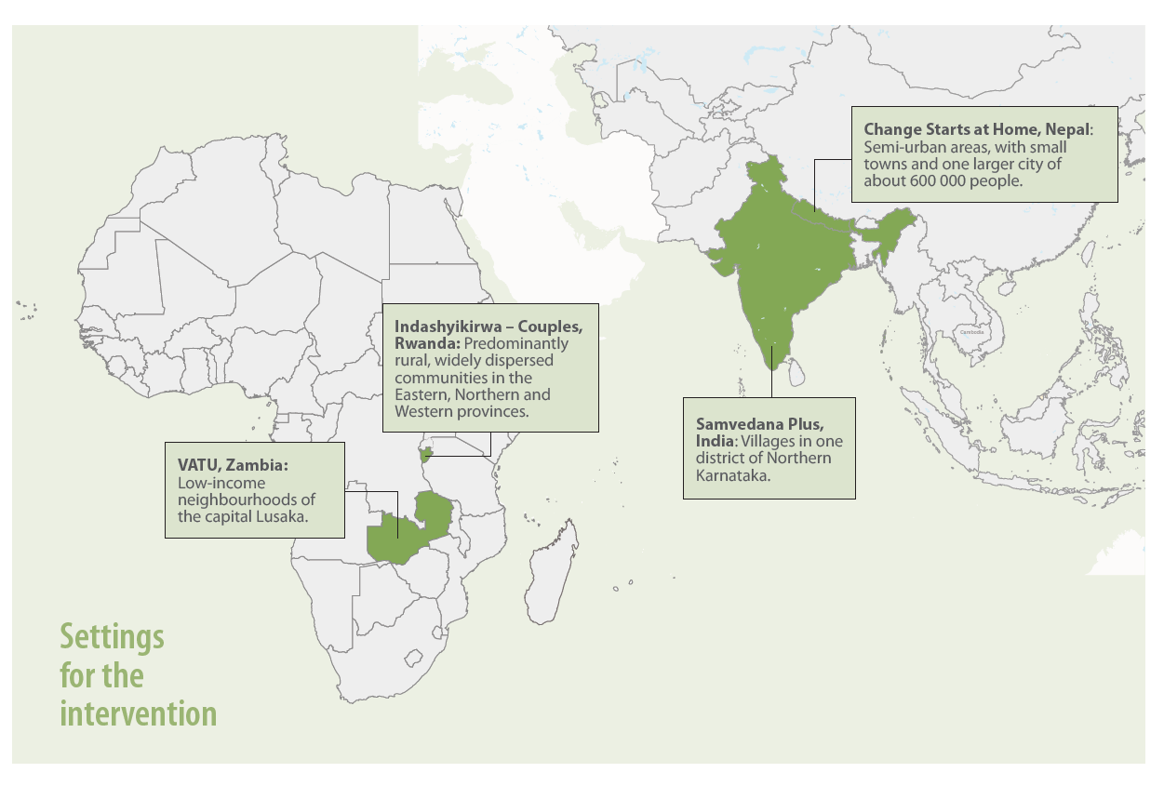

Slide 17
Couples and special populations
Couples programming can be delivered safely and reduce IPV
We have demonstrated particular benefit in:
  Couples (family) economic & gender empowerment interventions
  Substance abuse driven violence
  Highly patriarchal & traumatised populations
  Counselling as an adjunct to social norms change interventions
These interventions are effective where the overall interventions addresses the key drivers for VAWG and where there is a direct and overt focus on building the relationship of ‘the couple’
Effective interventions for couples:
  in the general population
  with substance abuse problems using psychotherapeutic approaches

Slide 19
Connections between VAWG and education
There is evidence for the effectiveness of school-based interventions for reducing dating violence, but mainly delivered outside the class room teaching

Slide 20
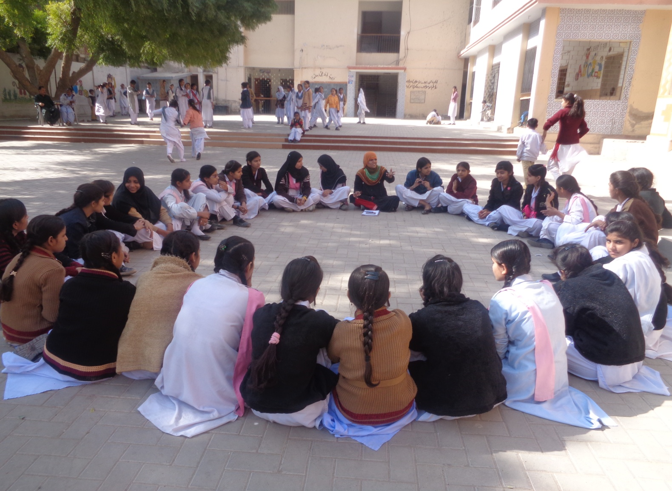
Key learnings from what works to prevent violence experienced by, and among, children
Interventions must empower children
Must be age appropriate
Children take time to process and learn new ideas: Effective interventions are delivered over a long period of time
Designed to address multiple drivers of violence
Effective methods are participatory (including play-based) and build gender equity and relationship and communication skills, fostering positive interpersonal relations

Slide 21
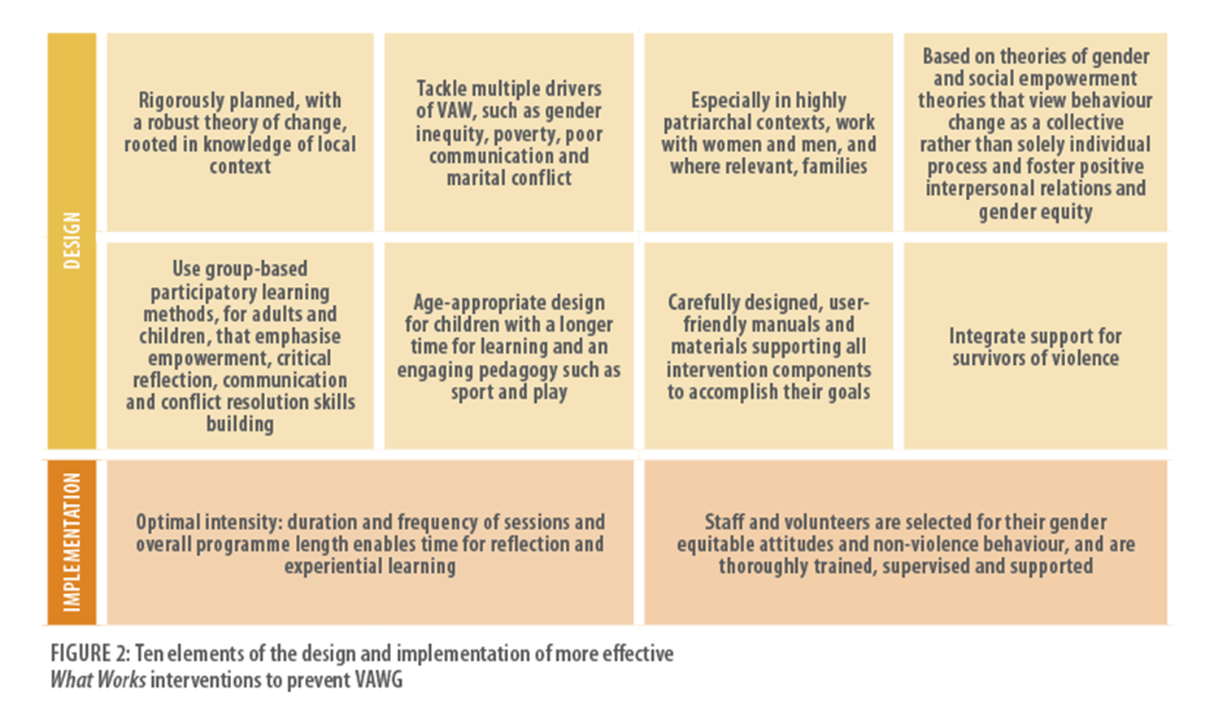
Ten elements of design and implementation of more effective interventions
having a strong theory of change based on a contextual understanding of drivers of violence and social and gender empowerment theory, but some evidence for psychotherapeutic approaches, when needed
Address multiple drivers and (mostly) work with men and women (+/- families)
carefully designed to ensure different parts of the intervention could achieve the goals of the theory of change – appropriate manuals and materials
well established behaviour change methods using participatory (group) learning approaches for adults and children, including emphasis on critical reflection and positive interpersonal relations -communication and conflict resolution skills building.
Support survivors or positively engage with couples with IPV
Age appropriate design
Implementation
Programming with sufficient intensity and duration (no short interventions)
Personnel (staff and volunteers) – selected with established gender equitable attitudes and non-violent
Personnel – comprehensively trained, supported

Slide 22
Global evidence on what works to prevent VAW: 104 studies of 95 interventions evaluated with RCT or quasi-experimental design

Slide 23
We have a repertoire of interventions that are effective that can be adapted and taken to scale
Table of What Works? based on an in-depth review of the physical/sexual IPV prevention field 2019

Slide 24
Recommendations for preventing VAW and advancing the global research agenda
For donors
For practitioners
For researchers
Increased investment in evidence-based programming & evaluation
Stop funding approaches proven not to work to prevent VAW
Adapt and scale up programmes for different populations & contexts
Innovate
Increase the rigor of research methods
Report evaluation studies using standard approaches
Measure the impact on multiple forms of VAWG
Measure the effectiveness of interventions among women with multiple forms of discrimination

Slide 25
Conclusion
Violence against women and girls has a deep and enduring impact on women’s lives, wellbeing and economies
Yet it is preventable in programmatic timeframes
Robustly designed and implemented interventions are essential for success
There is a global repertoire of interventions that are effective in multiple settings, and can be adapted and taken to scale
We are positioned now to make a real difference to women’s and girls’ lives and it is imperative that we translate the science of the field to real impact on the ground

Slide 26
Acknowledgements
What Works was funded by UK Aid from the people of the United Kingdom and the funds were managed by the South African Medical Research Council
The Global Programme was managed by the South African MRC, LSHTM and Social Development Direct
Huge thanks to all the individuals and organisations who worked with us over the What works journey

