Slide 1
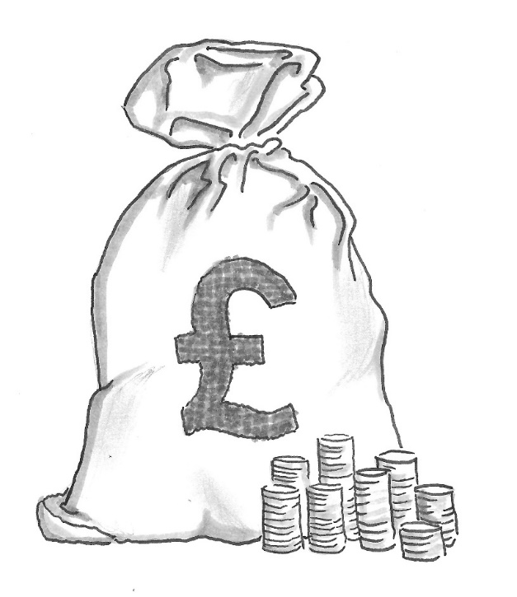
VAMHN ECR Seminar: Ins and outs of grant applications, 17 Nov 2021
idea
Demystifying the Grant Review Process
Who are you writing for?
Dr Eoin O’Sullivan, University of Cambridge

Slide 2
Grant writing is not paper writing

Slide 3
Why (some) academics struggle to write proposals
Paper writing versus grant writing
Why academics have a hard time writing good grant proposals, R.Porter (VA Tech):
www.wpi.edu/Images/CMS/OSP/Article_on_Proposal_Writing.pdf

Slide 4
Why (some) academics struggle to write proposals
Grant writing is not paper writing
Some researchers don’t feel comfortable “selling”
Believe a proposal’s success shouldn’t be dependent on stimulating excitement or enthusiasm in reviewers...
Feel more comfortable carefully / cautiously reporting highly technical findings that have been carried out, rather than persuading others to fund work yet to be done
Feel they shouldn’t need to “dumb down” for generalists
More used to disseminating to peers in narrow technical field...

Slide 5
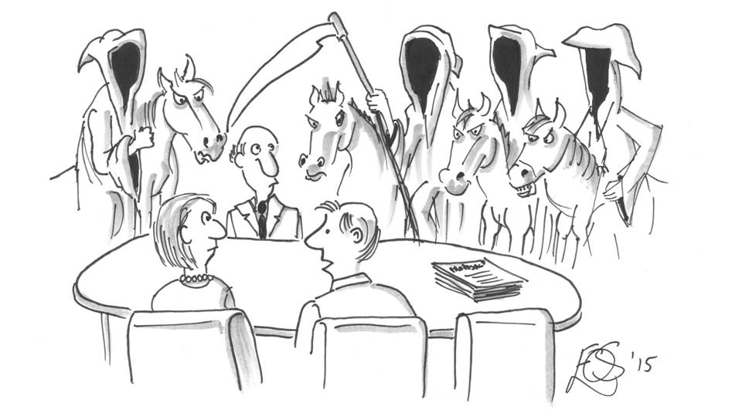
Demystifying the review process
What really goes on in a review panel
“Is it just me or are these review panels getting a lot tougher?”

Slide 6
What goes on in review panels
It’s a competition
Survive the attrition

Slide 7
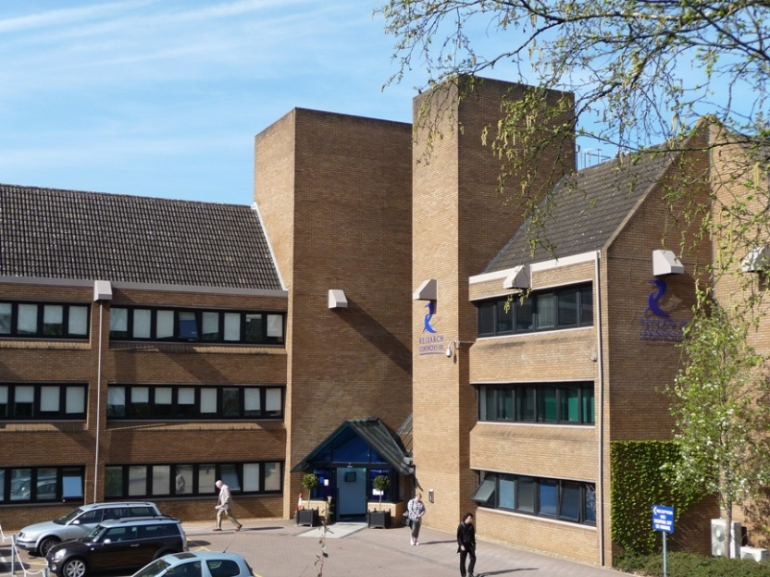
What really goes on in a prioritisation panel...
Proposal
Big pile of ~40-50 proposals
+
postal reviews
+
response to reviewers

Slide 8
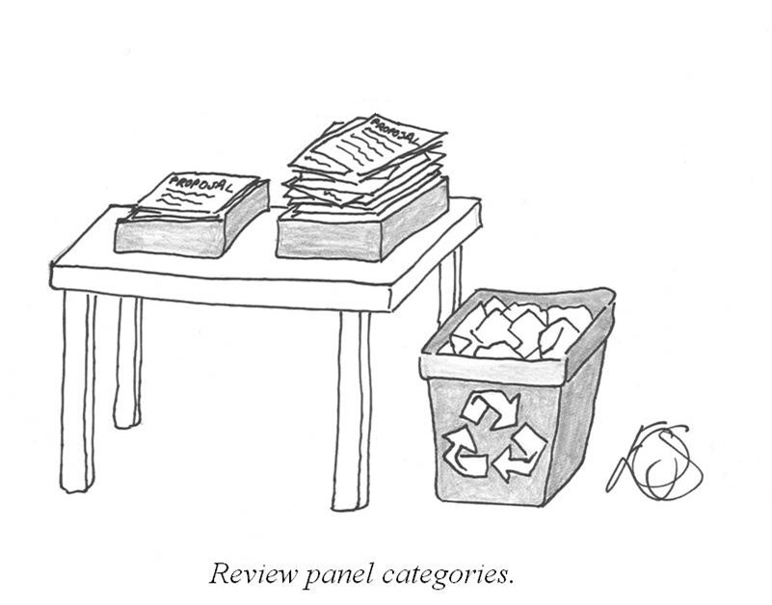
What really goes on in a prioritisation panel...

Slide 9
What goes on in a prioritisation panel...
DEFINITELY FUND
MAYBE
FUND
DO NOT
FUND
First iteration
All about the excellence
Number that can be funded (£)

Slide 10
What goes on in a prioritisation panel...
FUND, IF FUNDS AVAILABLE
DO NOT
FUND
DEFINITELY FUND
Rank order

Slide 11
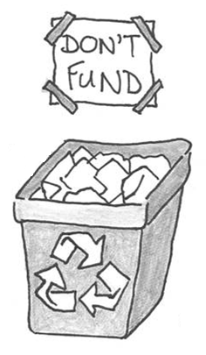
What goes on in a prioritisation panel...
It’s a competition: Main goal is to…
Survive the attrition
Need to distinguish your proposal.
Need to stand out
Give reviewers reason to keep you in ‘maybe’ pile during 2nd, 3rd... n^{th} iteration
Not just about the ‘case for support’... Other issues matter…
Compelling story about potential impact
Convincing partnerships which add value
....

Slide 12
Heilmeier’s Catechism
Some basic questions the proposal needs to have clear answers to

Slide 13
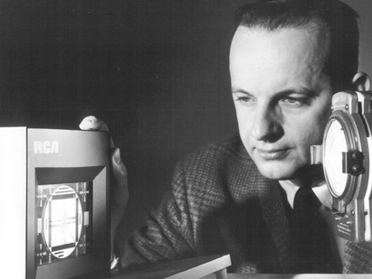
What are you trying to do? Articulate your objectives using absolutely no jargon.
How is it done today, and what are the limits of current practice?
What’s new in your approach and why do you think it will be successful?
Who cares?
What difference will it make?
What are the risks and the payoffs?
How much will it cost?
How long will it take?
What are the midterm and final "exams" to check for success?
Heilmeier’s Catechism

Slide 14
Summary
Three key messages:
Grant writing is not paper writing
It’s ok to ‘sell’. It’s ok to convey excitement
Write for the prioritisation panel
It’s a competition. Need to stand out.
Remember ‘Heilmeier’s Catechism’
Need clear visible answers to the basic questions:
What’s new? Who cares? What difference will it make?...

Slide 15
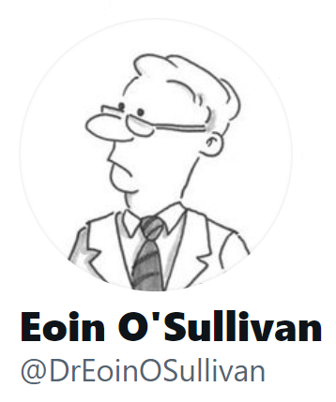
Thank You
Dr Eoin O’Sullivan
eo252@cam.ac.uk

