Slide 1
Supporting ‘off-radar’ children at risk of abuse in the home
VAMHN Seminar 1st October 2020
Concetta Perôt, Psychotherapist & Research Consultant, Co-founder Survivors’ Voices, Hon. Associate King’s College London
concetta.perot@kcl.ac.uk
concetta@survivorsvoices.org

Slide 2
Survivors responding to lockdown
Reliving terror of entrapment -> ‘survivor mission’ (Judith Herman)
Survivor-initiated & survivor-run project, in line with the Survivors’ Charter that considers survivors central to the entire research process
Specific population of children & young people (c&yp) – those experiencing violence and abuse but “off-radar” to services
Initial quick-fire, urgent survey aimed at adults with this direct experience : 3 day turnaround, 43 responses 39 from adult survivors
Interim report produced April 2020

Slide 3
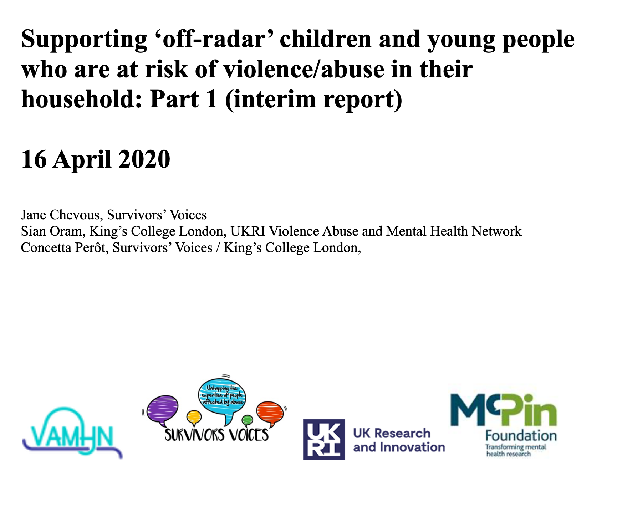
Interim report – April 2020
1. Communication: ideas to reach off-radar c&yp, campaigns, methods,
content…
2. Range of ideas for action to be taken by :
schools, nurseries and childcare
Statutory services (sw, police, health)
Youth and community organisations
Governmental and inter-agency
Communities and families
Distributed to Silver Command group via Survivors Trust, reporting to Cabinet

Slide 4
Deepening & enriching the understanding ….
Second survey enquiring further about actions that enable identification, disclosures and support for off-radar c&yp at risk in their homes
Draft report and themes
Forthcoming roundtables with survivors, professionals and people with skills in communications (Oct / Nov 2020)

Slide 5
Our second survey (n=71)

Slide 6
The findings of our survey focus on:
Recognising abuse
Disclosing abuse
Supporting children and young people experiencing or at risk of abuse
Messages of hope to children and young people experiencing or at risk of abuse
Thematic analysis of free text fields
Top 3 urgent actions from survey 1 ranked by respondents

Slide 7
Top 3 highest ranked urgent actions

Slide 8
Thematic analysis
3 survivor researchers
Themes to be explored at forthcoming roundtables

Slide 9
1. Barriers to disclosure
It is impossibly hard for many children and young people being abused at home to reach out for help & tell
Trauma bonding
Lack of recognition that what is happening is not right or normal
Internalised messages of secrecy and threat from abusers and family systems
Trauma behaviour being mislabelled - ‘difficult child’
Stereotype of abused child as ‘troubled child’ hides ‘model child / pupil’ as a trauma response
Attempts to tell dismissed / poorly responded to
Issues of resourcing of statutory services to respond – children’s services, CAMHS, teacher time…

Slide 10
“... I was dying for someone to openly ask me about this as I did not have the words to describe what was happening to me.”
“ Looking back, if a teacher, doctor or friend of the family asked me directly if I felt safe at home - it would have been an opportunity to say no without having to find the courage or the words that as 10 year old I lacked."
"To encourage disclosure, honesty is key. Telling children that it is safe and ok to talk about what is happening, and it will all be ok will not help. Children who are being abused will be conditioned not to tell people, which may well include threats of what will happen if they do talk. In situations where it is someone very close to them doing the abusing, then they will not trust a stranger who suddenly tells them something different. In addition, children will know that talking about the abuse risks bringing change, and not being up front about that wont help."

Slide 11
2. Education to help recognition of abuse
Critical to raise awareness, reflected in the VAMNH Research Priorities Consultation with survivors conducted in 2019
Normalisation and trauma bonding mean often even the most severe abused not seen as ‘abuse’ - need to use a wider range of language, not just the words ‘violence & abuse’
Education needed for c&yp, professionals and communities, including recognizing and responding to abuse
School based education for c&yp critical, as are social media, ‘influencers’ & communication in ‘normal places’ c&yp people go
A national, public information campaign needed

Slide 12
“In my case, it was not until I got to university that I discovered other people's fathers didn't hit them. I had always assumed that this happened to everyone.”
"Educate all children about safe and unsafe experiences at home so they can recognise what is acceptable and unacceptable living situations and make them aware of services available for them to access"
“We need to make sure that every single adult knows what child abuse is and what the signs are so that if you need to, you can disclose to your neighbour or your local shop keeper and they would know what to do.”

Slide 13
3. Safe places & relationships of trust are critical
Safe places & trustworthy people - at school, in mental health & support services and in the community - was mentioned repeatedly
Creation of safe places requires intentionality eg. ‘ambassadors’ (cf. dementia friends); in pandemic restriction times having pastoral check-ins with teacher who has rapport
Real listening - backed up with training for professionals in responding
Interventions…tricky area due to fear, attachments etc. but empowering c&yp with a range of options (as far as possible) to support their wellbeing

Slide 14
“In my experience having one consistent trustworthy adult was key! This can be anyone”
“Surround the community with a positive set of invisible proactive people.”
“Provide more community base drop in centres for children to access a safe place which is known for a 'hang out' place but also offers lots of advice/support resources of different topics; domestic abuse being one of them."
“ LISTEN LISTEN LISTEN!!! I was in so much pain, I need someone to listen to me, one human talking to another."

Slide 15
"Really listen to young people and remove your adult safeguarding lens for a moment to fully take in what a child is communicating with you... listen to them with love and care and try to walk in their shoes as much as possible.”
“Someone really seeing you as a person and a human being, and validating your experience, is the most powerful thing that services, organisations and communities can do to help off-radar children experiencing abuse, whether that leads to disclosure or not."
"So I think it would be helpful if children knew there was a "safe" and confidential way to talk first, assess their options, and then decide who they want to disclose to. We need to trust children. An abused child's worst fear is disclosing and then a professional going to their abuser with it and things getting worse for them”

Slide 16
Taking it further…
Reviewing our analysis, deepening and enriching through roundtables
Production of policy & practice guides aimed at different sectors, governmental and inter-agency
Production of communication tools aimed at c&yp and wider community (for various mediums), including “Messages of Hope”
Lessons for lockdown…lessons from lockdown…
Implications for statutory safeguarding pathways & interventions…
Follow up projects that retain the distinctive that this is a survivor-run initiative aimed at tapping the expertise of survivors and their allies in order to target system change where it is really needed

Slide 17
References
The VAMNH Consultation on Survivor Research Priorities (2019)
The Charter for Engaging Survivors in Project, Research & Service Development (2018)
Supporting ‘off-Radar’ children & young people who are at risk of violence/abuse in their household: (Part 1) interim report (2020)

