Slide 1

Notes:
Thank participants for attending
This is the first of our network meetings, which will run every six months
Acknowledge that individuals in the room have experience of violence, abuse, and mental health problems
Let people know we have booked a separate room should anyone want to step out and take some time away from the presentations and discussions

Slide 2
Programme
10.30- 10.40 Welcome and aims of the day
10.40-11.15 Findings from research prioritisation – Dr Dan Robotham & Dr Angie Sweeney
11.15-12.00 Roundtable Discussions
12.00-13.00 Lunch
13.00-14.00 NGO Presentations
- Safe Lives - Emma Vallis and Shanti Rao – Domestic Abuse Perpetration and Mental Health Needs
- Standing Together Against Domestic Violence - Sarah Hughes - Implementing Lessons from Domestic Homicide Reviews: A Focus on Intimate Partner Violence
14.00-15.30 Domestic Homicide International Research Group presentations
- ​ Learning from Domestic Homicide Reviews: Parricide, Mental Health and Domestic Abuse - Dr Khatidja Chantler, University of Central Lancashire
- Domestic homicide, mental health and substance misuse - Dr Solveig Vatnar, Oslo University Hospital
- Children and Domestic Homicide - Prof Nicky Stanley, University of Central Lancashire
15.30-16.00 Upcoming activities and events, plus Q&A

Slide 3
Network meeting – aims
To share information about network aims and activities
To discuss how we can best work together
To share recent findings and resources

Slide 4
Our vision is to reduce mental health problems by addressing associated violence and abuse, particularly domestic and sexual violence.

Slide 5
Why an interdisciplinary network?
We believe that progress will require:
A shared language and approach to measurement
A better understanding of pathways to domestic and sexual violence and their relationship to mental health problems
Improved experiences of health and social care
More effective interventions

Slide 6
Network objectives
Co-producing prioritised research questions on violence, abuse, and mental health.
VAMHN/McPin Foundation Research Prioritisation
Supporting research on violence, abuse, and mental health
Networking and learning events | Grant competitions | Online data resource |
Ethics and safety protocols
Developing cross-disciplinary methodological approaches
Methodology workshops | Grant competitions
Nurturing the next generation of researchers (incl. survivor researchers and non-university researchers) in this field
ECR Network | Travel and training bursaries | Grant-writing workshops

Slide 7
Network themes
Measurement of domestic and sexual violence and related outcomes in relation to mental health
Understanding pathways to domestic and sexual violence and their relationship to mental health problems
Interventions and services to prevent, reduce, and address domestic and sexual violence in people with mental health problems or at risk of problems.

Slide 8






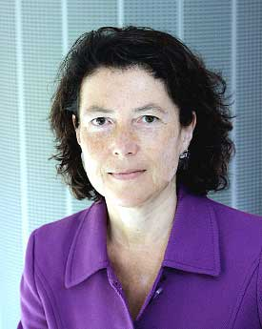


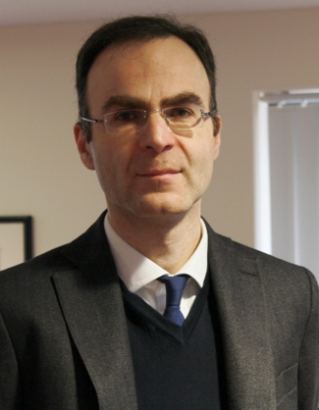


VAMHN Team
Professor Louise Howard: Women’s Mental Health at King’s College London
Dr Alana Harris: Historian at King’s College London
Dr Jude Towers: Violence and Society at Liverpool John Moores University
Dr Sian Oram: Women’s Mental Health at King’s College London
Dr Emma Howarth: Children’s Mental Health at University of Cambridge
Dr Angie Sweeney: Social Scientist at St George’s University of London
Professor Sylvia Walby: Director of Violence and Society Centre at City University of London
Dr Ravi Thiara: Gender Violence at University of Warwick
Dr Rachel Hewitt: History and Creative Writing at Newcastle University
Professor Seena Fazel: Forensic Psychiatry at Oxford University
Dr Leonie Tanczer: International Security and Emerging Technologies at UCL
Prof George Danezis: Security and Privacy Engineering at UCL

Slide 9
Network members
More than 300 individuals and organisations, including from
  In academia - anthropology, computer science, criminology, data science, electrical engineering, epidemiology, gender studies, geography, health economics, history, implementation science, law, literature, mental health nursing, psychiatry, psychology, psychotherapy, public health, social care, sociology, statistics, survivor-led research
  In the third sector – Agenda, Action for Children, AVA, Bristol Reconnect, Family Action, MMHA, McPin Foundation, MQ, NSPCC, Place2Be, Rape Crisis, Safe Lives, Standing Together Against Domestic Violence, Stefanou Foundation, Survivors’ Trust, Survivors’ Voices, Women’s Aid
  Policy, policing, journalism, publishing.

Slide 11
Setting research priorities
Dan Robotham, McPin Foundation
Notes:
Introduce McPin
Introduce what we will be talking about
- These are not final – this is a process we are going through

Slide 12
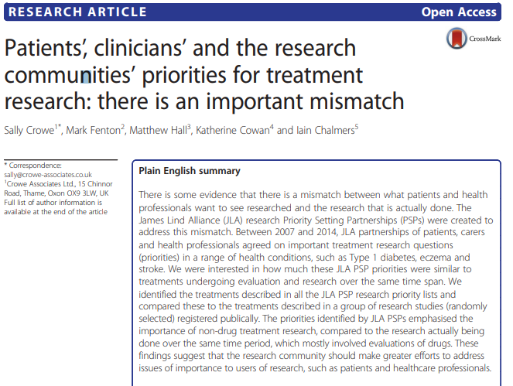
Setting research priorities - why bother?
Notes:
85% of biomedical research is ‘wasted’ (Chalmers & Glasziou, 2009)
Wrong questions being asked
Wrong outcomes assessed
No stakeholder involvement
Poor design/bias
Under-reported, unpublished, inaccessible findings

Slide 13


Setting research priorities – how?
Notes:
What research really matters, and to whom?
We’re not doing a full JLA process here – time consuming and beyond the budget we have.

Slide 14
Process
Involvement
Involvement
Involvement
Surveys
Analysis
‘Nominal’ groups
Notes:
Survey developed with insight from people
Developing the blurb

Slide 15
Survey
What do you think are the most important research question(s) relating to how violence and abuse affects mental health? (Please list as many as you like)
Notes:
There were other questions, but this was the most important one.

Slide 16
Sample
89 responses
  70% survivors of violence or abuse
  69% experienced mental health problems
  64% support someone who has experienced violence or abuse
  77% support someone who has experienced MH problems
84% Female
67% White British
69% defined themselves as ‘Heterosexual or Straight’
28% considered themselves to have disability

Slide 17
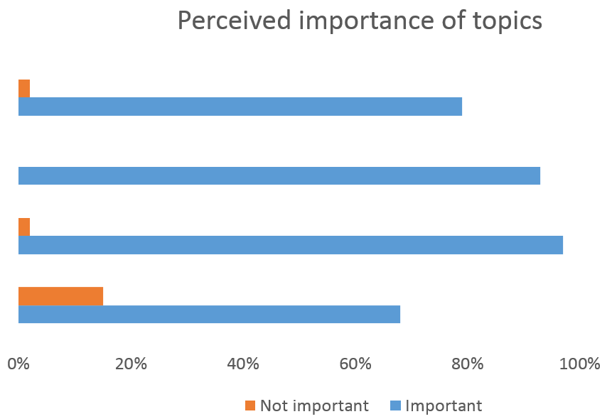
Our example topics
How is technology changing people's experience of abuse?
How can the risk of developing poor mental health be reduced?
Reducing the risk of people with mental health problems experiencing violence against them?
Developing research methods to research the topic of violence, abuse and mental health?

Slide 18
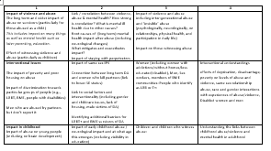
Analysis
Themed the data
Four independent analysts
Collation of analysts themes
Send back for comment
List of themes for stage 2

Slide 19
Potential ‘stage 2’ process
Ranking
Tell group the average
scores
Individual
Rankings#1
Group discussion
Individual
Rankings#2
0
Time (hours)
4
Notes:
Need three people, one computing in real time, one chairing, one co-facilitating (handing out packs)
Some people will be slower than others in the rating sessions
Also did a Delphi group with consultant psychiatrists (as it was hard to get everyone in a room together at the same time)

Slide 20

Preliminary themes
Impact of violence and abuse
Intersectional issues (e.g., impact of poverty, poor housing, etc.)
Impact of early childhood
Empowering survivors to seek help/speak
Stigma of being a survivor
Support & effective services
How survivors experience structural or organisational settings
Why do perpetrators abuse?

Slide 21


Contact
DanRobotham@mcpin.org
@djrobotham

Slide 23
Roundtable discussions
What are the most significant opportunities and challenges for this network over the next 4 years?
What does coproduction mean in the context of this network?
How can we make the most of member expertise and resources to make this network effective and high impact?
What will make this network worthwhile to its members so that people continue to join and stay?
How do we avoid having lots of “silent” members (e.g. lots of people signed up but only a small number actively engaging)?

Slide 25
Domestic abuse perpetration & mental health needs
Suzanne Jacob, Emma Vallis and Shanti Rao
VAMHN Open Network Meeting, 11th March 2019

Slide 26
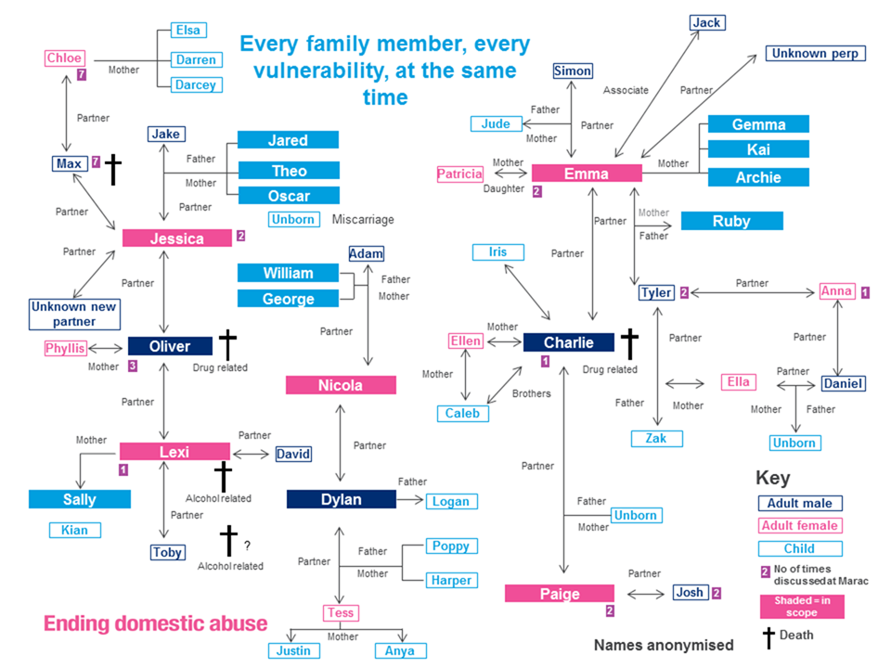

Slide 27




Our strategy to end domestic abuse, for good
 | Whole Person Seeing and responding to the whole person, not addressing a series of issue | Whole Family Adult victims, survivors, those who harm, individuals connected to the victim/perpetrator including extended family | Whole Community All communities of geography, identity and online spaces | Whole Society The general public and those who influence them: the media, politicians, employers, key opinion formers and commentators
Act before someone harms or is harmed | People are treated as just that – people, and not issues. The complexity of domestic abuse and links to other adverse experiences are understood. | Protective factors are put in place for those at risk of abusing or being abused – people and services sufficiently understand domestic abuse and what makes it more or less likely to happen | Communities of geography, identity and online spaces are equipped to identify and act on early risk factors and warning signs of abusive situations. | Gender stereotypes are challenged and deconstructed – particularly those of masculinity – supporting boys and men to break these norms. Societal shifts see a reduction in the motivation and opportunity for different types of power to be abused.
Identify and stop harmful behaviour | Harmful behaviour is addressed by proactively identifying all motivating factors and consequences, such as other violence, abuse and criminality. | Individuals who abuse any family member are appropriately assessed for the risk they pose to all family members – and themselves. | Community members know they are more than passive bystanders – there is low tolerance and high urgency about identifying and holding to account those who abuse.
Increase safety for those at risk | The protection offered to people means proactively checking that all risks posed have been addressed, not just the initial presenting issue. | The safety and wellbeing of all non-abusive family members – physical, mental and emotional – is defended from those who pose a risk to them. | Communities of geography, identity, online spaces and employers/ businesses understand the risks posed by those who abuse and their role in protecting the safety and wellbeing of those at risk.
Support people to live the lives they want after harm occurs | People are responded to as people, not an issue or series of issues. Both crisis and longer term responses to people who have experienced abuse are sensitive to their possible vulnerability to future adverse experiences. | When an immediate experience of abuse is over, all family members’ safety and wellbeing – physical, mental and emotional – are (re)built. People are supported to live the lives they want, drawing strength from each other. | People who speak about their experience of abuse are believed. Communities and society validate their experience and support their process of creating safety, wellbeing and resilience so they can live the lives they want. The voices, strengths and needs of survivors are paramount, and survivors draw further strength from one another
Notes:
In everything we do, the expert voice of frontline practitioners and the authentic voice of survivors will be a prominent and vital part. We will keep expanding the opportunities for those with lived experience to speak for themselves, in their own voices, and be heard by those who can make change.

Slide 28
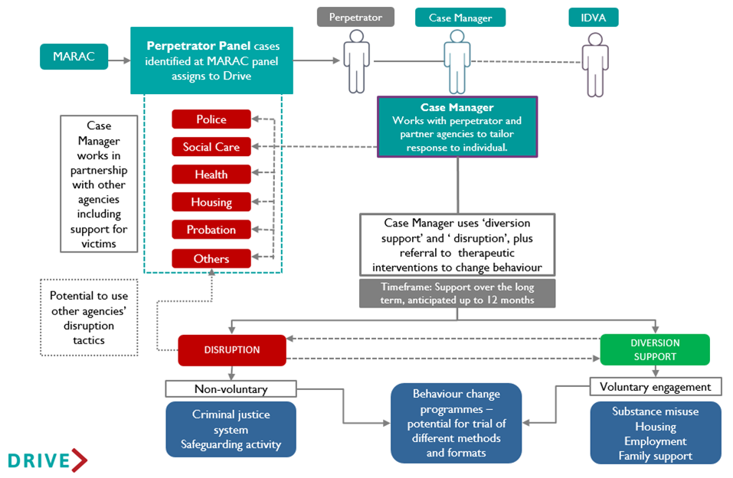
The Drive model
Drive is an intensive intervention which coordinates action around those perpetrating abuse, with the aim of disrupting abuse and challenging and changing behaviour.

Slide 29

Overview
Why is it important to understand the relationship between domestic abuse perpetration and mental health?
What are the needs of those perpetrating abuse?
Why are these needs so prevalent?
How does Drive work with service users who have mental health needs?
Notes:
Prompts:
Introduce title ‘perpetration of DA and MH needs’
Go through overview
Mention ref (e.g. they are numbered on the slides)

Slide 30
Key points
Most people with mental health needs are not violent and will never perpetrate abuse¹
Mental health needs are never an excuse for perpetration of domestic abuse²
Notes:
Prompts:
Mental health issues are prevalent amongst some groups of individuals who perpetrate abuse, most people = not violent. MH = do not cause DA, do not want to feed the myth
Secondly, SU using MH to reduce responsibility. Important to understand, but MH = not an excuse
Its important that any research into this relationship is undertaken carefully, balance risk
Some key points to raise -
1) Mental health issues are prevalent amongst some groups of individuals who perpetrate abuse, but most of us know that the majority of people with mental health needs will never harm another person (1). Mental health needs do not cause people to perpetrate DA and we do not want to feed the myth and public perception that people with mental health problems are generally ‘dangerous’.
2) Secondly, some Drive service users have used their mental ill health to reduce their level of responsibility towards their crime (2). This is unacceptable. Although its important for us to understand, having mental health needs are never an excuse for perpetration of abuse.
Its important that any research into this relationship is undertaken carefully, we must balance the potential risk for increased stigma towards those with MH issues against the benefits of improved understanding and risk management.

Slide 31

Why is it so important to understand this relationship?
Risk factor^{3,4,5}
Limited research⁶
Better understanding = better interventions⁷
Victims/survivors voice⁸
Notes:
Prompts:
Although most people with MH need will never be violent, consensus its risk factor. Study = 22% homicide cases.
Considering it’s a risk, limited research
Through building better understanding, we can develop more effective interventions. Drive MH = lever for engagement. Too often those perpetrating do not get a proper response, unacceptable and dangerous.
Perhaps most importantly, led by survivor
Although most people with a mental health needs will never be violent (1), there is general consensus that having a mental health need is a risk factor (3,4). One study found that in 22% of the domestic homicide cases they reviewed, the perpetrator had symptoms of mental illness at the time of the offence & a staggering 90% of those cases also had a lifetime diagnosis of mental illness (5)
Considering it’s a risk factor, research is still very limited on the needs of those who perpetrate. Understandably research has focused on needs of victims and survivors, but there is a move to develop better understanding of the needs of those perpetrating, along side our understanding of victims/survivors. (6)
Through building a better understanding we can develop more effective interventions. Drives found that MH needs can often be lever for engagement and research suggests that interventions aimed at targeting violent behaviour will only be marginally effective if mental health needs are ignored (7). Too often those perpetrating do not get a proper response to change or be held to account. It is unacceptable and dangerous for these individuals to be left without an effective intervention and free to continue unchallenged.
Perhaps most importantly, we need to be led by victims and survivors voice – next slide. (8)

Slide 32


AVA survivor consultation
Survivors are being punished for what was done to them. It’s time we focused more on perpetrators and stopped them from abusing from one relationship to the next. IDVA⁸
We need to make men accountable. They need to start doing something to stop the violence and make things better for others. No more excuses. Embarrassment is not an excuse. Survivor⁸
Notes:
Prompts:
In a piece of research commissioned by Drive – survivors asked about support. Tended towards punishment, but MH support most common area of need.
There is a clear need as highlighted by survivors to hold those perpetrating to account. Feedback is invaluable & central to informing
In a piece of research commissioned by Drive, survivors were asked what could be done to support their partners/ex-partners to change their abusive behaviour. Much of the responses tended towards punishment rather than rehabilitation however from the women who spoke about support, mental health support such as counselling was the most common area of need mentioned. (8)
There is a clear need as highlighted by survivors to hold those perpetrating to account for their abusive behaviour, while also addressing the needs of these individuals. This type of feedback is invaluable & the survivor voice must be central to informing the work we all do.
*Outside of Drive - In SafeLives’ Every Story Matters survey, 73% of survivors agreed that mental health support for perpetrators was a good idea. “They [perpetrators] should all go on a perpetrator programme, have in depth assessments on mental health and trauma for specific, relevant treatment.” - Survivor, Respondent to Every Story Matters survey

Slide 33
UoB independent evaluation – needs²
40% of service users had 3 or more needs
*Graph taken from year 2 evaluation report
Notes:
Prompts
The University of Bristol, led by Marianne Hester – evaluate Drive.
As part of the evaluation the needs of the SUs were assessed. Needs of cohort = high. Third = employment, over quarter = MH & alcohol. Many had multiple needs = 40% 3+ needs.
Although high = unknown data so may underestimate true level of need.
With that being said, the level of need is higher than DVPPs & MH need = higher then gen pop (17%).
The University of Bristol, led by Marianne Hester, was commissioned by Drive to evaluate the Drive project. This data is from the year 2 evaluation which assessed results up to the end of March 2018.
As part of the evaluation the needs of the SUs were assessed using data recorded by Case Managers. It was found that the needs of this cohort were incredibly high – with a third of service users having employment needs, just over a quarter had mental health needs or misused alcohol and many had multiple needs, with 40% needing support with in at least 3 of these need areas (2). Although these needs are high, we know there are still significant amounts of unknown data so its thought that these figures may underestimate the true levels of need within this cohort.
With that being said, the level of need within this group is still much higher than that usually seen in group Perpetrator Programmes (DVPPs) (2) and levels of MH need are thought to be much high then seen in general population – with estimates of around one in six (17%) people experiencing a common mental health problem in the past week in the UK (9).
*1 in 4 in the UK will experience a mental health problem each year

Slide 34
UoB independent evaluation – service user interviews²
4 out of 16 said they had felt suicidal at the start of Drive’s intervention
“I hated talking to people – just going out in public. I hated social interaction, and I was quick to lose my temper” – Service User
Notes:
Prompts:
As part of the year 2 Bristol evaluation, qualitative interviews were used – again found high need. 15/16 needing support.
Levels high in number & severity – 25% disclosed feeling suicidal.
Obviously those who agreed to be interviewed were highly engaged = not representative of whole cohort, but high needs
As part of the year 2 Bristol evaluation, qualitative interviews were used to gain deeper insight into the processes relating to Drive. This analysis again found high needs within this cohort, with 15 out of the 16 interviewed needing assistance with housing, drug or alcohol misuse or their mental health (2).
Levels of mental health needs were particularly high both in number and severity for the service users interviewed and 25% of SUs disclosed feeling suicidal at the start of drives intervention, although UoB noted that this improved during drive (3). Obviously those who agreed to be interviewed were highly engaged and aren't going to be representative of the whole cohort, even so this is still considerably higher than seen in the general population*.
*With research suggesting around 5% of UK will have experienced suicidal thoughts in the past year (9).
*Its worth noting – given the high risk nature of the work, Drive prepares for and monitors critical incidents (fatality or serious harm). Over the course of the past 3 years, there have been 6 critical incidents. 4 of these were perpetrator suicide, 1 injury to child post-Drive intervention; 1 injury to victim.

Slide 35
Drive data – diagnosed mental health conditions
Analysis of 130 Drive service users found that they had a range of diagnosed mental health conditions.
Notes:
Prompts
Moving away from the Bristol evaluation - We conducted an internal analysis on the drive data. Contact only from year 2.
You'll notice these levels are higher = because they are contact
Found 42% had diagnosed MH, depression, anxiety and personality disorders most common.
Again compared to gen pop = much higher. 6% anxiety, 3% depression.
Moving away from the Bristol evaluation - We conducted an internal analysis on the drive data. This analysis looked at contact only cases opened during year 2 of the pilot and that had now closed.
You'll notice that the levels of need found in this analysis are much higher than found in the year 2 evaluation, this is because this analysis only looks at cases where contact has been made with the SU, as case managers are unlikely to know the same level of detail in cases where there is no contact with the service user.
This analysis found that a huge 42% (55) of these SUs had a diagnosed mental health condition. The most common of which were depression (38% n=21), anxiety disorders (31% n=17) and personality disorders (24% n=13). Again, compared to general pop stats these levels of mental health need are incredibly high – its estimated that around 3% of the UK suffering with depression and 6% anxiety disorders in the past week. (9).
*35% of the 130 Drive SUs had planned or attempted suicide at least once in the past.

Slide 36
Drive data – high additional needs
Having a mental health need was associated with much higher additional needs than those who were identified as not having a mental health need.
Notes:
Prompts
This graph shows the additional needs of Sus, with MH need (blue) or without (pink). MH much higher rates of additional needs.
86% had 3+ needs, which is 34% higher than seen in those without a MH need.
By recognising & understanding these high needs = create stability and space to take responsibility.
This graph shows the additional needs of SU identified as either having a MH need (in blue) or not having a MH need (in pink). Where SUs were identified as having a mental health need, there were much higher rates seen across all additional needs.
86% of service users identified as having a MH need had 3 or more needs & service users with an identified mental health need were 34% more likely to have multiple needs than those without.
By recognising & understanding these high and multiple needs case managers work hard to increase stability and create space for service users to take responsibility and address their abusive behaviour.
*Note: There were 38 cases where it was unknown whether there was a mental health need. These have been excluded

Slide 37
Types of mental health need
High mental health needs seen amongst those who have perpetrated domestic abuse, including (not limited to):
  Depression^{6,10,11}
  Anxiety^{6,10,11}
  PTSD^{10,11}
  Alcohol and Drug Disorders^{10,12}
  Personality Disorders¹²
  Social Phobias¹⁰
NB. None of these will inevitably lead to perpetration of abuse
Notes:
Prompts
Looking outside of drives data, these are some of the most common MH issues – not extensive
Prevalence rates = significantly higher for individuals that perpetrate
Men in treatment for IPV = depression 40%
Another study, quarter of men arrested = PTSD, x6 higher than gen pop.
Its important to flag, that information presented on the needs of those who have perpetrated domestic abuse varies dramatically
Looking outside of drives data, these are some of the most common issues experienced by those who perpetrate abusive behaviours, although obviously this list isn’t extensive. The prevalence of these needs has been found to be significantly higher for individuals that perpetrate compared to the general population or those who have not disclosed abusive behaviour.
As an example:
- In a piece of research looking at men in treatment for IPV, rates of depression were found to be 40% (11). – this is very similar to the rates of depression found in the Drive cohort (38%) and again much higher than estimated in general population.
-Another study found that a quarter (26%) of men arrested for DV were found to have PTSD (10), which is around 6x higher than thought in general population – (4.4% in past month - (13)) and 10% higher than found in the Drive cohort.
Its important to flag, that information presented on the needs of those who have perpetrated domestic abuse varies dramatically and although the needs of the Drive cohort are relatively high, this isn’t necessarily true for all people that perpetrate domestic abuse. Not everyone who commits domestic abuse will have a mental health need and actually those with a mental illness are much more likely to be a victim of crime than to perpetrate crime (14).

Slide 38
High prevalence in domestic homicide cases
Looking at domestic homicides, high levels of the following issues/factors have been identified in research, including (not limited to):
Risk factors
  Suicidal ideation/attempts & self harm^{15,16}
  Depression¹⁷
High occurrence
  Substance abuse¹⁵
  Mental illness at the time of the homicide⁵
  Life-time diagnosis of a mental health need⁵
Risk reduction can be achieved by addressing mental health needs^{5,14}
Notes:
Prompts:
DH = extreme form of DV, common type of homicide. Risk factors = suicidal thoughts/attempts and depression (associated with increased risk)
Following factors = high occurrence
Despite the clear overlap between mental health and domestic abuse, the two sectors have developed as separate professional fields. Need effective MA working.
Domestic homicide is an extreme form of domestic violence and one of the most common types of homicide. Along with risk factors I’m sure most are aware of, such as access to weapons & recent separation from partner research has found MH needs such as suicidal thoughts/attempts and depression to also be associated with increased risk of violent behaviour & homicide (15, 16, 18)
Following on from this, high occurrence of the remaining issues on this slide have all been identified in research looking at domestic homicide cases.
Despite the clear overlap between mental health and domestic abuse, the two sectors have developed as separate professional fields. These factors highlight the important of dealing with this group of individuals with effective multiagency working and in particular mental health provision to identify and address these needs as early as possible, alongside the individuals abusive behaviour.
Suicidal thoughts/attempts – 40% had attempted suicide / self harmed prior to the incident and in most of those cases, there is no evidence that these facts were known to police prior to the homicide (15)
Depression – In 50% of DH cases reviewed the perpetrator had depression (17)
Substance misuse - High rates of chronic substance abuse (61%) (15)
Mental illness at the time of the homicide - 20% of intimate partner homicide perpetrators and 34% of adult family homicide perpetrators had symptoms of mental illness at the time of offense (5)
Life-time - In a sample looking at individuals convicted of domestic homicide, more than 90% who had symptoms of mental illness at the time of the offense also had a lifetime diagnosis and history of mental illness. Despite the high levels of lifetime mental illness, around 1/3 had never been in contact with mental health services. (5)
Risk reduction – applies both to violence against others and self-directed violence

Slide 39



Mental health need and abuse type^{4,10}
Physical abuse
Sexual abuse
Psychological abuse
Notes:
Prompts:
Research has suggested that there may be a link between certain types mental health illness and type of abuse perpetrated.
One study found: panic disorder = physical abuse, social phobia = sexual abuse and alcohol disorder = psychological and physical
Another study: men with PTSD x3 sexual abuse, women with depression x4 physical abuse
Back to Bristol evaluation = multiple needs = highest levels of harassment & stalking and jealousy & control behaviours
Although this suggests there may an association = limited research
Handover to Shanti
Research has suggested that there may be a link between certain types mental health illness and type of abuse perpetrated.
One study found that men with a panic disorder perpetrated significantly more physical aggression, while men with a social phobia were linked with more sexual abuse and men with alcohol disorder diagnosis perpetrated high rates of psychological and physical aggression. (10)
Another study found men who reported higher symptoms of PTSD were 3 times more likely to report sexual abuse (42.9% vs. 23.8%) and women who reported moderate to severe symptoms of depression were 4 times more likely to report perpetrating physical abuse than those who didn’t have symptoms of depression. (4)
Looking back at the drive year 2 evaluation, it was found that those with multiple needs (which included mental health) had the highest levels of harassment & stalking and jealousy & control behaviours compared to those without. (2)
Although this suggests there may an association between areas of mental health need and abuse type, there is very limited research on this area so should be considered & generalised with caution as more research needs to be done on this potential link to understand it better.
Handover to Shanti…[going to talk through a couple of reasons that MH needs might be so prevalent in those perpetrating abuse]

Slide 40






Adverse Childhood Experiences (ACE)¹⁹
Traumatic events during childhood, which have the potential to negatively impact health and wellbeing throughout life
Emotional
abuse/neglect
Physical
abuse/neglect
Sexual abuse
Domestic abuse
Parental
separation
Household
mental illness
Household
member
incarceration
Household
substance
misuse

Slide 41
Adverse Childhood Experiences (ACE)
Increased likelihood of several outcomes in adulthood, including (not limited to):
  IPV victimisation and perpetration^{20,21}
  Serious and violent offence perpetration²²
  Interpersonal processing difficulties,
  readily accessing aggressive strategies
  in response to interpersonal problems²³
  Self-harm²⁴
  Mental illness²⁵
  Problematic substance misuse²⁵
  Homelessness²⁶
NB. None of these outcomes is inevitable – there are many mediating factors
Notes:
Relevant outcomes listed but none are inevitable (resilience, PP rships)
Up to 3x perpetration. >3x anxiety, >4x depression, 37x suicide attempt + other outcomes
[Click] Drive data
FULL DETAIL FOR REFERENCE:
ACE linked to a multitude of outcomes - have included some of the most relevant to today’s conversation here
Important to note that these things are never inevitable. Factors like individual resilience and having a positive relationships with parents mediate outcomes
However, up to 3x perpetration
>3x anxiety, >4x depression, 37x suicide attempt
Can also see increased chances of violence and aggression toward others, self-harm, substance misuse and homelessness
[Click] Only added ACE question to Drive dataset fairly recently so can’t report on that yet, but have had a question on childhood DA experience throughout the project. Those that reported experiencing DA in childhood were twice as likely to have a MH need as those that didn’t experience childhood DA. Graph N=77
²⁰ Ehrensaft, M. K., Cohen, P., Brown, J., Smailes, E., Chen, H., & Johnson, J. G. (2003). Intergenerational transmission of partner violence: A 20-year prospective study, Journal of Consulting and Clinical Psychology, 71(4), 741-753
DA > physical violence = V/S OR 2.68 Perp OR 2.34
²¹ Miller, E., Breslau, J., Chung, W-J. J., Green, J. G., McLaughlin, K. A., & Kessler, R. C. (2011). Adverse childhood experiences and risk of physical violence in dating relationships, Journal of Epidemiology and Community Health, 65(11), 1006-1013
DA > physical violence in adolescence = OR 1.5-2.8; risk proportion attributable to ACEs was 53%
²² Fox, B. H., Perez, N., Cass, E., Baglivio, M. T., & Epps, N. (2015). Trauma changes everything: Examining the relationship between adverse childhood experiences and serious, violent and chronic juvenile offenders, Child Abuse & Neglect, 46, 163-173
In offenders, each ACE increased the risk of becoming an SVC juvenile offender by 35% (Duke 35-144%)
²³ Dodge, K. A. Pettit, G. S., Bates, J. E., & Valente, E. (1995). Social information-processing patterns partially mediate the effect of early physical abuse on later conduct problems, Journal of Abnormal Psychology, 104(4), 632-643
Early abuse increased teacher-rated externalising behaviour outcomes x4
²⁴ Duke, N. N., Pettingell, S. L., McMorris, B. J., & Borowsky, I. W. (2010). Adolescent Violence Perpetration: Associations With Multiple Types of Adverse Childhood Experiences, Pediatrics, 125(4), 778-786
OR 2.45-15.0 depending on ACE + gender
²⁵ Hughes, K., Bellis, M. A., Hardcastle, K. A., Sethi, D., Butchart, A., Mikton, C., Jones, L., & Dunne, M. P. (2017). The effect of multiple adverse childhood experiences on health: a systematic review and meta-analysis, The Lancet, 2(8), 356-366
Anxiety OR 3.7; Depression OR 4.7; Suicide attempt OR 37.5; Alcohol OR 6.9; Drugs OR 10.2
²⁶ Hermann, D. B., Susser, E. S., Struening, E. L. & Link, B. L., (1997). Adverse Childhood Experiences: Are They Risk Factors for Adult Homelessness?, American Journal of Public Health, 87(2), 249-255
OR 1.7-26.0 depending on ACE

Slide 42
Traumatic Brain Injury (TBI)
There is overlap in the neuropsychological deficits of people that have perpetrated DA, those with TBI and those that misuse alcohol²⁷
TBI concurrence with:
  IPV victimisation and perpetration^{28,29}
  Violent offence perpetration – with aggression, disinhibition, reduced cognitive functioning³⁰
  Impaired empathy and behaviour regulation³¹
  Self-harm³²
  Mental illness³²
  Problematic substance misuse³³
  Homelessness³⁴
NB. None of these outcomes is inevitable – there are many mediating factors
Notes:
Another possible reason prevalence TBI
Could be 2-3 minor injuries, cumulative effect
12% gen pop vs. 53% perpetrated IPV. >2x panic disorder + depression >4x suicide attempt controlling for alcohol misuse + other outcomes
No Drive data, 121 assessment required
May be seen as ‘challenging’ by services (miss appts, not following up)
FULL DETAIL FOR REFERENCE:
Another possible reason that MH needs are so high in this group could be prevalence of TBI
Not necessarily extreme, life-changing injuries – can be 2-3 minor concussions; wouldn’t necessarily notice the effect; cumulative effect of mild TBI
Gen pop 12% vs. meta-analysis suggests 53% people that have perpetrated IPV
2.5x panic disorder; 2.3x depression; 4.5x suicide attempt – both even when controlling for alcohol misuse
Also increases likelihood of these other outcomes, similar to ACEs
Unfortunately don’t have data on this for the Drive cohort – a true estimate would require 1-2-1 assessment with every service user
May be seen as ‘challenging’ by services – frequently miss appointments (memory impairment), say they will do something but fail to follow up (poor initiation skills)
The Disabilities Trust – Making the Link – 96% female offenders have experienced DA; 62% sustained a TBI due to DA
²⁷ Romero-Martínez, Á., & Moya-Albiol, L. (2013). Neuropsychology of perpetrators of domestic violence: The role of traumatic brain injury and alcohol abuse and/or dependence [Neuropsicología del maltratador: El rol de los traumatismos craneoencefálicos y el abuso o dependencia del alcohol, Revista de neurologia, 57, 515-522
²⁸ Smith, T. J., & Holmes, C. M. (2018). Assessment and Treatment of Brain Injury in Women Impacted by Intimate Partner Violence and Post-Traumatic Stress Disorder, The Professional Counselor, 8(1), 1-10
²⁹ Farrer, T. J., Brock Frost, R., & Hedges, D. W. (2012). Prevalence of Traumatic Brain Injury in Intimate Partner Violence Offenders Compared to the General Population: A Meta-Analysis, Trauma, Violence, & Abuse, 13(2), 77–82
TBI prevalence 53% people that have perpetrated IPV (12% gen pop)
³⁰ The Disabilities Trust. (2015). The association between neuropsychological performance and self-reported traumatic brain injury in a sample of adult male prisoners in the UK, https://www.thedtgroup.org/media/4061/prison_research_briefing_paper_16022015.pdf
60% of offenders with TBI committed violent offences; 38% without TBI
³¹ https://www.headway.org.uk/about-brain-injury/individuals/effects-of-brain-injury/
³² Silver, J. M., Kramer, R., Greenwald, S., & Weissman, M. (2001). The association between head injuries and psychiatric disorders: findings from the New Haven NIMH Epidemiologic Catchment Area Study, Brain Injury, 15(11), 935-945
Panic disorder OR 2.5; Depression OR 2.3; Suicide attempt OR 4.5; (controlling for alcohol abuse)
³³ Corrigan, J. D. (1995). Substance Abuse as a Mediating Factor in Outcome From Traumatic Brain Injury, Archives of Physical Medicine and Rehabilitation, 76, 302-309
Nearly 2/3 may have history of substance abuse that preceded their injuries
³⁴ The Disabilities Trust. (2015). Head injury and mortality in the homeless population, https://www.thedtgroup.org/media/4073/1i_brain_injury_and_homelessness__glasgow__-_briefing_paper.pdf

Slide 43
Practice implications
Interventions for this group should be trauma-informed and trauma-responsive
Tailored, flexible interventions may be more appropriate for those in this group who experience psychological and emotional difficulties
What other links might there be? Could understanding them help improve interventions?
Notes:
Know experienced trauma > frontline training on effects + practice adapted to minimise further harm
Know barriers to ‘OSFA’ programmes due to psychological/emotional difficulties > consider tailored, flexible interventions
Take down barriers. Important LP for DA services but also MH + other sectors
Only 2 examples – what else
FULL DETAIL FOR REFERENCE:
So what does this mean for practice?
We know a number of service users have experienced trauma. So frontline staff should receive training on the effects of trauma, and practice should be adapted to minimise further harm
We know a number of service users are likely to experience barriers to engagement in one-size-fits-all programmes, due to psychological or emotional difficulties. So we should consider tailored, flexible interventions
We need to take down barriers to engagement. These are important learning points for domestic abuse services, but also mental health and lots of other sectors
These are only two examples – what other relationships are there? If we understand links like these, we can improve our approach

Slide 44
Drive Case Manager approach
Discussing & challenging abuse, making SU accountable
Pro-social modelling
Motivational interviewing, eliciting change talk
Active listening, reframing and constructive challenge
Reliability, maintaining boundaries
Acknowledge SU feelings
Trauma-responsive
Tailored to the individual
Notes:
Drive: At centre is challenging, but also these techniques > therapeutic rship. Risk management + foundation
As a result of learning, MH specialist + commissioned training/guidance/protocols
Exploring similar piece with input from forensic psychologists
FULL DETAIL FOR REFERENCE:
Onto Drive’s approach to working with this group
At the centre is challenging the abuse, but CMs also use these techniques to build a therapeutic relationship. Allows for risk management but also builds a foundation for meaningful work
As a result of learning about MH issues and working with this cohort, we brought in a MH specialist to consult on individual cases and commissioned specific training, guidance and protocols.
Exploring a similar piece of work with input from forensic psychologists

Slide 45
Drive Case Manager approach
Rather than focusing on diagnoses, staff consider factors:
  Affective empathy
  Cognitive empathy
  Affect dysregulation
  Impulsivity
  Impaired reality testing
  Affective disorders/suicide risk
Notes:
Bullet 1. Severity may = barriers to BCW, CMs monitor to avoid destabilising
But can inform approach e.g. little/no empathy
FULL DETAIL FOR REFERENCE:
Following that training, rather than considering diagnoses, staff consider these factors
Depending on severity, they may be barriers to behaviour change work – CMs monitor closely to make sure work is not destabilising SUs
But this may inform the approach taken, e.g. if little/no empathy for others, will be motivated by consequences for themselves > disrupt/police liaison may be main contributor to risk reduction

Slide 46
Examples of Drive work around mental health
Information sharing on service user mental state, e.g. suicidality, to ensure a full picture of risk
Securing consistent prescriptions for SUs due to leave prison, who might otherwise face a gap in their medication
Pursuing and supporting services users to mental health appointments
Use of grant funding to pay for counselling
Institutional advocacy
Daily welfare checks via phone
Notes:
CMs don’t deliver MH treatment directly, work tailored to individual e.g. top 2
Evaluation: 20% MA support activity = MH, more than other agencies
Majority actively engaging have MH need (other needs also high), MH need = highly engaged, CMs report more time e.g. 6
Found access to support = motivator voluntary engagement BCW
FULL DETAIL FOR REFERENCE:
Case Managers obviously wouldn’t deliver MH treatment to engaged SUs, but would work closely with mental health services
Work is always tailored to the individual. Couple of examples here, such as sharing information on suicidality to inform risk assessment, securing prescriptions for those about to leave prison
Evaluation found 20% of multi-agency activity to support SUs related to mental health – more than any other agency
73% of SUs who actively engage with the service have a MH need. Levels of other needs are also very high, but mental health is the most common
Lots of SUs with MH needs are highly engaged in the intervention and CMs report spending more time working with these SUs overall – in this final example of daily welfare checks you can see that some of the work Drive does is really high intensity
We’ve found that access to support (in a variety of areas, including MH) can be a key motivator for voluntary engagement in behaviour change work

Slide 47
Challenges
Poor mental health remains the most frequent area of need highlighted by Case Managers as an outstanding concern at exit
Inadequate local provision of mental health services
  Long waiting lists, high thresholds for action, low intensity interventions
If service users are experiencing severe mental health issues, it may be too risky to engage them in behaviour change work
  Limited access to behaviour change focused support for some
Notes:
Bullet 1. Unfortunately no data on proportion rec’g MH service, but ½ these cases CMs flagged lack of ongoing support
Relates to local SP – sadly MH services not funded to do what they would like – apt referrals not always possible
Severe MH can = too risky for direct work. Extremely limited access to BC focused support (but still indirect/risk management)
UoB suggest MH support earlier could reduce
FULL DETAIL FOR REFERENCE:
On to the challenges. In several cases, poor mental health has remained an outstanding concern for Case Managers at exit
Unfortunately we don’t have data on the proportion of service users that are receiving some kind of MH service, but in approx. half of the cases were concerned about MH needs, a lack of support was also highlighted as an issue
This relates to the next point on local service provision – you will all know, sadly MH services are not funded to do the work they would like to. This means referrals are not always possible or appropriate
Finally, some SUs might be too risky to engage directly. For this group, extremely limited access to interventions that could support with BCW
That said, lots of indirect work around risk management can still take place
UoB report does suggest that mental health support accessed at an earlier stage, could reduce the likelihood of abuse being perpetrated in the future

Slide 48
Outcomes
 | MH need | No MH need
Percentage of cases with complete cessation of abuse at exit | 58% | 75%
Notes:
Despite challenges, reduction similar [explain graph – blue + pink]
[Click] However, significantly less complete cessation. Emma mentioned multiple needs incl. MH = higher H&S/JCB
High engagement + these outcomes suggests willingness + barriers
FULL DETAIL FOR REFERENCE:
Despite these challenges, levels of reduction in each abuse type are very similar if you compare service users with MH needs to those without. This chart is split out into 4 abuse types (first 2 columns P, then S, H&S, JCB). You can then see the comparison within the abuse types of those with MH needs on the left versus those without on the right. The blue bar indicates the percentage of cases with a reduction in abuse, and these differences within abuse type are not statistically significant
Worth reflecting that the small number of cases with an increase in level of abuse, shown in pink, tend to involve a service user with a mental health need
[Click] However, SUs with MH needs are significantly less likely to demonstrate complete cessation of abuse at case closure
X² (1, N = 162) = 5.12, p < .05)
As Emma mentioned, SUs with multiple needs (including mental health) perpetrate higher levels of H&S/JCB at intake. So although chances of reduction are similar, complete cessation is less likely
Taking the high engagement rates into account alongside the outcomes, this data suggests a willingness on the part of service users, but potentially that there are barriers to them ending their abuse

Slide 49
UoB independent evaluation – service user interviews³
10 of 16 service users interviewed said their Case Manager helped with their mental health
“Service users perceived the care expressed by Case Managers as central to their emerging ability to think differently and their capacity to ‘open up’”
“Drive saved my life”
Notes:
Although challenging, positive feedback
FULL DETAIL FOR REFERENCE:
Although this is challenging work, there has been some good feedback – 10 of 16 service users interviewed for the evaluation said Drive helped with their MH
Multiple SU said that Drive had saved their life
Final quote is from the University of Bristol report, about the fact the care expressed by CMs is important in SUs feeling they can open up

Slide 50

Service user feedback
“It is not any one thing in particular but I have been able to develop an understanding of my emotions and how they are part of me but also how they impact upon those around me. I have to manage these emotions on an hourly/daily basis but by knowing what they are and working through the consequences of my actions I can make better choices for myself and the people around me”
“I have learned tools that allow me to see things from other people's perspectives. This helps me to be more empathetic, understanding and generally be more calm”
“Got me to reflect on my own thoughts, feelings and choices and realise I always have a choice even in bad situations. I have also been made to feel like a human not just an abuser”
suzanne.jacob@safelives.org.uk
emma.vallis@safelives.org.uk
shanti.rao@safelives.org.uk
Notes:
Examples of service user feedback Drive has received directly

Slide 51







Keep in touch
www.safelives.org.uk
0117 403 3220
@safelives_
@safelives.uk
@safelives_
community.safelives.org.uk

Slide 52
References (1)
1 | Van Dorn, R., Volavka, J., & Johnson, N. (2012). Mental disorder and violence: Is there a relationship beyond substance use?, Social psychiatry and psychiatric epidemiology, 47(3), 487-503
2 | Hester, M., Eisenstadt, N., Jones, C., Magnus., L., Morgan, K., & Bates, L. (2019). Evaluation of Year 2 of the Drive Project – A Pilot to Address High Risk Perpetrators of Domestic Abuse, http://driveproject.org.uk/year-2-evaluation/
3 | Reingle, J. M., Jennings, W. G., Connell, N. M., Businelle, M. S., & Chartier, K. (2014). On the pervasiveness of event-specific alcohol use, general substance use, and mental health problems as risk factors for intimate partner violence. Journal of Interpersonal Violence, 29(16), 2951-2970.
4 | Breet, E., Seedat, S., & Kagee, A. (2016). Posttraumatic Stress Disorder and Depression in Men and Women Who Perpetrate Intimate Partner Violence, Journal of Interpersonal Violence, doi:10.1177/0886260516660297
5 | Oram, S., Flynn, S. M., Shaw, J., Appleby, L., & Howard, L. M. (2013). Mental illness and domestic homicide: a population-based descriptive study, Psychiatric Services (Washington, D. C.), 64(10), 1006-1011
6 | Hester, M., Ferrari. G., Jones, S. K., Williamson, E., Bacchus, L. J., Peters, T. J., & Feder, G. (2015). Occurrence and impact of negative behaviour, including domestic violence and abuse, in men attending UK primary care health clinics: A cross-sectional survey, BMJOpen, 5, e007141
7 | Rhodes, K. V., Houry, D., Cerulli, C., Straus, H., Kaslow, N. J., & McNutt, L. A. (2009). Intimate partner violence and comorbid mental health conditions among urban male patients, Annals of Family Medicine, 7(1), 47-55
8 | Against Violence & Abuse. (2018). “Capturing the Victim Voice” Report of a consultation commissioned by the Drive Project, Unpublished manuscript
9 | McManus, S., Bebbington, P., Jenkins, R., & Brugha, T. (eds.) (2016). Mental health and wellbeing in England: Adult Psychiatric Morbidity Survey 2014. Leeds: NHS Digital
10 | Shorey, R. C., Febres, J., Brasfield, H., & Stuart, G. L. (2012). The prevalence of mental health problems in men arrested for domestic violence, Journal of Family Violence, 27(8), 741-748
11 | Askeland, I. R., & Heir, T. (2014). Psychiatric disorders among men voluntarily in treatment for violent behaviour: a cross-sectional study, BMJOpen, 4, e004485
12 | Okuda, M., Olfson, M., Wang, S., Rubio, J. M., Xu, Y., & Blanco, C. (2015). Correlates of intimate partner violence perpetration: Results from a National Epidemiologic Survey, Journal of Traumatic Stress, 28(1), 49-56
13 | Mental Health Foundation. (2016). Fundamental Facts About Mental Health 2016. Mental Health Foundation: London. https://www.mentalhealth.org.uk/sites/default/files/fundamental-facts-about-mental-health-2016.pdf
14 | Royal College of Psychiatrists. (2010). No Health Without Public Mental Health. The case for action. Royal College of Psychiatrists. https://www.rcpsych.ac.uk/docs/default-source/improving-care/better-mh-policy/position-statements/ps04_2010.pdf?sfvrsn=b7316b7_4
15 | Bridger, E., Strang, H., Parkinson, J., & Sherman, L. W. (2017). Intimate Partner Homicide in England and Wales 2011-2013: Pathways to Prediction from Multi-agency Domestic Homicide Reviews, Cambridge Journal of Evidence-Based Policing, 1(2-3), 93-104
16 | Belfrage, H., & Rying, M. (2004). Characteristics of spousal perpetrators: A study of all cases of spousal homicide in Sweden 1990-1999, Criminal Behaviour and Mental Health, 14(2), 121-133
17 | Dawson, M., & Piscitelli, A. (2017). Risk factors in domestic homicides: Identifying common clusters in the Canadian context. Journal of interpersonal violence, https://doi.org/10.1177/0886260517729404

Slide 53
References (2)
18 | Campbell, J. C., Webster, D., Koziol-Mclain, J., Block, C., Campbell, D., Curry, M. A., Gary, F., Glass, N., McFarlane, J., Sachs, C., Sharps, P., Ulrich, Y., Wilt, S. A., Manganello, J., Xu, X., Schollenberger, J., Frye, V., & Laughon, K. (2003). Risk factors for femicide in abusive relationships: Results from a multisite case control study, American Journal of Public Health, 93(7), 1089-1097
19 | Felitti, V. J., Anda, R. F., Nordenberg, D., Williamson, D. F., Spitz, A. M., Edwards, V., Koss, M. P., & Marks, J. S. (1998). Relationship of Childhood Abuse and Household Dysfunction to Many of the Leading Causes of Death in Adults. The Adverse Childhood Experiences (ACE) Study, American journal of preventative medicine, 14(4), 245-258
20 | Ehrensaft, M. K., Cohen, P., Brown, J., Smailes, E., Chen, H., & Johnson, J. G. (2003). Intergenerational transmission of partner violence: A 20-year prospective study. Journal of Consulting and Clinical Psychology, 71(4), 741-753
21 | Miller, E., Breslau, J., Chung, W-J. J., Green, J. G., McLaughlin, K. A., & Kessler, R. C. (2011). Adverse childhood experiences and risk of physical violence in dating relationships, Journal of Epidemiology and Community Health, 65(11), 1006-1013
22 | Fox, B. H., Perez, N., Cass, E., Baglivio, M. T., & Epps, N. (2015). Trauma changes everything: Examining the relationship between adverse childhood experiences and serious, violent and chronic juvenile offenders, Child Abuse & Neglect, 46, 163-173
23 | Dodge, K. A. Pettit, G. S., Bates, J. E., & Valente, E. (1995). Social information-processing patterns partially mediate the effect of early physical abuse on later conduct problems, Journal of Abnormal Psychology, 104(4), 632-643
24 | Duke, N. N., Pettingell, S. L., McMorris, B. J., & Borowsky, I. W. (2010). Adolescent Violence Perpetration: Associations With Multiple Types of Adverse Childhood Experiences, Pediatrics, 125(4), 778-786
25 | Hughes, K., Bellis, M. A., Hardcastle, K. A., Sethi, D., Butchart, A., Mikton, C., Jones, L., & Dunne, M. P. (2017). The effect of multiple adverse childhood experiences on health: a systematic review and meta-analysis, The Lancet, 2(8), 356-366
26 | Hermann, D. B., Susser, E. S., Struening, E. L., & Link, B. L. (1997). Adverse Childhood Experiences: Are They Risk Factors for Adult Homelessness?, American Journal of Public Health, 87(2), 249-255
27 | Romero-Martínez, Á., & Moya-Albiol, L. (2013). Neuropsychology of perpetrators of domestic violence: The role of traumatic brain injury and alcohol abuse and/or dependence [Neuropsicología del maltratador: El rol de los traumatismos craneoencefálicos y el abuso o dependencia del alcohol], Revista de neurologia, 57, 515-522
28 | Smith, T. J., & Holmes, C. M. (2018). Assessment and Treatment of Brain Injury in Women Impacted by Intimate Partner Violence and Post-Traumatic Stress Disorder, The Professional Counselor, 8(1), 1-10
29 | Farrer, T. J., Brock Frost, R., & Hedges, D. W. (2012). Prevalence of Traumatic Brain Injury in Intimate Partner Violence Offenders Compared to the General Population: A Meta-Analysis, Trauma, Violence, & Abuse, 13(2), 77–82
30 | The Disabilities Trust. (2015). The association between neuropsychological performance and self-reported traumatic brain injury in a sample of adult male prisoners in the UK, https://www.thedtgroup.org/media/4061/prison_research_briefing_paper_16022015.pdf
31 | https://www.headway.org.uk/about-brain-injury/individuals/effects-of-brain-injury/
32 | Silver, J. M., Kramer, R., Greenwald, S., & Weissman, M. (2001). The association between head injuries and psychiatric disorders: findings from the New Haven NIMH Epidemiologic Catchment Area Study, Brain Injury, 15(11), 935-945
33 | Corrigan, J. D. (1995). Substance Abuse as a Mediating Factor in Outcome From Traumatic Brain Injury, Archives of Physical Medicine and Rehabilitation, 76, 302-309
34 | The Disabilities Trust. (2015). Head injury and mortality in the homeless population, https://www.thedtgroup.org/media/4073/1i_brain_injury_and_homelessness__glasgow__-_briefing_paper.pdf

Slide 55
Implementing lessons from domestic homicide reviews: a focus on intimate partner violence
Violence, Abuse and Mental Health Network Meeting
March 11th 2019
Sarah Hughes, Mental Health Coordinator
Notes:
12.00

Slide 56
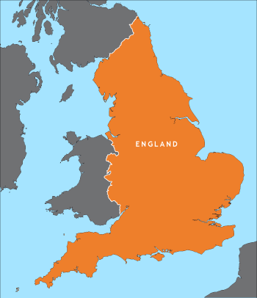
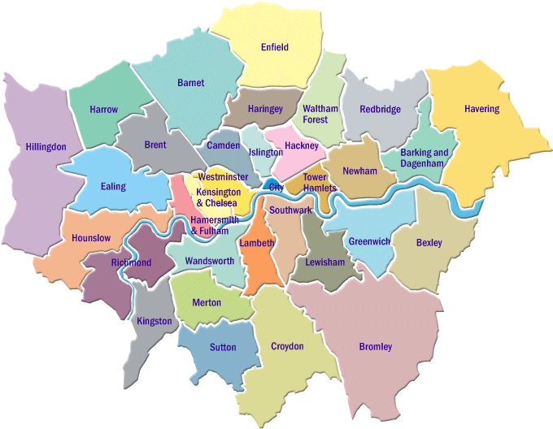
STADV Operational Focus
(Hammersmith, Westminster, Kensington and Chelsea)
Notes:
12.00-12.01
STADV pioneered the Coordinated Community Response model in West London in the 1990s with guidance from the US creator of the CCR Ellen Pence.
This model is based on the principle that “No single agency can effectively respond to domestic abuse alone.’
All agencies -that play a part in tackling abuse from prevention to prosecution must work closely with each other to keep survivors safe, hold abusers accountable and ultimately prevent domestic abuse
We know that this approach works. It has been repeatedly cited as a model of best practice and a number of initiatives have been widely adopted around the UK including:
-IDVAs, MARACs, Specialist DV Courts.
Victims are often at risk of falling through the gaps in the system. We ensure coordination and integrated working.
We help agencies come together to share critical information and learning, and to keep communicating.
The CCR enables a whole system response to a whole person, recognising the wellbeing and safety needs of victims and survivors, with communities and organisations working alongside them.
Responsibility for safety should not rest solely with individual victims but also with the community and services.
Perpetrators must be held to account for the harm they inflict, and offered routes to change their abusive behaviours.
A CCR supports organisational responses, it does not replace them: organisations remain responsible and accountable (to victims, to their own agencies and to the partnership) for their own responses to domestic abuse, within a context of multi-agency working.
A CCR requires leadership, a shared understanding of domestic abuse and risk, and coordination (including: agencies understand their role in the CCR and the role of partner agencies).
Strategy + Governance + Services
All link up and work to a single vision of to promote a co-ordinated, multi-agency community response to domestic violence. This approach recognises that no one agency can tackle domestic violence effectively if acting alone. Without effective coordination of activities between agencies, responses are less effective and survivors of domestic violence are still at risk of falling through the gaps in the system.
The coordinated partnership model enables all the relevant agencies to identify and respond successfully to domestic violence. We work together with statutory and community organisations - from criminal justice agencies to children’s services and refuges - to ensure that victims and children are safer, and perpetrators are held to account.
The criminal justice system is just one aspect of a fully functioning coordinated approach, particularly when only a small number of victims report to the police and only a percentage of these cases will carry through into court. Health, Children’s Services, schools, faith groups, family, friends, work colleagues, and the plethora of voluntary agencies which support individuals and families, all have an important role to play in the response to domestic violence. No one agency can respond effectively on its own. Our success depends on the relationships and partnerships we build.
The core purpose of developing coordinated responses is to enable individuals and communities to live free of violence and abuse. This approach seeks to eliminate domestic violence through improving integrated working, through written procedures, policies, shared action plans and resources, all supporting professional interventions. We take survivor safety very seriously; this must be integrated into all aspects of planning and delivery. In addition we believe that challenging social attitudes that normalise or minimise abuse are crucial in supporting prevention and early intervention work.
Our approach acknowledges that the onus of holding perpetrators accountable lies with service providers, and the wider community, rather than the survivor. While each agency maintains its independence, all agencies involved must work in an integrated and coordinated way to achieve the following:
• An increase in the safety of domestic violence survivors
• An increase in the safety of children who live with domestic violence
• Holding perpetrators accountable for their actions
• Effective prevention strategies.

Slide 57
Domestic Homicide Review
Statutory requirement since 2011
Commission by the Community Safety Partnership
Quality assured at the Home Office
(Almost all) published using pseudonyms
Independent Chair
Multi-agency panel (including mental health trusts)
The panel will set the terms of reference based on the specific circumstances
Sometimes links to other reviews
Notes:
12.05-12.06

Slide 58
Standing Together’s DHR database
62 deaths*
75%
25%
Intimate Partner Homicide- 41
Family-Related Homicide- 15
Current Partner- 35
Ex-partner- 6
Matricide-9
Patricide- 2
Fratricide- 2
Sororicide-1
Filicide- 1
⓪⓪
①①①①①①①①①①
①①①①①①①①①①
①①①①①①①①①①
①①①①①①①①①
⓪⓪⓪
①①①①①
①①①①①
Notes:
12.07-12.08
6 DHRs where relationship was either; roommate, friend (with sexual relationship), unknown
Government definition for DHRs specifically includes people who live together so may get some cases where not IPV or AFH.

Slide 59
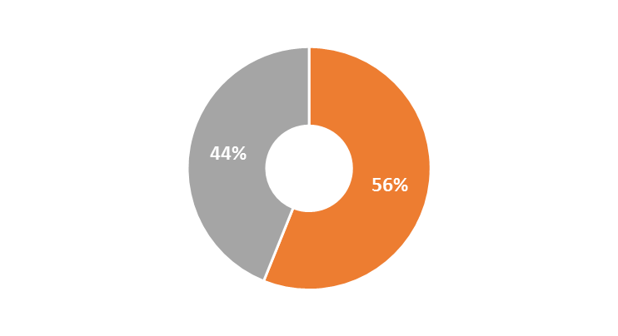
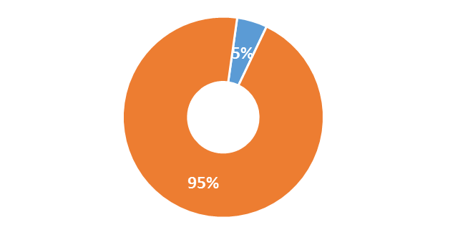
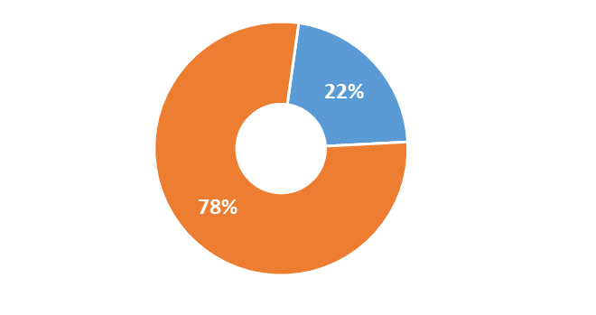
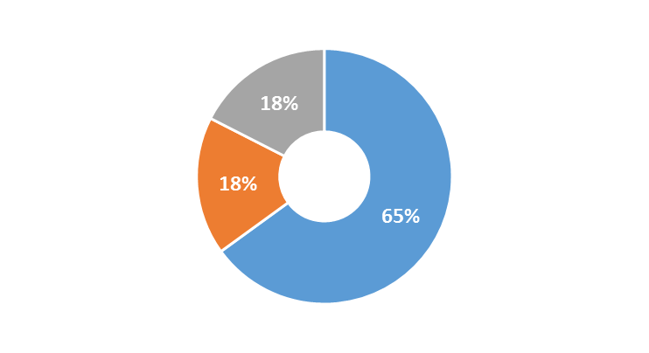
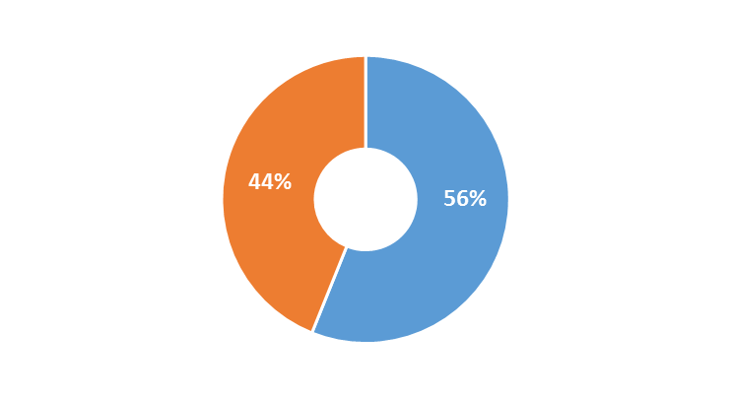
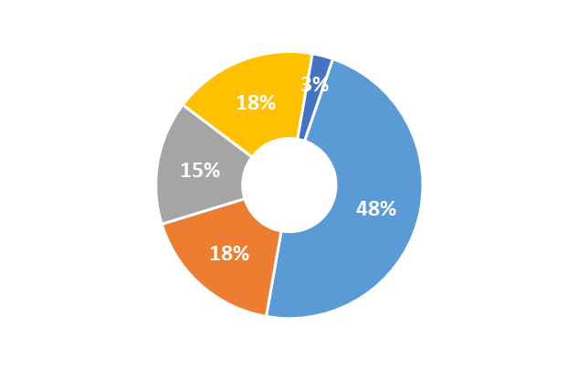
Overview of Victim Demographics
Sex
5
5
5
Disability
95% female
22% disability
27
27
60-81
Age
1
Sexuality
20-81; Mean 37
16-39
44% unknown sexuality
40-59
Unknown
31
Eastern European
Mixed Background
Children
56% of victims had children
Asian/Asian British
17
White British
7
Ethnicity
15
Black/Black British
Notes:
12.08-12.09
Gendered Issue- IPH and AFH
Key persistent finding from both STADV and Home Office case analysis is that intimate partner homicides disproportionately affects women. Men by overwhelming majority are the perpetrators and women by overwhelming majority are the victims.
In IPH sample- 96% perpetrators were male (23/24 and 1 female perpetrator). 92 % of victims were female (22/24 and 2 male victims);
ONS : 95% male perpetrators; 89% female victims
This is consistent with prominent research such as Dobash and Dobash 2007 and the Office of National Statistics 2014
AFH is Gendered TOO-
Analysis of the whole STAV DHR sample (32) reveals gendered victimisation across both types of homicide with women representing 85 % (27) of victims and men representing 97% of perpetrators. Supported by Home Office findings.
International studies spanning more than four decades have consistently concluded that AFV is gendered (Westmarland, 2015).
When parents are killed it is typically by their sons (Morris & Blom-Cooper, 1964; Green, 1981; Walsh et al. 2008; Hunter & Nixon, 2012).
The STADV sample was consistent with these findings 7 out of 8 parents were killed by son and 5 matricides (mother killed by son) and 2 patricides (father killed by son). Home Office findings were also consistent with these findings– all (7) involved a male perpetrator who committed the homicide and 6 involved a son killing mother- matricide and 1 patricide (father killed by son).
Gendered issue can not be ignored – not saying women do not kill men, and can not ignore also same sex relationship homicide, however it is key we look at look at different experiences of men and women who experience DV and the perpetration of DV (women experience more severe injury and more likely to be in fear of abuser, and studies show that predominant motive for women who kill their partners is to protect themselves or their children (Liem and Roberts 2009). Research and reality can not be ignored - The highest risk factor by far in domestic homicide is being female.
2. Age-IPV is not always recognised as an issue for older people (Pillemer & Finkelhor, 1988). Assumptions about age mean that when older people are seen to be injured, depressed or have other injuries, then it may be presumed to be the result of health or social care needs
3. Ethnicity:
Half of the sample are either people of colour or from outside the UK. Implications for ability to access help.
4. Disability- Almost 1 in 5 victims had a disability. Approx. 17% of people in UK have a disability.
5. Sexuality- 2% of sample gay however, large proportion unknown. Highlights the need for more detailed data collection.
6. Children –new research by Safe Lives- one child in every classroom when they start primary school, will have lived with domestic abuse since the day they were born. 1 victim in our sample had a child that was also killed.

Slide 60
Intimate Partner Homicide:
It’s a gendered issue
STADV Report: 95% perpetrators were male (39/41 and 2 female perpetrators). 95 % of victims were female (39/41 and 2 male victims)
HO Report: 29/33 were male perpetrator and female victim (87%). 4/33 – male victim and female perpetrator.
ONS : 95% male perpetrators; 89% female victims
Alcohol Concern & AVA: Two Thirds of the IPH- female victims and male perpetrators.
Notes:
12.09-12.10
Key persistent finding from both STADV and Home Office case analysis is that intimate partner homicides disproportionately affects women. Men by overwhelming majority are the perpetrators and women by overwhelming majority are the victims.
In IPH sample- 95% perpetrators were male (39/41 and 2 female perpetrators). 95 % of victims were female (39/41 and 2 male victims);
ONS : 95% male perpetrators; 89% female victims
This is consistent with prominent research such as Dobash and Dobash 2007 and the Office of National Statistics 2014

Slide 61




Findings: Common Risk Factors
Abuse to previous partners
Wider offending history
Coercive Control
Jealous surveillance
Separation*
Suicide and attempts of perpetrator
Older women
Disability
Caring relationship
Notes:
12.11-12.12
One of the aims of identifying risk factors is to inform professional judgment of those cases in which the potential for lethal violence is strongest.
The frequency of risk factors in our DHR sample;
Physical Violence in current relationship:
Physical violence in the current relationship – two thirds of cases (17/24)
Abuse to previous partners:
Physical Violence in a previous relationship – third of cases (8/24)
DHR 4- Bromley Susan Published: Perp had been abusive to 4 previous partners
Supported by other case analysis and research (Campbell 2008) that previous violence towards a partner is clearly a risk factor for perpetuating future violence. Recommend disseminating information on Clare’s law/ domestic abuse/domestic violence disclosure scheme as for example a victim’s family felt information regarding the perpetrator’s previous domestic abuse should have been disclosed to the victim so she could make a more informed decision about her relationship with him. They note: that there is a risk that victims could be subjected to more victim-blaming and the threat to remove their children may be greater if this information is not shared with a good understanding of coercive control and commitment to empowering victims.
Previous Criminality:
Previous criminality was present in over half of the cases (n=15).
This included violence towards others (n=8) including police officers (n=3)
Coercive Control and Jealous Surveillance:
Research on IPH by Regan et al (2007) found that coercive control and in particular jealous surveillance, was a more prominent risk factor than physical and sexual violence. Ongoing- no visible injury – there is a context of control. Stark: ‘Not what abusive men are doing to women but what they are preventing women from doing’.
Coercively controlling behaviours were identified in just over half of the cases (n=13)
Jealous surveillance in a slightly smaller number (n=11)
Academic Jane Monckton Smith conducted research of 358 cases of criminal homicide which occurred in the UK in the years 2012, 2013, and 2014. Control was recorded in 92% of the cases. Isolation of the victim was recorded in 78% of cases.
Separation- talk about it next
Suicide, Mental health and attempts of suicide by perpetrator:
Threats of suicide well known tactic of control by perpetrators.
Within the 6 confirmed cases of depression, 3 perpetrators were known to have had suicidal thoughts/previously attempted suicide.
In addition, 3 of the six perpetrators with confirmed depression went on to attempt suicide immediately following the homicide (two successfully through hanging; and one unsuccessfully through monoxide poisoning).
Older Women (mentioned earlier)
Over a quarter were over 58 years old. (30 %)
Disability (mentioned earlier)
5 victims had a disability
Caring Relationship (mentioned earlier):
6 Partners also carer
Clustering of risk factors:
The highest number of factors found in any individual case (done retrospectively) was 18 and the lowest was one.
If time: Other risk factors:
Consistent with previous research (Dobash et al. 2007) problematic substance use was also high in this sample (n=14).
Other risk factors that were recorded for a lower number of cases included:
isolation (n=6) and
stalking/harassment (n=5).
Violence in pregnancy only noted in 4 of the cases (4/24). Violence in pregnancy has been noted as a risk factor in research (McFarlane et al. 2002)
Sexual assault disclosed in only 2 cases.
Do not mention: Excluding the one case in which no risk factors were identified, the average across the remaining 23 cases was eight. This is considerably lower than the ‘visible high risk’ threshold of 14 identified within DASH guidance (Safe Lives, 2014).
Abuse In previous relationships other analysis:
SET (essex) analysis :
– physical violence and violence in previous relationship: (pp.12-13)
physical violence was a common behaviour noted in their sample
6 of the 8 perpetrators were known to be abusive to previous partners. In 2 DHRS, perpetrators had a significant history of DA involving a number of other partners.Neville and Sanders (2014) –: no distinction between AFH and IPH- disclosure of DA of previous partner:
In five cases (5/13) the victim’s partner had previously been violent towards a former partner.
Previous Criminality - Supported by other analysis:
SET analysis: 5 of the 8 perpetrators (IPH) had criminal records which included violent crime.
Home Office Case Analysis:
In 24 of the 33 intimate partner homicide DHRs the perpetrator had a history of violence. In seven of these cases the history of violence was not known to any agency. Of the other 17 cases, agencies had recent knowledge of this in 12 cases.
In 13 of the 24 DHRs where the perpetrator had a history of violence, the violence mentioned was towards the victim only. Of the remaining 11 DHRs, nine had a history of violence towards others, seven had a history of violence towards women specifically, and six had a history of general criminality.

Slide 62
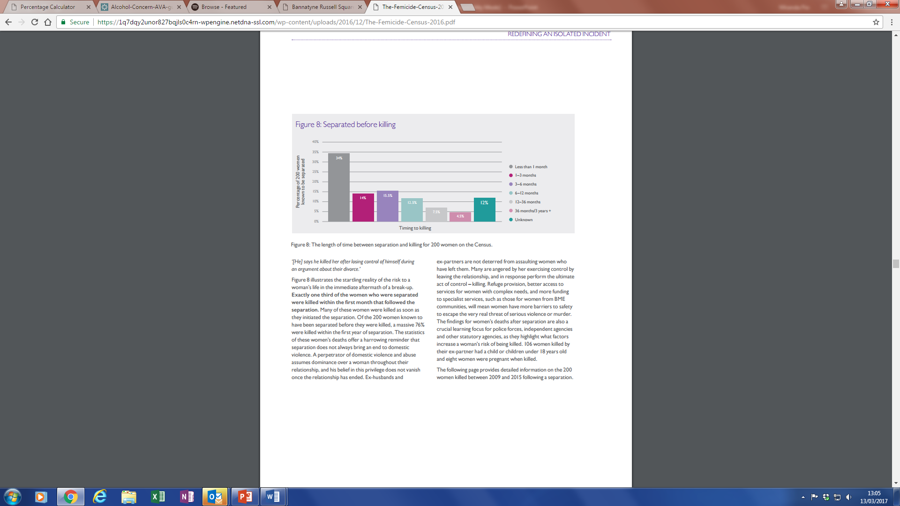
Women killed in the context of separation- ‘separation as a process not a single event’
Femicide Census, 2009 - 2015
Notes:
12.12-12.13

Slide 63


Mental Health Findings
Mental health issues were identified for 17 (41%) of victims and 19 (46%) of perpetrators.
Diagnosis | Victim | Perpetrator
Depression | 7 | 8
Personality Disorder* | 3 | 5
Psychosis |  | 3
Schizophrenia | 2 | 1**
Self Harm | 2 | 2
Bipolar Affective Disorder | 1
Substance Use
Victim
Perpetrator
6
7
2
Both
3
7
Notes:
12.13-12.14
*3 different types of personality disorder- emotionally unstable, dissocial and PD (non-specific)
In 8 cases mental health issues were self-reported.
** 3 cases of schizophrenia for perp were paranoid schizophrenia
Where people present with mental health and substance use, DVA is overlooked or not addressed

Slide 64





Key Themes for Mental Health
Risk
Often not picked up- Identification/ assessment and referral pathway clarification
Gaps in sharing-within and between agencies
Practitioners not adequately prepared to respond to the issue
Records are patchy, systems and protocol differ
Tendency to focus on mental health or substance use issues over DVA
Information Sharing
Training
Record
Keeping
Overlapping Issues
Notes:
12.14-12.17

Slide 65
Key Themes for Mental Health
Continuity of Care
Information can be lost in transition from one setting to another
‘Carer Aware’
Carers
1
Victim was a carer
8
Perpetrators were carers
Notes:
12.17-12.18

Slide 66


Recommendations for Mental Health
STRUCTURE
Create DA policies
Embed training
Create referral pathways and links with specialist services, MARAC
Improve mechanisms for information sharing
Improve links between health services
Embedded DA leads
Opportunities for commissioning – IRIS, IDVAs etc.
PRACTICE
Training
Implement enquiry
Co-location
Leads / Champions
Resources
Record keeping
Joint assessments
Integrated working
Information sharing
Perpetrators
Notes:
12.18-12.21
[3 minutes]
Listed here is a summary of the some of the key recommendations outlined in the reports. These recommendations, while devised for health – specifically GPs and MH – are not without relevance for other contexts. And, although hospitals weren’t a key feature in Standing Together’ analysis they were highlighted in the Home Office report.
Some of these recommendations will not be new to you, focussing on already established good practice, echoing those recommendations made over the years by peak bodies such as NICE, SafeLives, Royal Colleges or NHS England but that we still aren’t seeing routinely in practice – such as commissioning IRIS in General Practice & hospital-based IDVAs, DA training, enquiry, information sharing and so on. Some are newer recommendations developed because of the findings from DHRs for which practice may need to be established or adopted more widely, and in some cases where we may want to build links between research and practice about the best way implement these recommendations.
Specifically there are recommendations aimed at (1) improving how we work with perpetrators in health settings - improved mechanisms of enquiry and risk assessment with perpetrators, building links with Respect accredited perpetrator programmes; (2) Improving our knowledge around the impact of caring relationships on DA – assessments for carers (3) implementing intersectional understanding into policies, training and pathways.
There weren’t huge distinctions between the recommendations made for GPs and Mental Health – all focussed on improving identification & enquiry (with both victims and perpetrators); the need for embedded and ongoing training; development of comprehensive, standalone DA policies; integrated ways of working as well as better mechanisms for information sharing and improved understanding of risk.
In terms of the distinctions: for GPs improved record keeping was one. For example linking patient records where the victim and perpetrator are both patients at the same surgery. For Mental Health there were recommendations focussed on the overlap between Mental Health and Substance Misuse including developing guidance around dual diagnosis and joint assessments. Programmes that tackle both MH and SM are better able to reach and retain patients in services.
I think that it is important to recognise that some recommendations may be more ambitious than others. Some will be simpler to implement than others, and may offer quicker wins. It is important for us to think about what are our minimum requirements? What can be done now? What might require funding or commissioning?

Slide 67




Our local work so far…..
Over 900 mental health practitioners trained over two trusts
Quarterly steering group driving project and bringing together MH and DVA services.
Implemented new DVA policies in each trust
Data collection: training feedback/referrals to DVA services and MARAC
Audited patient records for the purpose of evaluation
Worked with trusts on awareness raising events
Notes:
12.21-12.23
Also beginning to establish a network of DA leads

Slide 68
Outcomes:
100% increase in referrals to MARAC
213% increase in referrals to specialist DVA services
Established partnership working between the MH trust and community based DVA services.
Increased confidence in MH staff to safety plan and respond effectively.
However, challenges remain:
Training- Who? How?
Resources, funding
Competing priorities
Infrastructure
Notes:
12.23- 12.26
Training:
Our sessions were 1-3 hrs long, feedback was consistently that sessions weren’t long enough
We cannot deliver on long term, who will?
Time, money

Slide 69
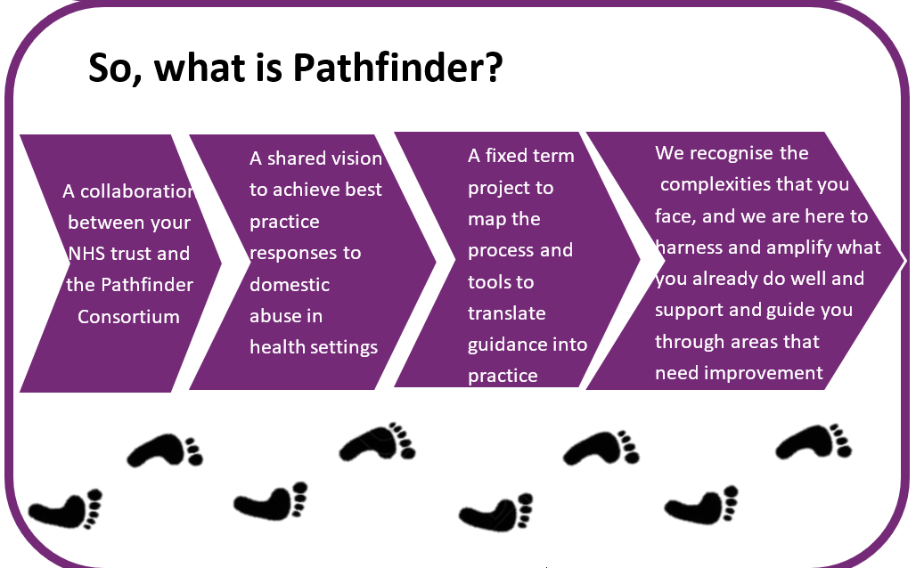

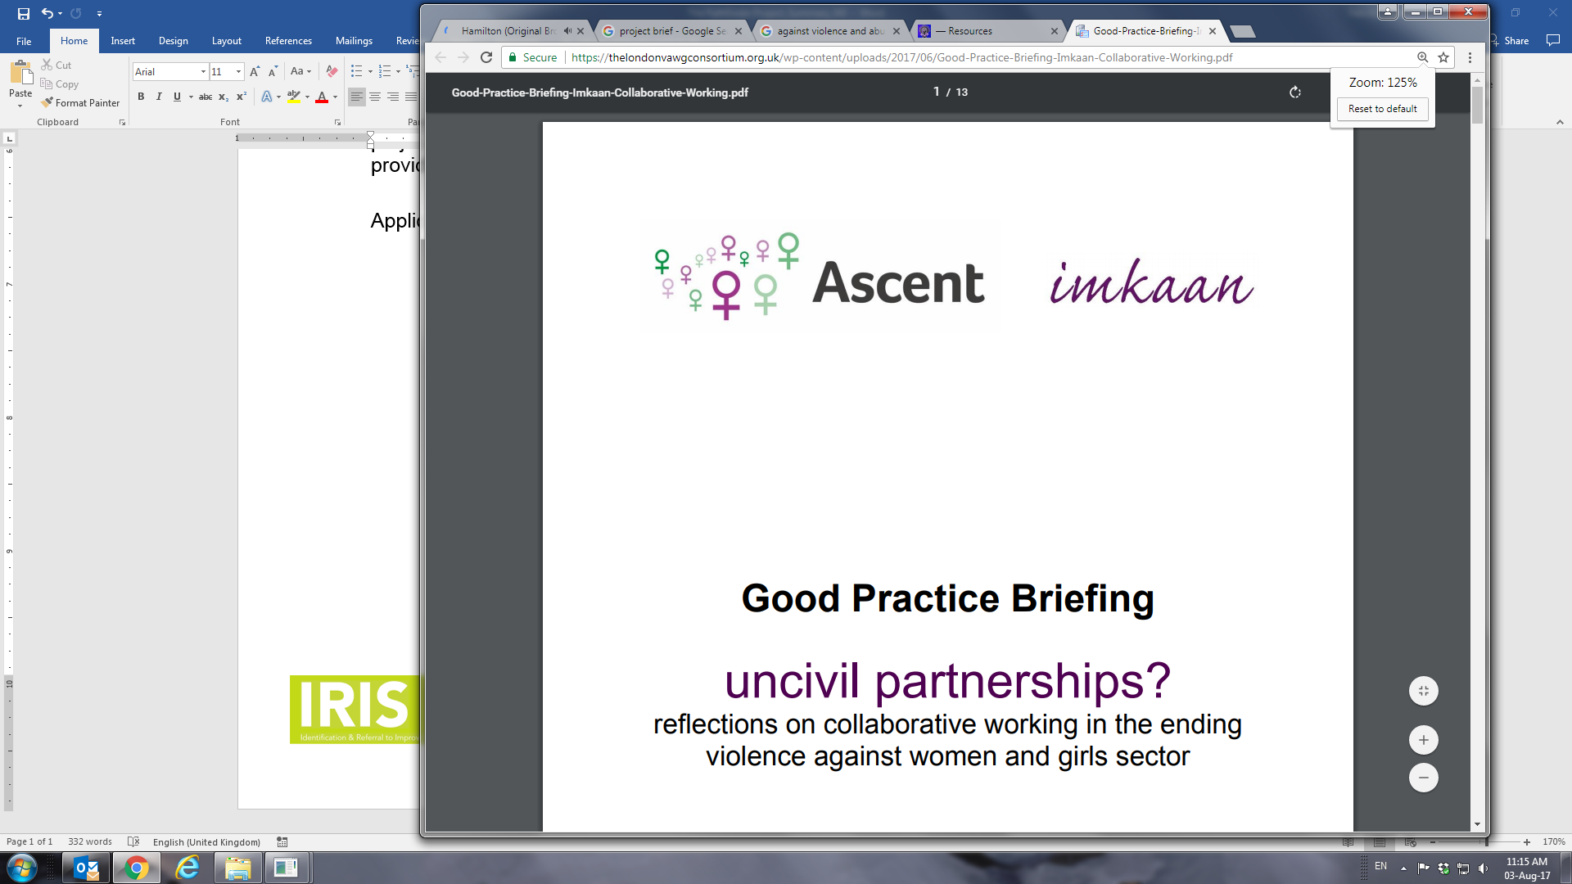



Taking ‘best practice’ to a national level:
We recognise the
Notes:
12.26-12.28

Slide 70
Supporting professionals and the community to address domestic abuse with confidence
Thank you and please be in touch
s.hughes@standingtogether.org.uk
Notes:
12.31-12.32

Slide 72
DOMESTIC HOMICIDE RESEARCH NETWORK
Introduction: Researching Domestic Homicide
Nicky Stanley, Professor of Social Work, Connect Centre, University of Central Lancashire

Slide 73

Why Research Domestic Homicide?
  National data highlights gendered nature of intimate partner violence
  Most domestic homicides: culmination of history of DVA – research can examine escalation and patterns of violence, help seeking and intervention over time
  Reviews/reports on individual cases provide in-depth accounts of violence and abuse and interactions with a range of agencies
  Research can identify narratives with high policy impact
  Generates valuable training tools for improving practice
  Best accounts: ‘Janus faced’ – look backward and forward

Slide 74
DOMESTIC HOMICIDE RESEARCH NETWORK
A network for researchers and non-academic partners to generate and share new evidence-based insights for reducing the prevalence of domestic homicide and its consequences
Our research aims to:
Produce new theoretically-informed empirical research into the nature of domestic homicide and why it occurs
Establish a research agenda that incorporates different data sources and methodologies and provides opportunities for testing and refining innovative research methods
Stimulate discussion and identification of best practice on ethics, consent and the sharing of sensitive information for research purposes
Our collaboration aims to:
Connect researchers, practitioners and postgraduate researchers working in this field within and across different countries
Disseminate research on the nature of domestic homicide and why it occurs in order to inform policy developments and improve practice
Engage with a range of stakeholders to facilitate better research, policy and practice
Provide evidence and expert insight to inform policy in local, national and international contexts
For more info or to join the network, contact Prof John Devaney at J.Devaney@ed.ac.uk

Slide 75
This session
Dr Khatidja Chantler, Connect Centre, University of Central Lancashire: Learning from Domestic Homicide Reviews
Prof Solveig Vatnar, Molde University College, Norway:
Domestic homicide, mental health and substance misuse
Prof Nicky Stanley, University of Central Lancashire:
Children and Domestic Homicide
Discussion & Questions

Slide 77
LEARNING FROM DOMESTIC HOMICIDE REVIEWS: PARRICIDE, MENTAL HEALTH & DOMESTIC ABUSE
Khatidja Chantler, Paul Hargreaves, Vicky Baker, Rachel Robbins, Nicky Stanley
Email: kchantler@uclan.ac.uk

Slide 78
Study Aims (pilot)
The parricide study is a subset of the 142 DHRs retrieved from 322 CSP web sites in England & Wales in July 2016. 141 included in analysis.
23 cases of the 141 (16%) are parricide
To investigate the characteristics of victims and perpetrators of parricides
To analyse the relationship characteristics of victims and perpetrators
To investigate whether formal agencies knew of the victims or perpetrators
To investigate contextual features of parricide DHRs
To identify lessons learnt from parricide DHRs

Slide 79
DHR Parricide study
Methods
Creation of quantitative and qualitative templates to extract data from DHRs
Quantitative analysis: SPSS to generate descriptive statistics (n=23 parricide DHRs)
Thematic qualitative analysis of parricide DHRs (n=23)
Key Themes
Mental Health
Carers
Risk Assessments
Complexity
Offence History

Slide 80



Victim Demographics
Age (n=13)
70% Mother (n=16)
years
Gender
49 86
30% Father (n=7)
Median = 69
44% Unspecified
4% Black African
35% White British
4% Middle-Eastern
9% White European
4% African-Caribbean
Ethnicity

Slide 81
Victim Risk Factors
48%
Chronic medical condition (n=11)
Previous victim of DA by perpetrator (n=13)
57%
30%
Physical disability (n=7)
Previous victim of DA by partner or ex-partner (n=7)
30%
26%
Housing issues (n=6)
22%
Problems with alcohol (n=5)
Previous use of violence towards perpetrator and or others (n=7)
30%
17%
Mental health diagnosis (n=4)

Slide 82



Perpetrator Demographics
Age
(n=13)
4% Daughter (n=1)
years
Gender
16 49
96% Son (n=22)
Median = 34
44% Unspecified
4% Black African
39% White British/British
4% Middle-Eastern
Ethnicity
4% White European
4% African-Caribbean

Slide 83
Perpetrator Risk Factors
83%
Mental health diagnosis (n=19)
Previous DA against homicide victim (n=13)
57%
74%
Offence history (n=17)
70%
Problem with drugs (n=16)
Previous DA against a partner or ex-partner (n=12)
52%
61%
Problem with alcohol (n=14)
39%
Exposure to DA as child (n=9)

Slide 84
Age/Gender
Missing data for just over a quarter (26%, n=6) of victims and perpetrators re: age.
Age sometimes given as mid-30’s, young person, over 65 etc (n=4 victims; n=5 perpetrators)
Most non-fatal adolescent to parent violence is directed at mothers (Condry & Miles 2014)
Parricide in international literature has similar proportions of men and women as victims (Holt, 2017)
This is different to homicide victims (largely men) and to IPV domestic homicide victims (largely female)
Perpetrators consistently male

Slide 85
Diagnosed MH Disorders (DSM-IV-TR)
Victims
Perpetrators
13%
Mood disorder
52%
4%
Anxiety disorder
22%
9%
Psychotic disorder
57%
Personality disorder
13%
Unspecified
4%

Slide 86
Mental Health Diagnoses (DSM-IV-TR)
MH disorders
Professional making diagnosis and number of separate diagnoses | Mood N (percent) | Anxiety N (percent) | Psychotic N (percent) | Personality N (percent)
Psychiatrist (n=24) | 7 (35%) | 1 (25%) | 13 (46%) | 3 (50%)
GP (n=7) | 5 (25%) | 2 (50%) | 0 | 0
MH Service worker (n=11) | 4 (20%) | 0 | 7 (25%) | 0
Unspecified (n=16) | 4 (20%) | 1 (25%) | 8 (29%) | 3 (50%)
Total diagnoses (n=58) | 20 (100%) | 4 (100%) | 28 (100%) | 6 (100%)

Slide 87
Mental Health (Victims)
Mental health mentioned in just under a quarter of victims (n=5, 22%).
Mental health diagnosis were given for four victims (17%) who had all received mental health support.
Dual diagnosis: Three victims had experienced both alcohol misuse and mental health problems.

Slide 88
Mental Health (Perpetrators)
Over three quarters (83%, n=19) of parricide perpetrators had been diagnosed with at least one mental health disorder concurrently or over the life course (compared to 44% of IPV homicides).
Amongst the 23 perpetrators, psychotic disorders (57%, n=13) and mood disorders (52%, n=12) were most commonly diagnosed.

Slide 89
Mental Health (Perpetrators)
Eleven (48%) had been diagnosed with more than one disorder. A diagnosis of depression was also common in those with psychotic disorders and personality disorders.
Seven (30%) of the perpetrators had previously been detained under the Mental Health Act.
Just under two-thirds of perpetrators had received mental health support (65%)

Slide 90
Mental Health (Perpetrators)
Dual diagnosis – alcohol & mental health: 11 perpetrators (48%)
Dual diagnosis – Drug misuse and mental health problems: 16 perpetrators (70%).
In 61% of cases (n=14), perpetrators were either unfit to plea due to their mental health or received hospital orders of an unrestricted term.
In 10 cases (43%) the victim or other family member/relative had contacted services with concerns about the perpetrators mental well-being prior to the homicide.

Slide 91
Parricide vs Other Domestic Homicide (MH)
Perpetrators with mental health diagnoses
IPV Homicides (n=113)
Parricides (n=23)
Other familial homicides (n=5)
*Perpetrators of parricide were significantly more likely to have had a mental health diagnosis than in other types of domestic homicide
Victims with mental health diagnoses
IPV Homicides (n=113)
Parricides (n=23)
Other familial homicides (n=5)
Notes:
A chi-square test of independence was used, because it works on proportions not whole numbers so uneven samples not so crucial, which resulted in alpha value p=.001. Cramers V test which is used to test the strength of relationship between variables i.e. domestic homicide type and likelihood of mental health diagnosis and it came out at 2.88 which is a moderate relationship should anyone ask which I think is unlikely.

Slide 92
Contact with Support Services
Service | Victims |  | Perpetrators
 | N | percent | N | percent
The police | 5 | 21.7% | 19 | 82.6%
NHS general including GP | 14 | 60.9% | 20 | 87.0%
Mental Health | 6 | 26.1% | 15 | 65.2%
Substance misuse | 2 | 8.7% | 5 | 21.7%
Housing/homelessness | 7 | 30.4% | 6 | 26.1%
IDVA | 0 | 0.0% | 1 | 4.3%
Social Care | 6 | 26.1% | 5 | 21.7%
Subject of adult protection/care plans | 0 | 0.0% | 2 | 8.7%

Slide 93




Relationship characteristics
31%
In 11 cases the victim was mentioned as a ‘carer’ for the perpetrator
4%
n=7
Son
Father
n=1
Daughter
Mother
65%
In 5 cases the perpetrator was mentioned as a ‘carer’ for the victim
n=15
Son
Mother

Slide 94
Carer Relationships
In 78.3% of the parricide cases the perpetrator lived with the victim (n=18) - the majority due to their homelessness or mental health problems.
Both lived together in eight out of the 11 cases in which the victim was considered to be a ‘carer’ for the perpetrator.
The perpetrator lived with the victim in four of the five cases in which the perpetrator was mentioned as a ‘carer’ for the victim.
Ambiguity of perpetrators as carers (e.g. self-declared in three cases).

Slide 95
Case Study 1 (DHR 057)
Date of homicide: Oct 2011
Last contact with MH services: day of homicide, initiated by mum
Background: The perpetrator had a history of enduring mental health illness and his mother was his main carer. He had made allegations that she had physically and emotionally abused him as a child, but it is clear that she was very concerned about his mental health and rang him on a daily basis. When he was very unwell, he went back to live with her as he felt safer at his mum’s.
Mental health history: Diagnosed with depression (1999), schizophrenia (2002), bi-polar (2005). Following a hospital admission in March 2009 under section 2 of the Mental Health Act, the perpetrator had been seen by health professionals every two to four weeks. He had several relapses and may not have been compliant with medication. His mental health could deteriorate rapidly and he used alcohol at these points and masked how unwell he was feeling. He heard voices and experienced visual hallucinations. He had 10 psychiatric hospital admissions between 2002-2009.

Slide 96

Case Study 1 (DHR 057)
Lack of understanding of familial violence as Domestic Abuse
The DHR057 report is emphatic that there was no previous domestic abuse between the perpetrator and the victim:
‘There was no known history of domestic abuse within their relationship and the victim was not identified as a vulnerable adult’ (DHR057 p.10, Executive Summary).
‘There was no evidence that the victim was frightened of her son but it is alleged that he had taken money from her and she had changed her locks to stop him coming into the house unannounced.’ (DHR057, p. 10, Overview Report).

Slide 97

Lack of understanding of familial violence as Domestic Abuse continued
Case Study 1 (DHR 057)
‘Evidence from friends was that the victim wasn’t frightened of her son but that she was reluctant to let him in as he had previously taken money from her – she had changed the locks some years previously and also had a “special knock” when a family friend visited. Though she didn’t often talk about her son or how she coped with his behaviour, friends described her being reluctant to take phone calls or accept visitors when he was in her home. A friend who spoke to the victim on the phone the day before the homicide stated that it was the first time the victim had sounded in any way concerned about his presence in the home, this being the same day that the victim rang the clinic and expressed concern about her son’s mental state.’
(DHR057 p.11, Overview report)

Slide 98

Lack of understanding of familial violence as Domestic Abuse continued
Case Study 1 (DHR 057)
Financial abuse – the DHR reports that the perpetrator had spent a lot of victim’s money;
She had changed her lock as she did not want the perpetrator to arrive unannounced
‘special knock’ for friends
On the day of the homicide despite having initiated contact with MH services, went on to say he wasn’t ‘very unwell’ in the presence of the perpetrator and the consultant psychiatrist - indicating that she may have been scared of him. This is salient as she had contacted MH services as she was worried about his mental health.

Slide 99

Learning: Familial violence as Domestic Abuse
‘The potential of child on parent violence may not be initially viewed in the spectrum of domestic violence. There was evidence that there were times when S [victim] expressed some fear of her son.’ (DHR 119, p. 24 Overview Report).
‘Management within the [name of team] assessment team within [name of mental health trust] must accept the findings of this DHR and the consequent lack of exploration of the risks connected to domestic violence. Relevant and appropriate training must be delivered for [mental health trust] professionals to better understand domestic violence, including in a familial setting, and risk assessment, safety planning and prioritisation of such cases’ (DHR 073, p.30, Executive Summary).

Slide 100
Learning re: Carers/Mental Health
‘[Name of services] put in place procedures and monitoring arrangements to ensure that a carer’s assessment is always offered where a significant other is offering a caring role, even if this is at specific times only’. (DHR057, p.13, Executive Summary)
‘[Name of MH trust] must ensure (as part of their organisation of care) that all carers are advised of their right to a carer’s assessment. The offer must be clearly documented. If the offer is not accepted the reasons should also be clearly documented and a date set to revisit this with the carer’ (DHR068, p.27, Overview Report)

Slide 101
Learning re: Risk Assessment
‘When one examines the circumstances of the alleged perpetrator it is clear that his deteriorating behaviour posed a risk to others. Whilst the [name of MH trust] does indicate there was no history of violence towards his mother, the evidence shows, that as time progressed and his mental condition worsened, his behaviour and verbal aggression towards his mother in particular should have been of concern, and the risk assessment as outlined above should have been completed.’ (DHR068, p.26, Overview report).

Slide 102
Summary of pilot
Mental health and substance misuse settings are prime locations to discuss domestic abuse with perpetrators.
Carers (whether victims or perpetrators) rarely had carer assessments
Where either the victim or perpetrator had physical or mental health needs these tended to dominate assessments. Domestic abuse was hardly ever considered in these contexts.
Professional understanding of domestic abuse needs to be expanded to include inter-familial violence and abuse
Further exploration in our ESRC funded DHR study

Slide 103
ESRC DHR Study (ES/S005471/1)
Learning from Domestic Homicide Reviews using Experience Based Co-Design (EBCD)
Three work packages:
Systematic literature review to identify learning from DHRs inter/nationally.
Quantitative analysis of all available DHRs (up to end of 2019); quantitative and qualitative analysis of subsets of DHRs e.g. complex needs, children, mental health, ethnicity, parricide. Creation of DHR database.
EBCD: Working with CSPs and third sector agencies (AAFDA, Safe-Net, Agenda) and those who have lost family members to domestic homicide to deepen learning from domestic homicide and to co-create guidelines for best practice.

Slide 105


Domestic homicide, mental health and substance misuse
Evidence from a Norwegian 22-year cohort
Solveig K. B. Vatnar, professor
Faculty of Health and Social Sciences
Molde University College, Norway
and
Centre for Research and Education in Forensic Psychiatry
Oslo University Hospital, Norway
Christine Friestad, head of research group
Centre for Research and Education in Forensic Psychiatry
Oslo University Hospital, Norway
and
University College of Norwegian Correctional Service, Norway
Stål Bjørkly , professor
Faculty of Health and Social Sciences
Molde University College, Norway
and
Centre for Research and Education in Forensic Psychiatry
Oslo University Hospital, Norway

Slide 106
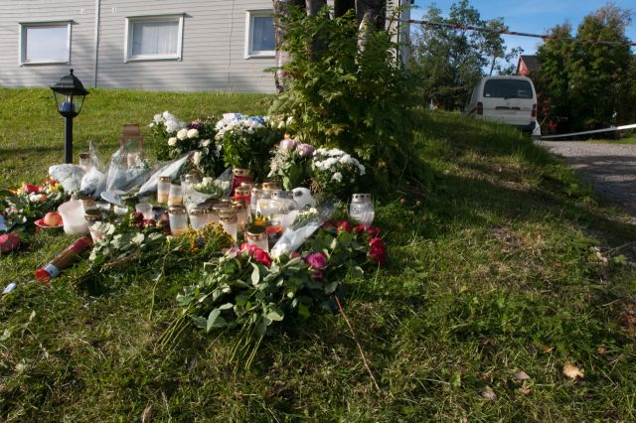
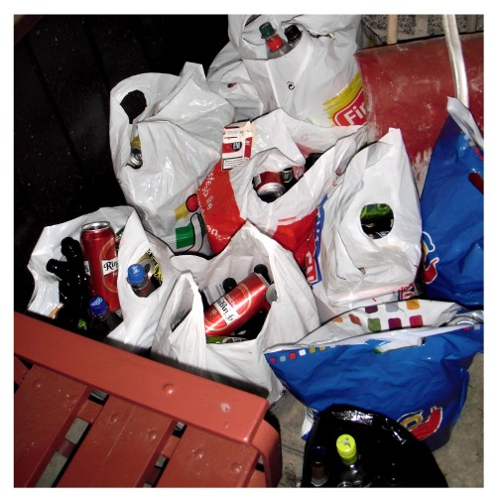

Topics
Background
  IPH in Norway
  The need to identify
  valid risk factors
  Substance use as a risk factor
Theoretical framework:
An interactional perspective
Material and methods
Results and implications

Slide 107

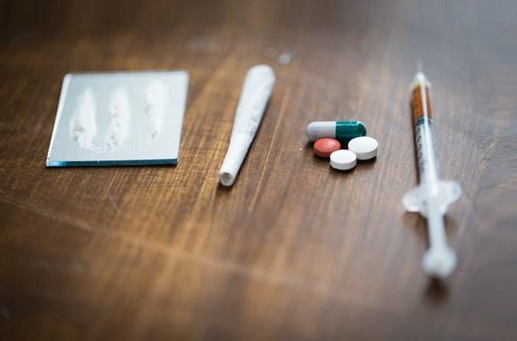
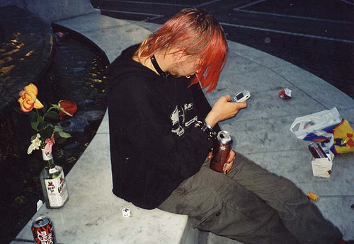

Background
Substance use - important risk factor
(e.g. Aldridge &Browne, 2003; Campbell, Glass, Sharps, Laughon, & Bloom., 2007; Campbell & Glass, 2009; Dobash, Dobash, & Cavanagh., 2009; Dobash & Dobash, 2015; Nicoladis et al., 2003)
Interpretive problems
Definitions
  use – misuse
  legal – illegal
  ongoing – previous use
  perpetrator – victim
Substance use in the IPH incident itself
  1990- 2018, 965 homicides (NCIS)
  0.6 homicides per 100 000 residents
  25% (n= 239) IPH
  Norway: 8 IPHs annually

Slide 108

Theoretical framework
Interactional perspectives on intimate partner violence ( Bell & Naugle, 2008; Dixon, Hamilton-Giachritsis, & Browne, 2008; Emery, 2011; Winstok, 2007, 2011)
  Victim and perpetrator interaction
  Integrating multiple academic disciplines
  Emphasis on ideographic factors
  Significant heterogeneity of IPV
  “The violence process”
  Crucial to investigate the IPH process

Slide 109
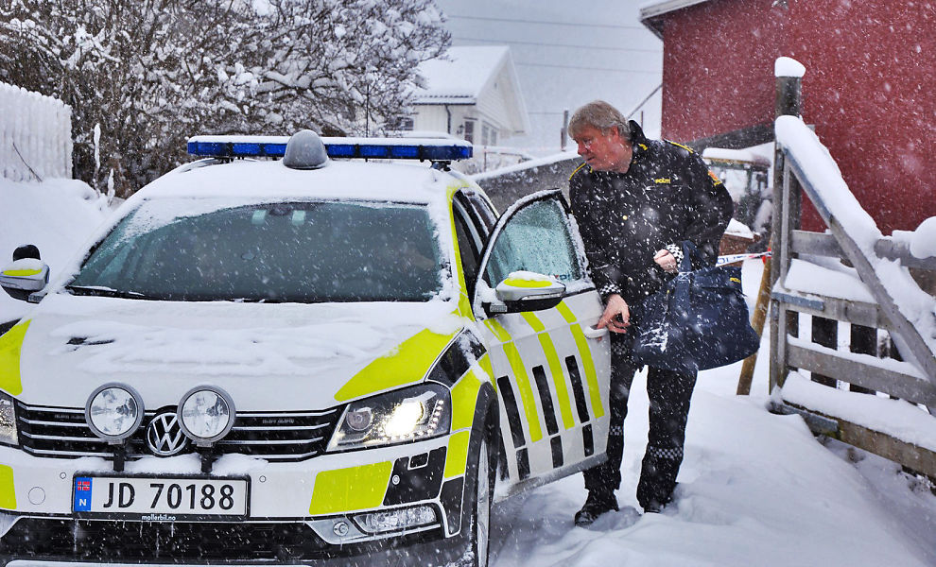

The aim of this study
Research questions:
What was the prevalence of substance influence at the time of the crime and the presence of substance use addictions in general?
Did IPH committed by a substance-influenced perpetrator have different characteristics than IPH committed by a non-influenced perpetrator?
Did IPH committed by a perpetrator
influenced by illegal substances have
different characteristics than IPH
committed by perpetrators influenced by
alcohol alone?

Slide 110

Material and methods
Sample: all IPHs in Norway from 1990 through 2012 (N=177)
  Including IPH-suicide (25%) and perpetrators unfit to plead (insane) (12%)
  Recently started including data from homicides 2012- 2018 – not included in the current analyses
Mixed methods study, convergent parallel design (Creswell & Plano Clark, 2011)
  Quantitative data extracted from court documents in each case (N = 177)
  Qualitative data from interviews with a stratified sample of bereaved (n=12; 9 women and 3 men) from different homicide cases
Legal access to the court documents was granted by the Norwegian Higher Prosecuting Authority. The study was approved by the Norwegian National Research Ethics Committee.

Slide 111
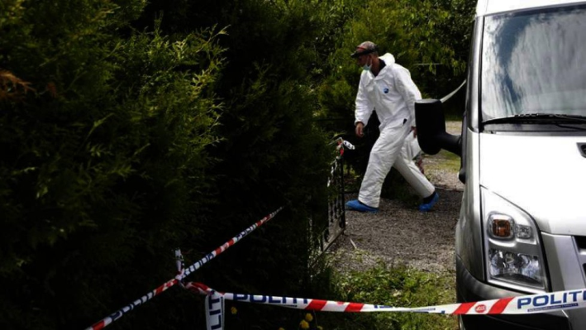

Material and methods
Procedures and measures
  Structured risk assessment
    Danger Assessment Revised 20 item (DAR20) (Campbell et al., 2009)
    Spousal Assault Risk Assessment Guide (SARA) (Kropp & Hart, 2000)
    Severe Intimate Violence Partner Risk Prediction Scale (SIVPAS) (Echeburua, Fernandez-Montalvo, de Corral, & Lopez-Goni, 2009)
SPJ tradition
    No scores
    SARA: Yes, partially, no or unknown/omit
Blood alcohol or other toxin levels
ICD-10

Slide 112
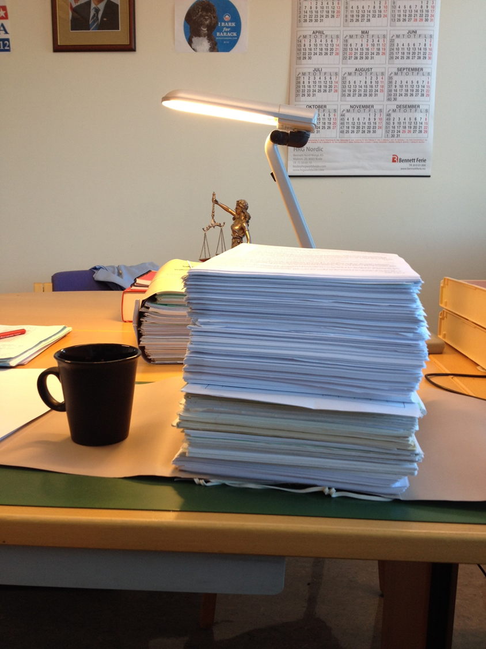
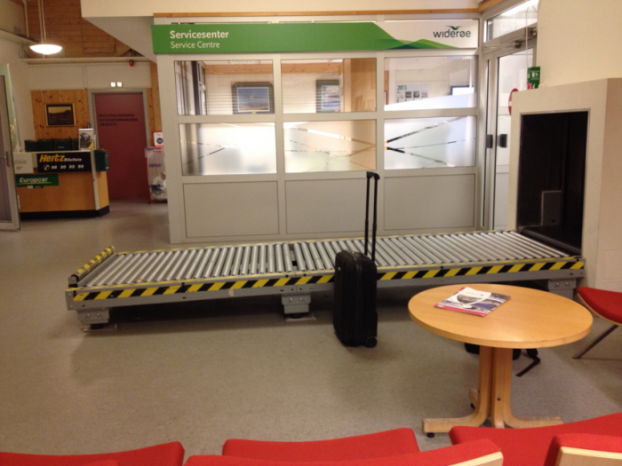

Reliability
ICC = 0.853, CI (0.741 – 0.923)
Based on two independent raters’ coding of data from 20 randomly selected cases

Slide 113

Material and methods
Analyses
  Univariate, bivariate analyses and multivariate logistic regression
  IPH by perpetrator influenced by alcohol or other toxins at the time of the incident or not
  IPH by perpetrator influenced by alcohol only compared to a drug or combinations of drugs and alcohol
  IPH by perpetrator not under the influence of substances compared to perpetrator with unavailable information about this influence (unknown/omitted).
The stepwise options recommended for logistic regression for small samples (Altman, 1990; Pallant, 2010)
      Hosmer-Lemeshow test
      Cox & Snell R Square

Slide 114

Results
Mental health
Majority of perpetrators – no metal health diagnoses previous to the homicide
Nearly half (45%) of perpetrators suicidal behavior previous to the homicide
Nearly 4 out of 10 (37%) perpetrators diagnosed (previous to the homicide)
  Depression and substance misuse/drug addiction
1 out of 3 (34%) perpetrators symptoms without a diagnose
  Mainly substance misuse/drug addiction

Slide 115

Results
Identifying and differentiating substance use
Perpetrators’ blood alcohol or other toxin levels at time of crime (available 88.7%)
  35.6% not under substance influence
  29.4% alcohol alone
  13.0% combinations (alcohol, illegal substance, prescription drugs)
  7.4 % prescription drugs alone
  3.4% illegal substance alone
Victims’ blood alcohol or other toxin levels at time of crime (available 97.7%)
  56.5% not under substance influence
  22.6% alcohol alone
  11.9% combinations (alcohol, illegal substance, prescription drugs)
  3.4 % prescription drugs alone
  3.4% illegal substance alone
Formal diagnosis – 11% substance use disorder

Slide 116

IPH incidents with and without the influence of substance and type of substance use
Several significant differences observed in the bivariate analyses
No group differences pertaining to previous IPV
No group differences pertaining to either perpetrators’ or victims’ contact with the police, healthcare, and social services, nor help-seeking among private relations (family, friends etc.)
Few variables remained in the multivariate models

Slide 117
IPH incidents perpetrator with (n = 94) compared to without (n = 63) the influence of substance
- multivariate analysis
12 times more likely victims also influenced by substances
  (OR = 11.697, CI = 4.259 – 31.631, p ≤ .000)
Perpetrator 7 times more likely to be identified as substance misusers in general
  (OR = 6.969, CI = 2.967 – 16.370, p ≤ .000)
Perpetrators not influenced by substances compared to perpetrators for whom this information was lacking
  Victims substance use at time of crime OR = 6.33, CI = 1.86-21.62, p = .003)

Slide 118

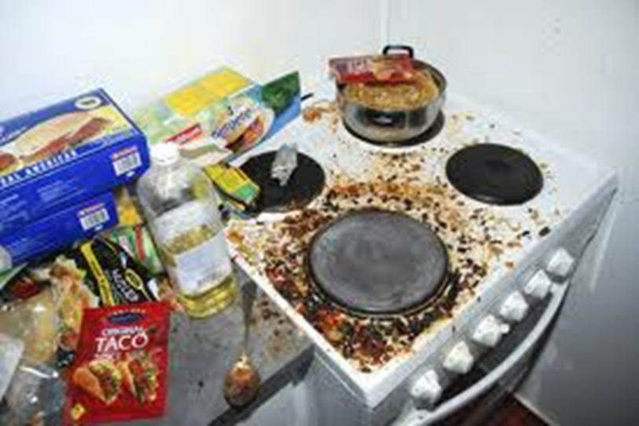
IPH incidents with alcohol only (n = 52) compared to drugs/combinations (n = 42)
- multivariate analysis
Only difference ; Perpetrators influenced by drugs or combinations at time of incident - 6 times more likely to have a general drug misuse
  (OR = 6.500, CI 1.500 – 26.511, p = .009)

Slide 119


Conclusions
Framework of an interactional perspective
Few differences and large proportion of similarities
Further investigation
Biological traces of substance use being found in 53.1% of the IPH perpetrators and in 41.2% of the victims
The positive association between perpetrators’ and victims’ substance influence at time of crime
The positive association of IPH-perpetrators’ type of influence at the time of the homicide and their substance misuse in general

Slide 120

Strengths and limitations
The total prevalence of IPH in Norway – external validity
Hosmer and Lemeshow and model fit indices were solid – internal validity
Criminal case documents were the only source for quantitative data
  not made for research purposes
  risk of false negatives
Risk for statistical Type II errors
  Combinations alcohol and drugs (n = 42)
  Alcohol alone (n = 52)
  Unknown (n = 20)
Fairly wide CIs

Slide 121

Research implications
Deepening the understanding of the
circumstances substance-related IPH occurs
Under what circumstances substance use interacts with other contextual and individual variables
Measurements of substance use is an urgent issue
To develop and test multivariate models in order to better grasp the complexity of IPH

Slide 122

Thank you.
uxvaso@ous-hf.no
http://www.sifer.no

Slide 124
Children and
Domestic Homicide
Nicky Stanley, Khatidja Chantler and Rachel Robbins, Connect Centre, University of Central Lancashire

Slide 125
Analysis of Domestic Homicide
Reviews (DHRs)
142 DHRs collected from local Community Safety Partnership websites for July 2011 – June 2016
55(39%) DHRs – children under 18 in family
Analysis both quantitative, involving identifying characteristics of families and interventions across DHRs, and qualitative with key themes identified from close reading of reports.

Slide 126
Characteristics of Domestic Homicides where Children Involved
125 children identified:
  52 victims’ and perpetrators’ children
  36 victims’ children from previous relationships
  37 perpetrators’ children from previous relationships
93% perpetrators - male
82% perpetrators - victims’ current/former partner
2 cases involved child deaths as well as mothers’ (arson)

Slide 127
Extent of Children’s Involvement
Child present at homicide: 17 DHRs
Child injured at homicide: 3 DHRs
5 children saw mother’s body immediately post-homicide
6 children reported to have directly witnessed homicide (another 5 may have done so):
‘Child B returned home with a friend at that point and saw Adult A assaulting Adult B. Police report that Child B tried to intervene’ - mother died an hour later in hospital. (DHR025, overview report, p 16)
One child alone with their mother’s body for over 24 hours; another assisted in lifting mother’s body into car; in another case, two children were driven around by the perpetrator with the victim’s body in the car boot.

Slide 128
Children’s Active Involvement
5 DHRs where children called for help:
The eldest daughter (aged 15) was physically prevented by the perpetrator from going to her mother’s aid. All the children were then kept in a bedroom overnight and the eldest daughter, fearing for her own safety and that of the other children, agreed that she would not tell anyone about what had happened. The following morning, she told the perpetrator she needed to get some provisions for the baby and he took her and the other children to the shops. She managed to engineer a situation where she went into one of the shops with one of the children, leaving the perpetrator outside with the others. She spoke to a shop worker who contacted the police. The perpetrator was later found 3 miles away from home with the other children. (DHR120)

Slide 129
Histories of child abuse and harm
16 DHRs (29%) described children previously exposed to DVA by current or previous partner
2 DHRs noted children previously injured in DVA incidents
11 DHRs – previous physical abuse of children
4 DHRs – threats of violence to children from perpetrator
4 DHRs – neglect
2 DHRs – perpetrator had locked children up in past

Slide 130
Child Contact as a Means of Sustaining Control and Coercion
Contact arrangements, both informal and informal identified in a third of DHRs.
Contact recognised as means of sustaining coercion/harassment in 3 cases:
‘Some aspects of the father’s attitudes and behaviour (e.g. asking the girls if they wanted to go to his house and who loved them more; requesting to take the girls outside of the centre contrary to the court order) may have been evidence of a manipulative personality.’ (DHR042, Overview Report, p30-31).
Failure to identify risks posed by contact:
‘…there was evidence from both parties that he still was having contact with the children. The risks involved in this never seemed to be considered…’
(DHR041, Overview Report, p 27).

Slide 131
Care of Children Post-Homicide
Future living arrangements not always specified; where parent who was not perpetrator survived, children went to live with them; 4 described as in local authority/foster care; 2 with older siblings; 5 with grandparents; 4 with other family members
Families not always supported to undertake this role:
‘The family feel that their need for financial support was not adequately recognised and that they have struggled to manage this burden on top of the tragic loss…’ (DHR054, Executive Summary, p13)
Notes:
he

Slide 132
Support for Children Post-Homicide
11 DHRs briefly mention support for children – provided /accessed by: school, children’s social care or Victim Support Services.
Questions such as the appropriateness of ongoing contact with perpetrator or future needs for support not addressed
3 DHRs identify need for trauma-focused support.
Need for long-term support flagged up:
‘the DHR Chair is aware that although some support has been available to them, more specialised and longer term help is required. It is vital to the wellbeing of the children and stepchildren that specialist support is available to them so that they can heal from this tragedy in their lives.’ (DHR055, Overview Report, p32)
Notes:
he

Slide 133
Trauma – risks and consequences (Alisic et al 2015)

Slide 134
Post-Homicide Care for Children to Encompass
(Alisic et al 2017)
Histories of maltreatment and experience of DVA
Degree of exposure to the homicide
Traumatic bereavement
Cultural differences
Disruption of daily life.

Slide 135
Professional Perception Lacking in Breadth and Depth
Mental health services involved in 15 cases (perpetrator) and 15 cases (victim) but DVA and child’s needs slip out of picture:
‘There is nothing to indicate that at any time during H1’s treatment for his periods of mental ill-health was there any consideration that V1 and C1 were being subjected to domestic violence… It appears neither V1 nor C1 was ever questioned in any depth about the impact H1’s behaviour was having on their lives.’ (DHR 132, Overview Report, p57-58)
‘mental health services appear to have dealt with each of these incidents in isolation and tried to treat each of the symptoms separately e.g. providing information on drug misuse programmes. None of the services involved in treating Derek had the full picture of what had happened as they did not share any information or seek any information other than the contact with children’s social care. Therefore, none of them were able to fully assess the risk that he posed to his wife and baby.’ (DHR053, Overview Report, 8.16)

Slide 136
Failures to Listen to Children
‘The failure to speak to Emma [the teenage daughter of victim] was a missed opportunity to establish whether she felt safe following her mother’s actions [to protect them]’. (DHR 123, Overview Report, p 33)
‘her son’s experience of living with domestic abuse and the fear of its recurrence was not given sufficient weight. He was never spoken to by the police or by the school despite witnessing a serious attack on his mother...’
(DHR134, Overview Report, p 46)

Slide 137
Children’s Involvement in DHR Process
Children rarely invited to contribute: too young, concerns about compounding trauma, anxieties about protecting anonymity
In 3 cases, children invited to contribute to the review process and declined.
In a small number of DHRs, family members or professionals comment on behalf of children:
‘Christopher’s mother has also shared the following information about the massive impact that domestic abuse has had on Peter and Elaine, both prior to and after the homicide:-
• Both have a mistrust of family and professionals and have a fear of being taken into care again.
• Both have displayed violent behaviour referring to the way their parents acted as being acceptable.
• Peter has serious behavioural difficulties.’ (DHR050, Overview Report, p58)
Notes:
he

Slide 138
Children’s Voices in DHRs (3 reports)
‘R aged 14 (mother killed by R’s adult brother):
‘R told the Panel Chair that she had felt ignored and unsupported by services dealing with her brother in the months before her mother’s death…The impact of his behaviour on her and her mother was not well understood or considered and in particular she highlighted that no-one talked to her directly about her experiences and feelings at the time or appeared to consider that they mattered in coming to decisions about her brother.’ (DHR119, Overview Report, p5)
DHR042: Children supported to talk about their parents and their relationship as part of the review process. Child 1 described the way that her father treated her mother as ‘torture’. (DHR attached to the children’s social care record so that it can be accessed by them at a later date).

Slide 139
Conclusions
Child survivors of domestic homicides will have complex care needs which will be long-term and recurrent but need for support requires early identification.
However, DHRs give scant consideration to ongoing needs of children or their carers.
MH practitioners working with violent men need to recognise potential for domestic abuse and acknowledge impact on children in family
Need for joint work and strong collaboration between mental health practitioners and specialist DV organisations.
Children and young people rarely contribute to the DHR process – ironic given that some DHRs criticise services that fail to attend to child’s voice.
Making children’s accounts more central to DHRs could contribute to reducing children’s invisibility in DV policy and practice.

Slide 140
References
Alisic, E., Groot, A., Snetselaar, H., Stroeken, T. and van de Putte, E. (2017) ‘Children bereaved by fatal intimate partner violence: A population-based study into demographics, family characteristics and homicide exposure’, Plos One,12(10), p. e0183466.
Alisic et al (2015) Children’s Mental Health and Well-Being after Parental Intimate Homicide: a Systematic Review. Clin Child Fam Psychol Review, 18:328–345
Stanley, N., Chantler, K, and Robbins, R. (2018) Children and Domestic Homicide, British Journal of Social Work, doi: 10.1093/bjsw/bcy024

Slide 142
Cross-network meeting
Event to launch the eight cross-disciplinary mental health networks funded by UK Research and Innovation in 2018, encourage networking, and share learning.
Representation from academic and non-academic network members encouraged.
Date: 17th April 2019
Venue: London TBC
Time: TBC
If you are interested to attend as a member of the Violence Abuse and Mental Health Network, please contact vamhn@kcl.ac.uk

Slide 143
Save the Date
Our next network meeting will be held on Monday 7th October 2019 at the University of Nottingham

Slide 144
Grants competitions
Three funding calls, aligned to three network themes: measurement, understanding, interventions
Year 1 funding call will focus on measurement
Call specification will be informed by findings of the VAMHN/McPin research prioritisation
Grants can be used to deliver a targeted piece of research or to pump-prime larger projects
Maximum value £25,000 and duration 12 months
We particularly welcome:
  Collaborative teams across academia, the third sector, policy, and practice
  Substantive involvement of survivors and survivor-researchers
  Substantive involvement of early career researchers
Timescale
  First call – June 2019
  Applications to be submitted September 2019

Slide 145
Online data resource
Development of an online resource collating information about datasets usable in research on violence, abuse and mental health, e.g.
  National surveys such as the Adult Psychiatric Morbidity Survey and the Crime Surveys for England and Wales, Scotland, and Northern Ireland
  Birth cohorts such as ALSPAC and E-Risk
  Administrative data from statutory agencies and third sector such as Ministry of Justice, Police Recorded Crime, Safe Lives Insights, and On Track
  Clinical data such as CRIS (anonymised mental health records)
  Data from trials/quasi-experimental studies e.g. A better start
  Data networks such as MQ Data Science Group and MQ Adolescent Data Platform
→ What datasets do you draw on in your work on violence, abuse and mental health? Please drop us a note at vamhn@kcl.ac.uk to let us know about resources we might not know about!

Slide 146
Network Website – future plans
Directory of network members
Information about network events and funding competitions
Library of accessible academic and other relevant resources
Ethical and safety protocols
Fieldwork training resources
Network outputs
If you have information or resources to share, please contact us on vamhn@kcl.ac.uk
Our web address is www.vamhn.co.uk

Slide 147
Next steps
We will….
With permissions, make slides and audio available online
Summarise roundtable discussions and make these available online
Follow up with individuals on specific ideas and any pressing suggestions from today
We hope you can…
Suggest resources you can bring to the network and initiatives you want to lead
Spread the word about the network among your colleagues and online
Keep talking with each other and with us
Join us again next time, on October 7th!

