Slide 1
Healing from Sexual Violence: Body-focused mental health approaches
Abbie Shepard Fields, Sophie Namy, Elizabeth Dartnall
November 23, 2021

Slide 2
“I was looking for the key and I think I found it. I no longer feel the same weight, or the same emotion, the same guilt. I feel completely calm, relaxed, safe. There is something that happened, and now I can see it… Yes, I think the yoga has had a lot to do with my healing process, because if not, it wouldn’t have been possible for me to connect with myself or understand others, because I feel like everything was shut down, everything was deafened, because you’re so stuck in the pain…”
CSA survivor “Juanita”

Slide 3
What we will examine today:
Ongoing impacts of sexual violence: symptoms that go beyond PTSD
New insights about neural processing of trauma
Processes of recovery: limitations of talk therapy
The mind-body connection in healing
Positive outcomes

Slide 4
Ongoing impacts of sexual violence: different conceptualizations
PTSD: Post Traumatic Stress Disorder (APA, 1980)
vs.
Complex Trauma (Herman, 1992)

Slide 5
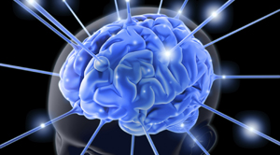
New insights: trauma and the brain

Slide 6
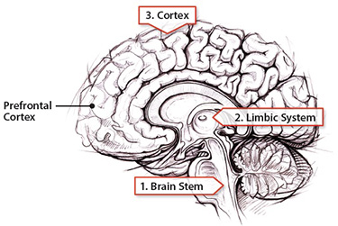
How we process traumatic experiences

Slide 7
The body-mind connection
Being traumatized, whether due to exposure to war, torture or sexual violence, means people can find themselves out of sync with their own bodies and what is going on around them. Trauma can get locked in the body, leaving many victims feeling immobilized and helpless, or in a continuous state of alert, never able to calm.

Slide 8
Healing from trauma: body-focused approaches

Slide 9
Trauma Informed Yoga

Slide 10
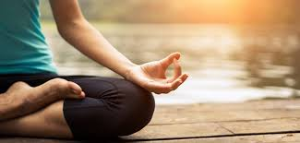
A yoga experience in Nicaragua

Slide 11
“Like I said, I now have memories but I no longer try to avoid them all the time... And I definitely think it’s been positive, giving me the ability to see that my body speaks. Yoga has allowed me this opening, to listen and explore the abuse that was hidden away, and to be able to heal.”
CSA survivor “Ana”

Slide 13
The work of HaRT and SVRI

Slide 14
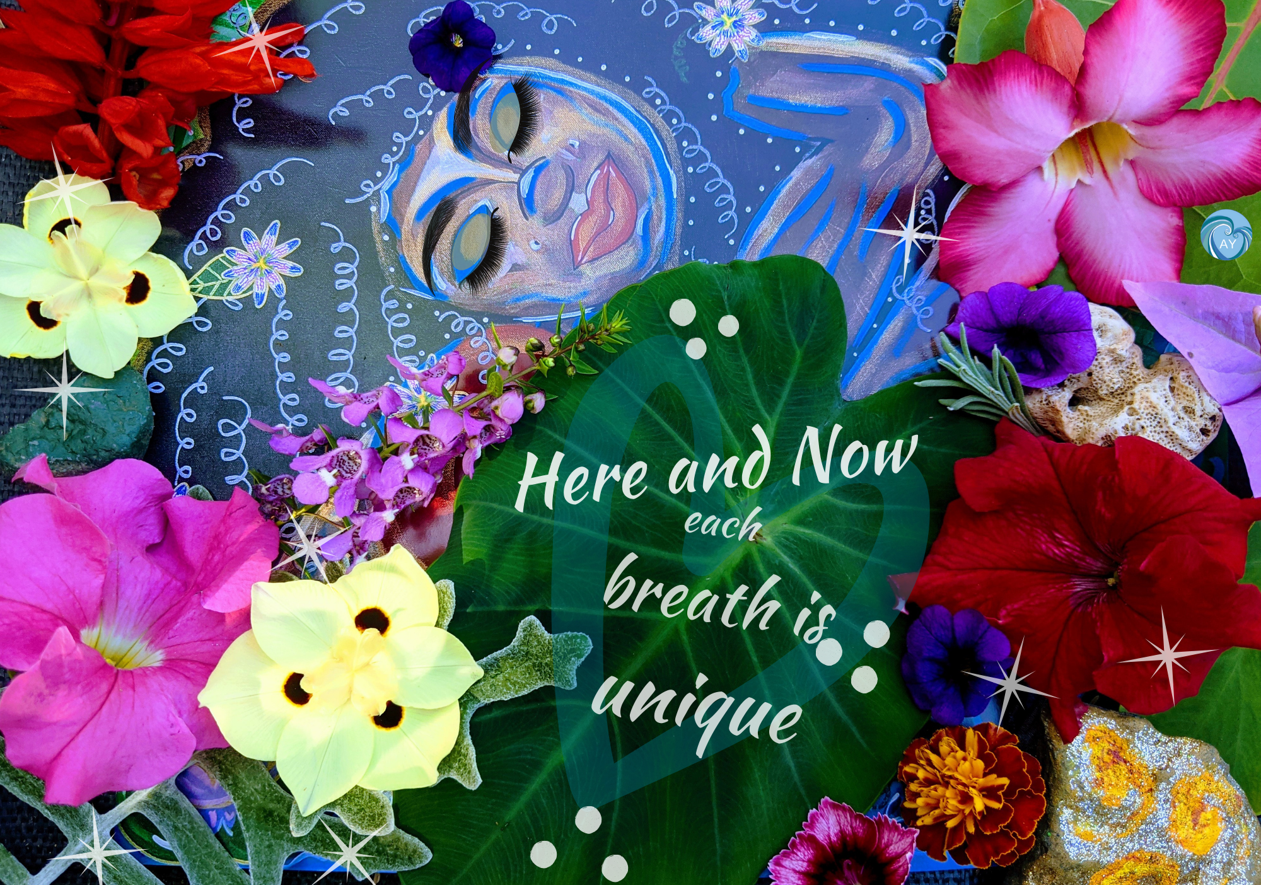
www.hartyoga.org

Slide 16
Thank you!

